Slide 1
CYCLING IN LONDON
Will Norman
Walking & Cycling Commissioner
Notes:
Good morning and thank you for having me here today
At the end of June we published our new Transport Strategy. I believe it is the most ambitious London has ever seen and one of the most ambitious a City like London has ever seen.

Slide 2
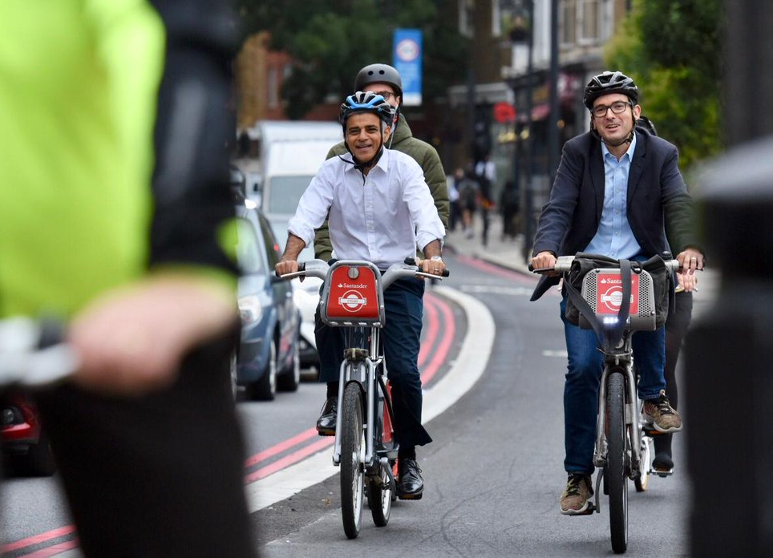
Notes:
And more people cycling – and that’s my job.
My job is to work with the Mayor and hundreds of other people to get more people walking and cycling.

Slide 3
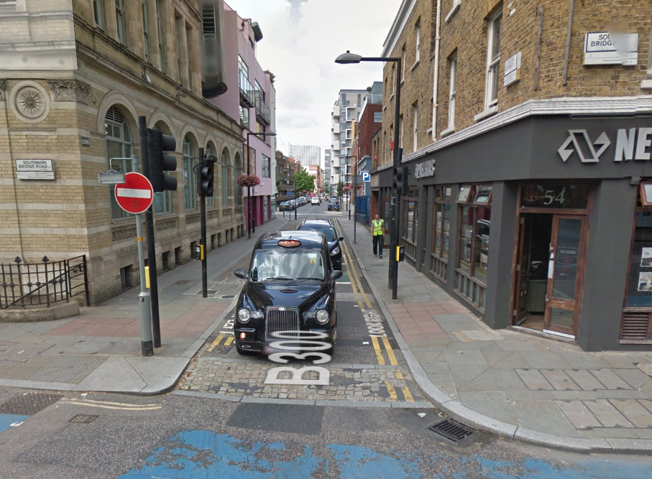
Notes:
This is what that section of Union Street used to be like. The westbound cycle lane was virtually impossible to use.

Slide 4
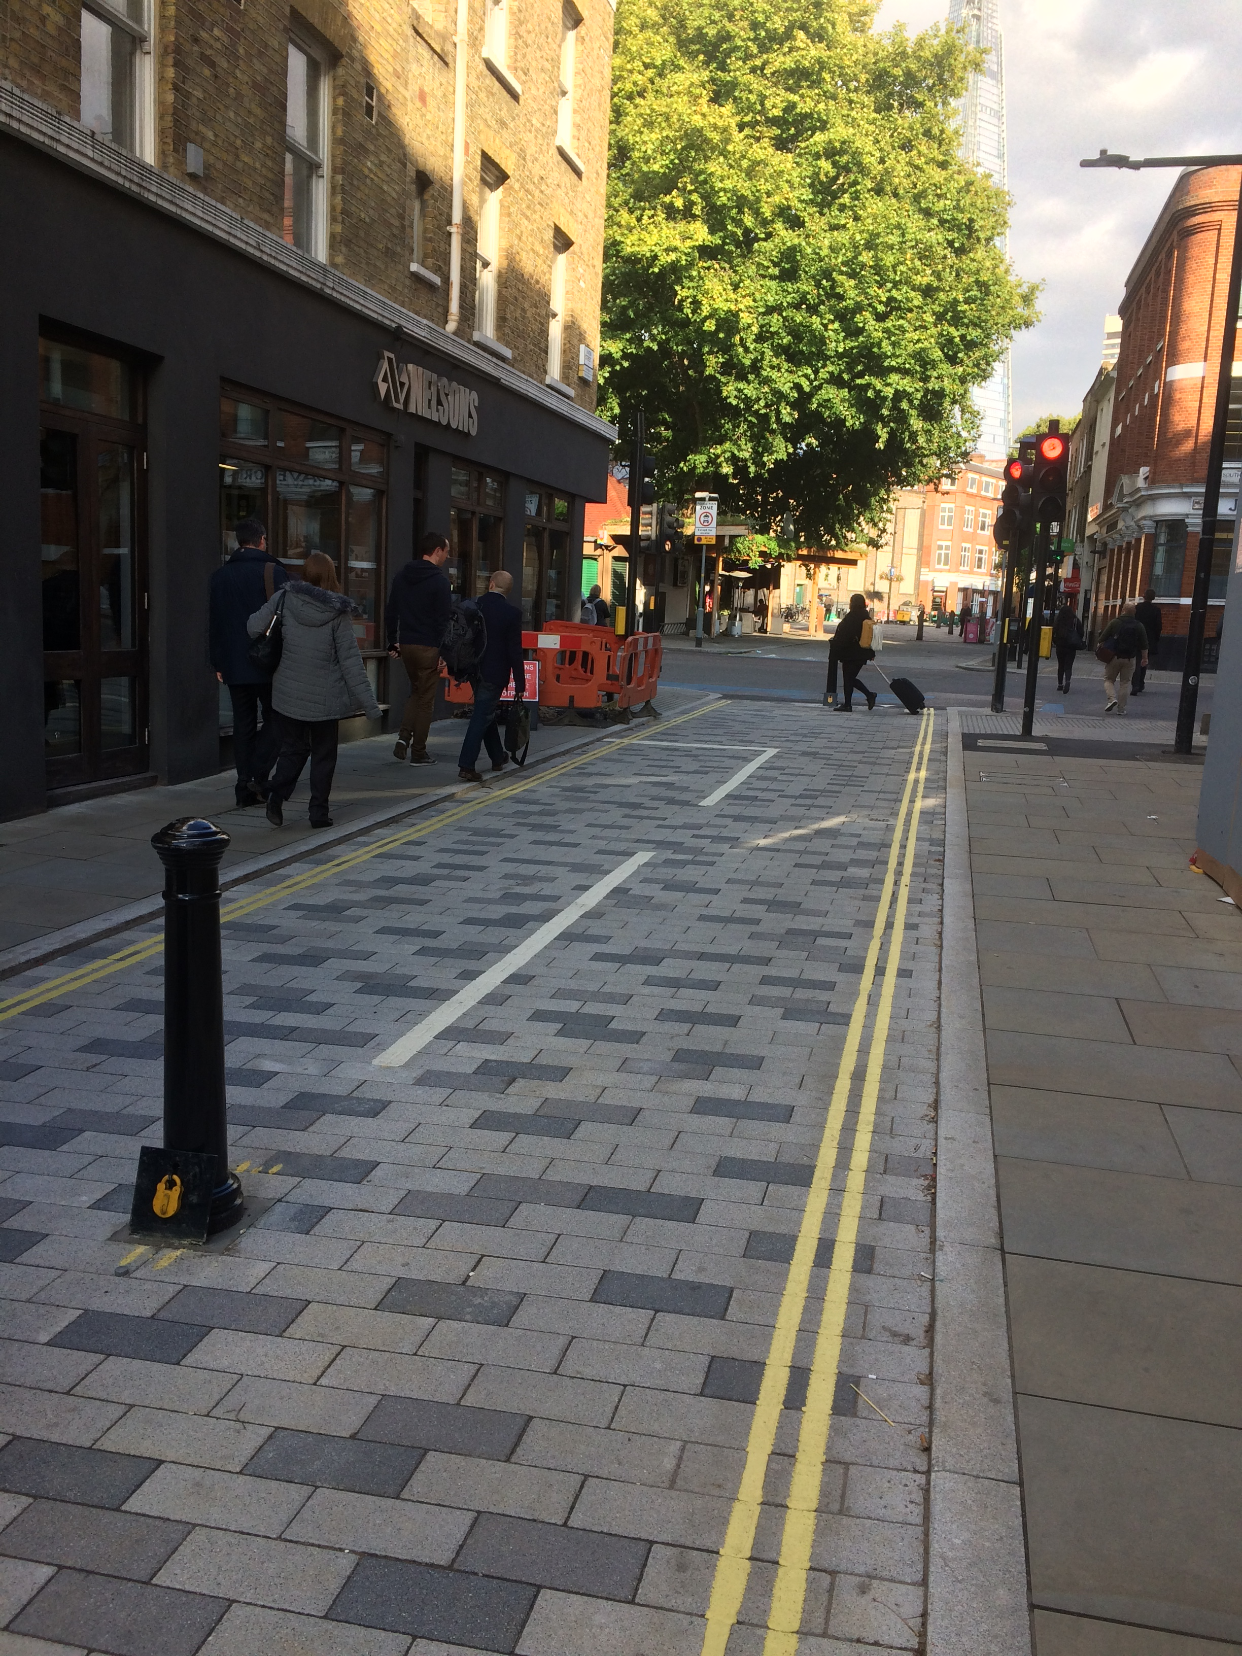
Notes:
On Union Street, a former rat run for taxis has been closed to vehicles, making it safe and pleasant to walk and cycle.

Slide 5
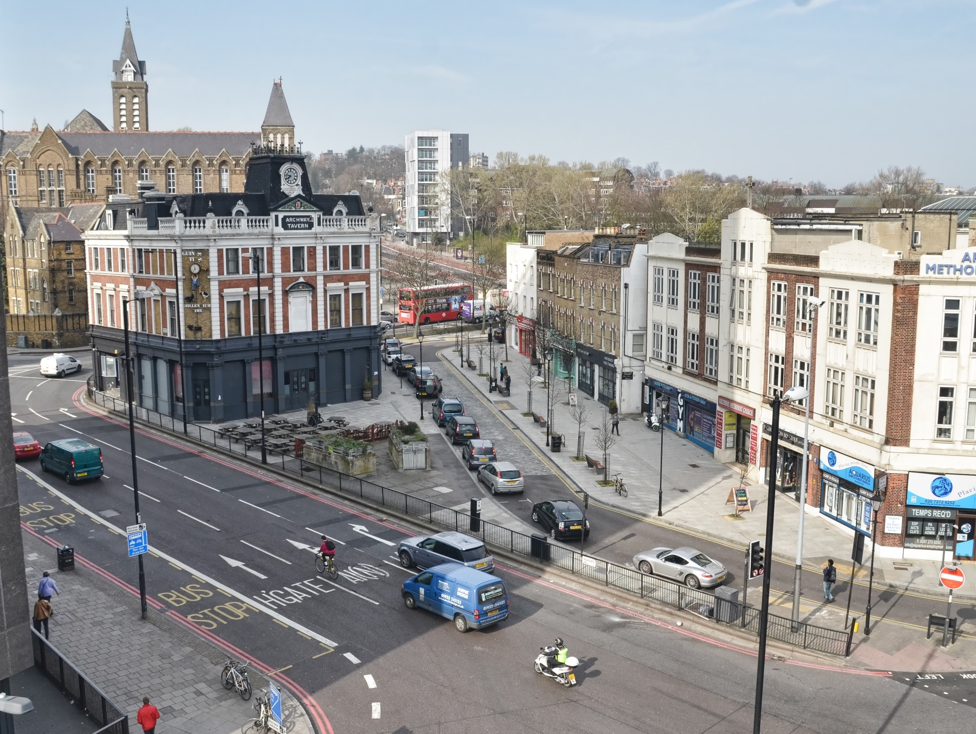
Notes:
It is not just local highstreets that we need to change. This is Archway, before the recent changes were started. Four lanes of traffic, circulating fast around a one way system. Very difficult to cross the road and very intimidating and dangerous to cycle around.

Slide 6
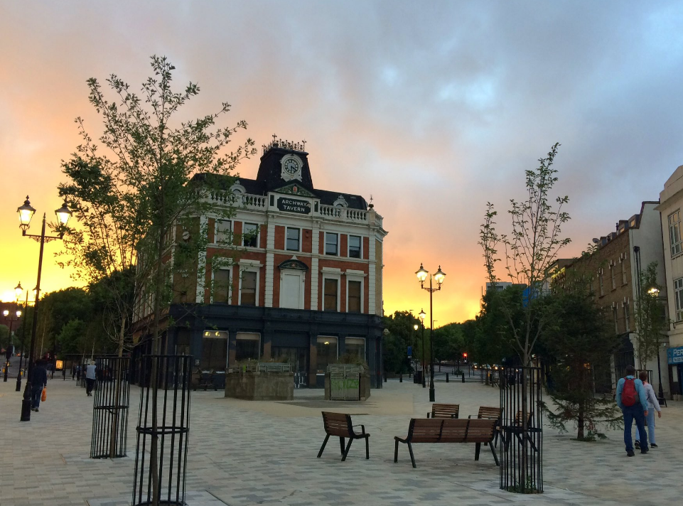
Notes:
And here is Archway today. A new pedestrian square with a separated cycle track through it.

Slide 7
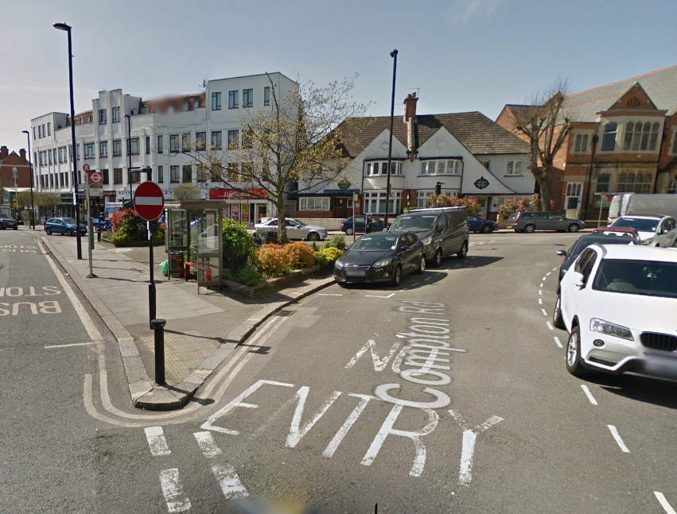
Notes:
Here’s what it looked like before, for those not as familiar with the area.

Slide 8
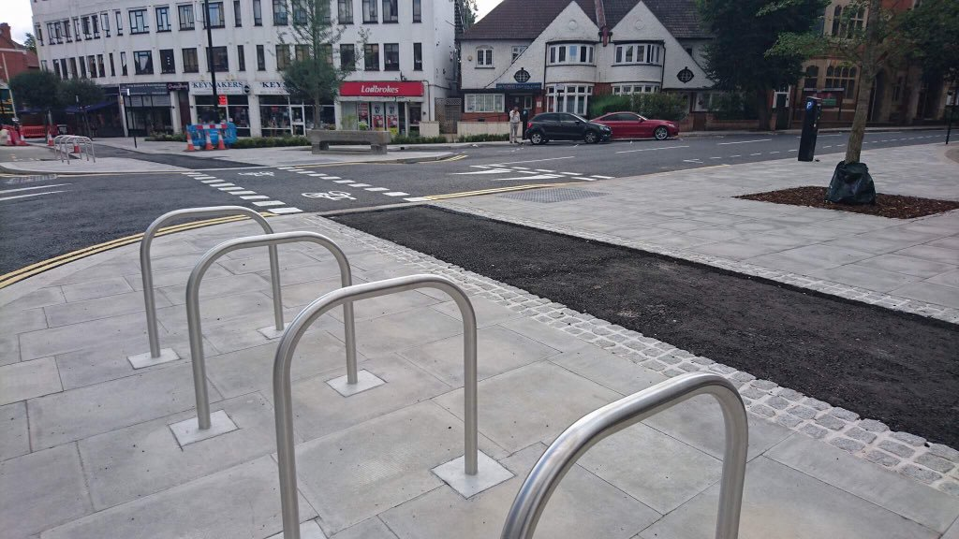
Notes:
The town-centre schemes along the route in Enfield, this one at Winchmore Hill, are also taking shape.
Here, a separated cycle track has been built and space previously taken up by cars given back to people.
Great scheme with a lot of vocal opposition
Have courageous local leadership
Strong support from local cyclists – want to thank them

Slide 9
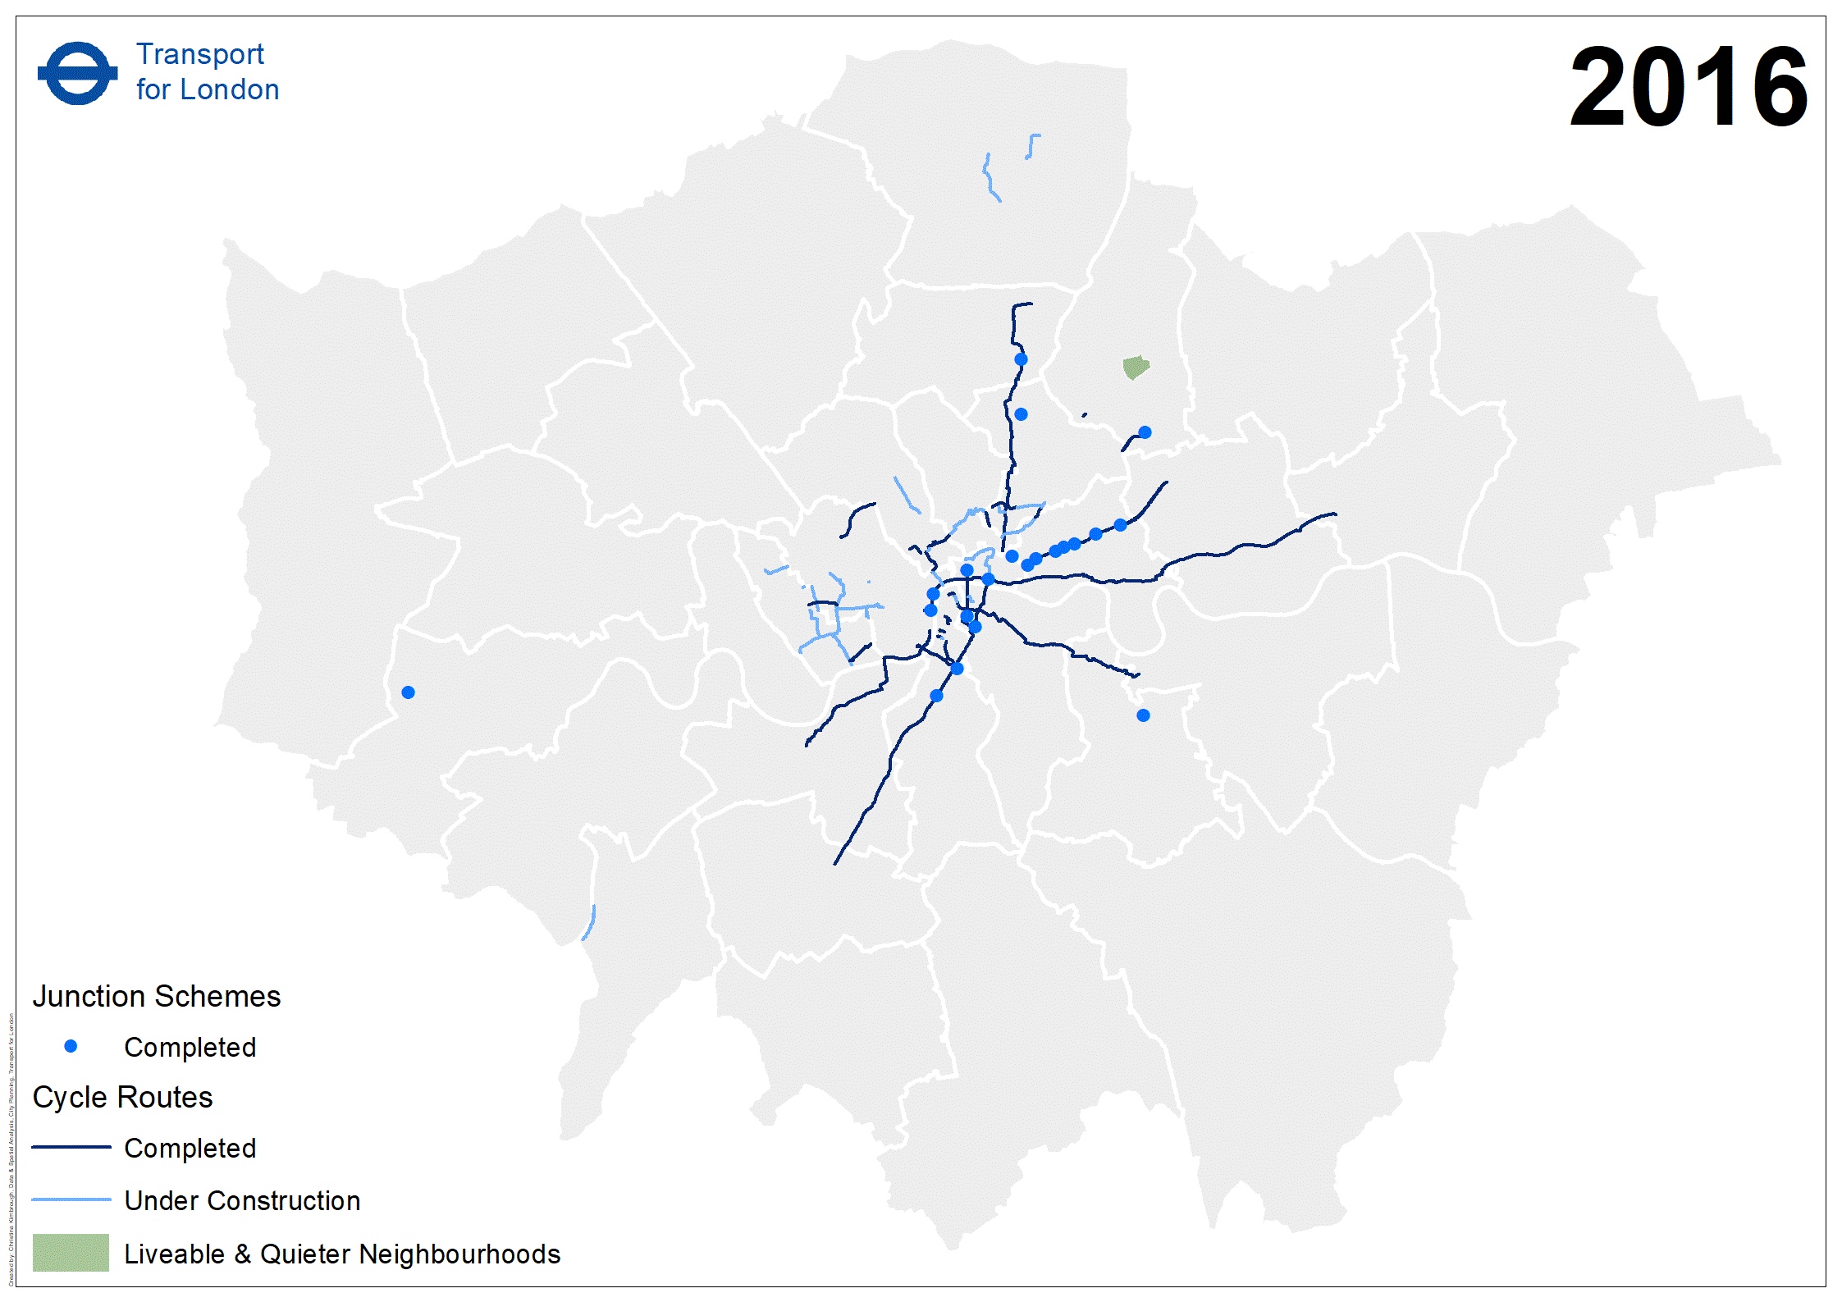

Slide 10
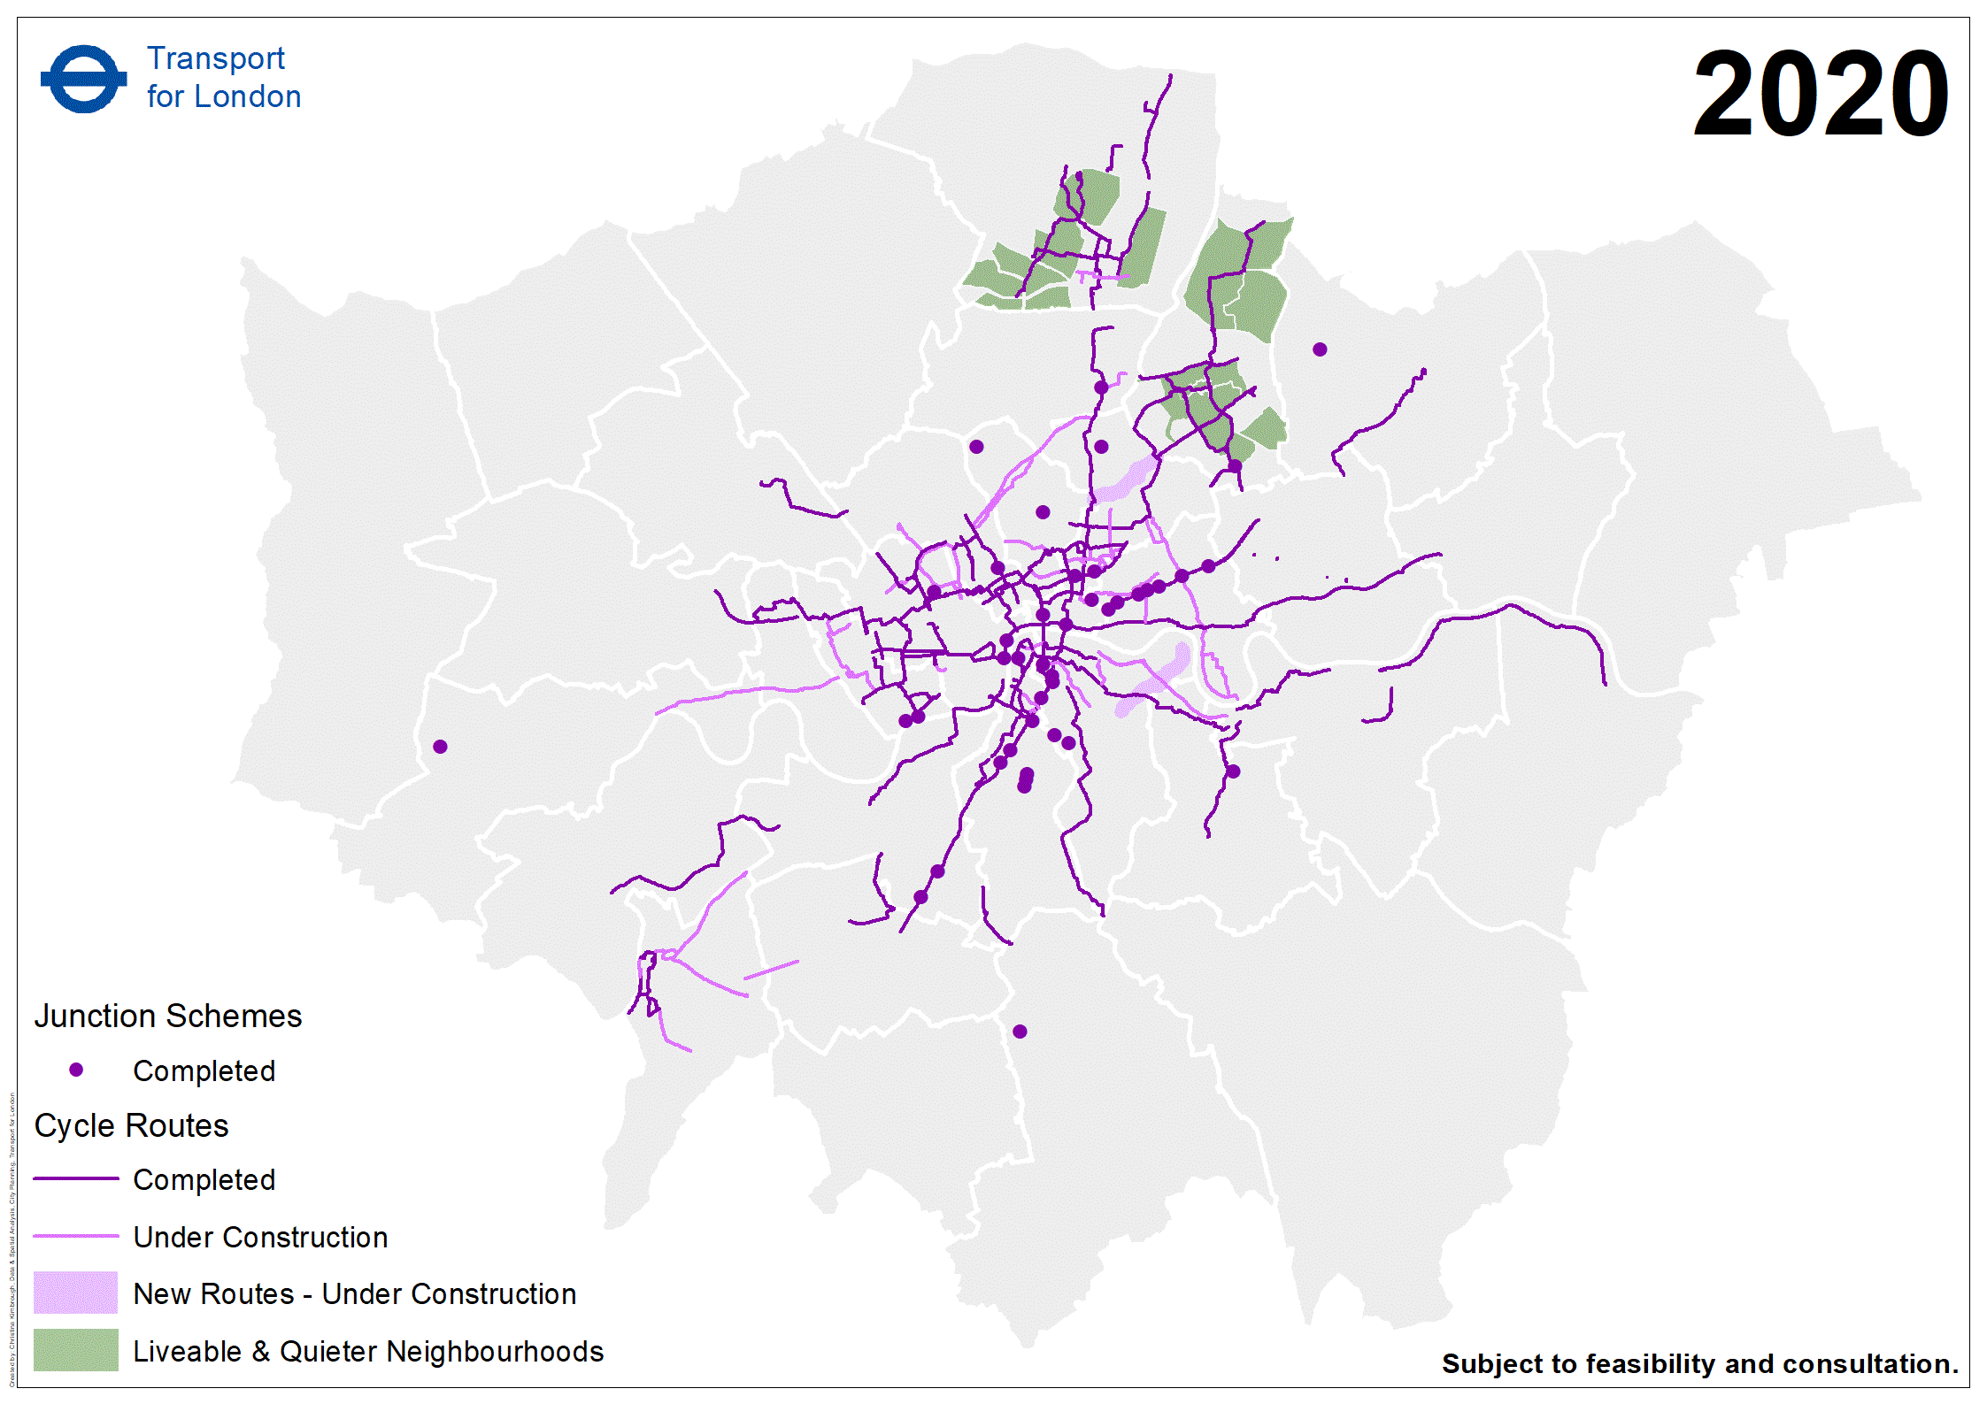

Slide 11
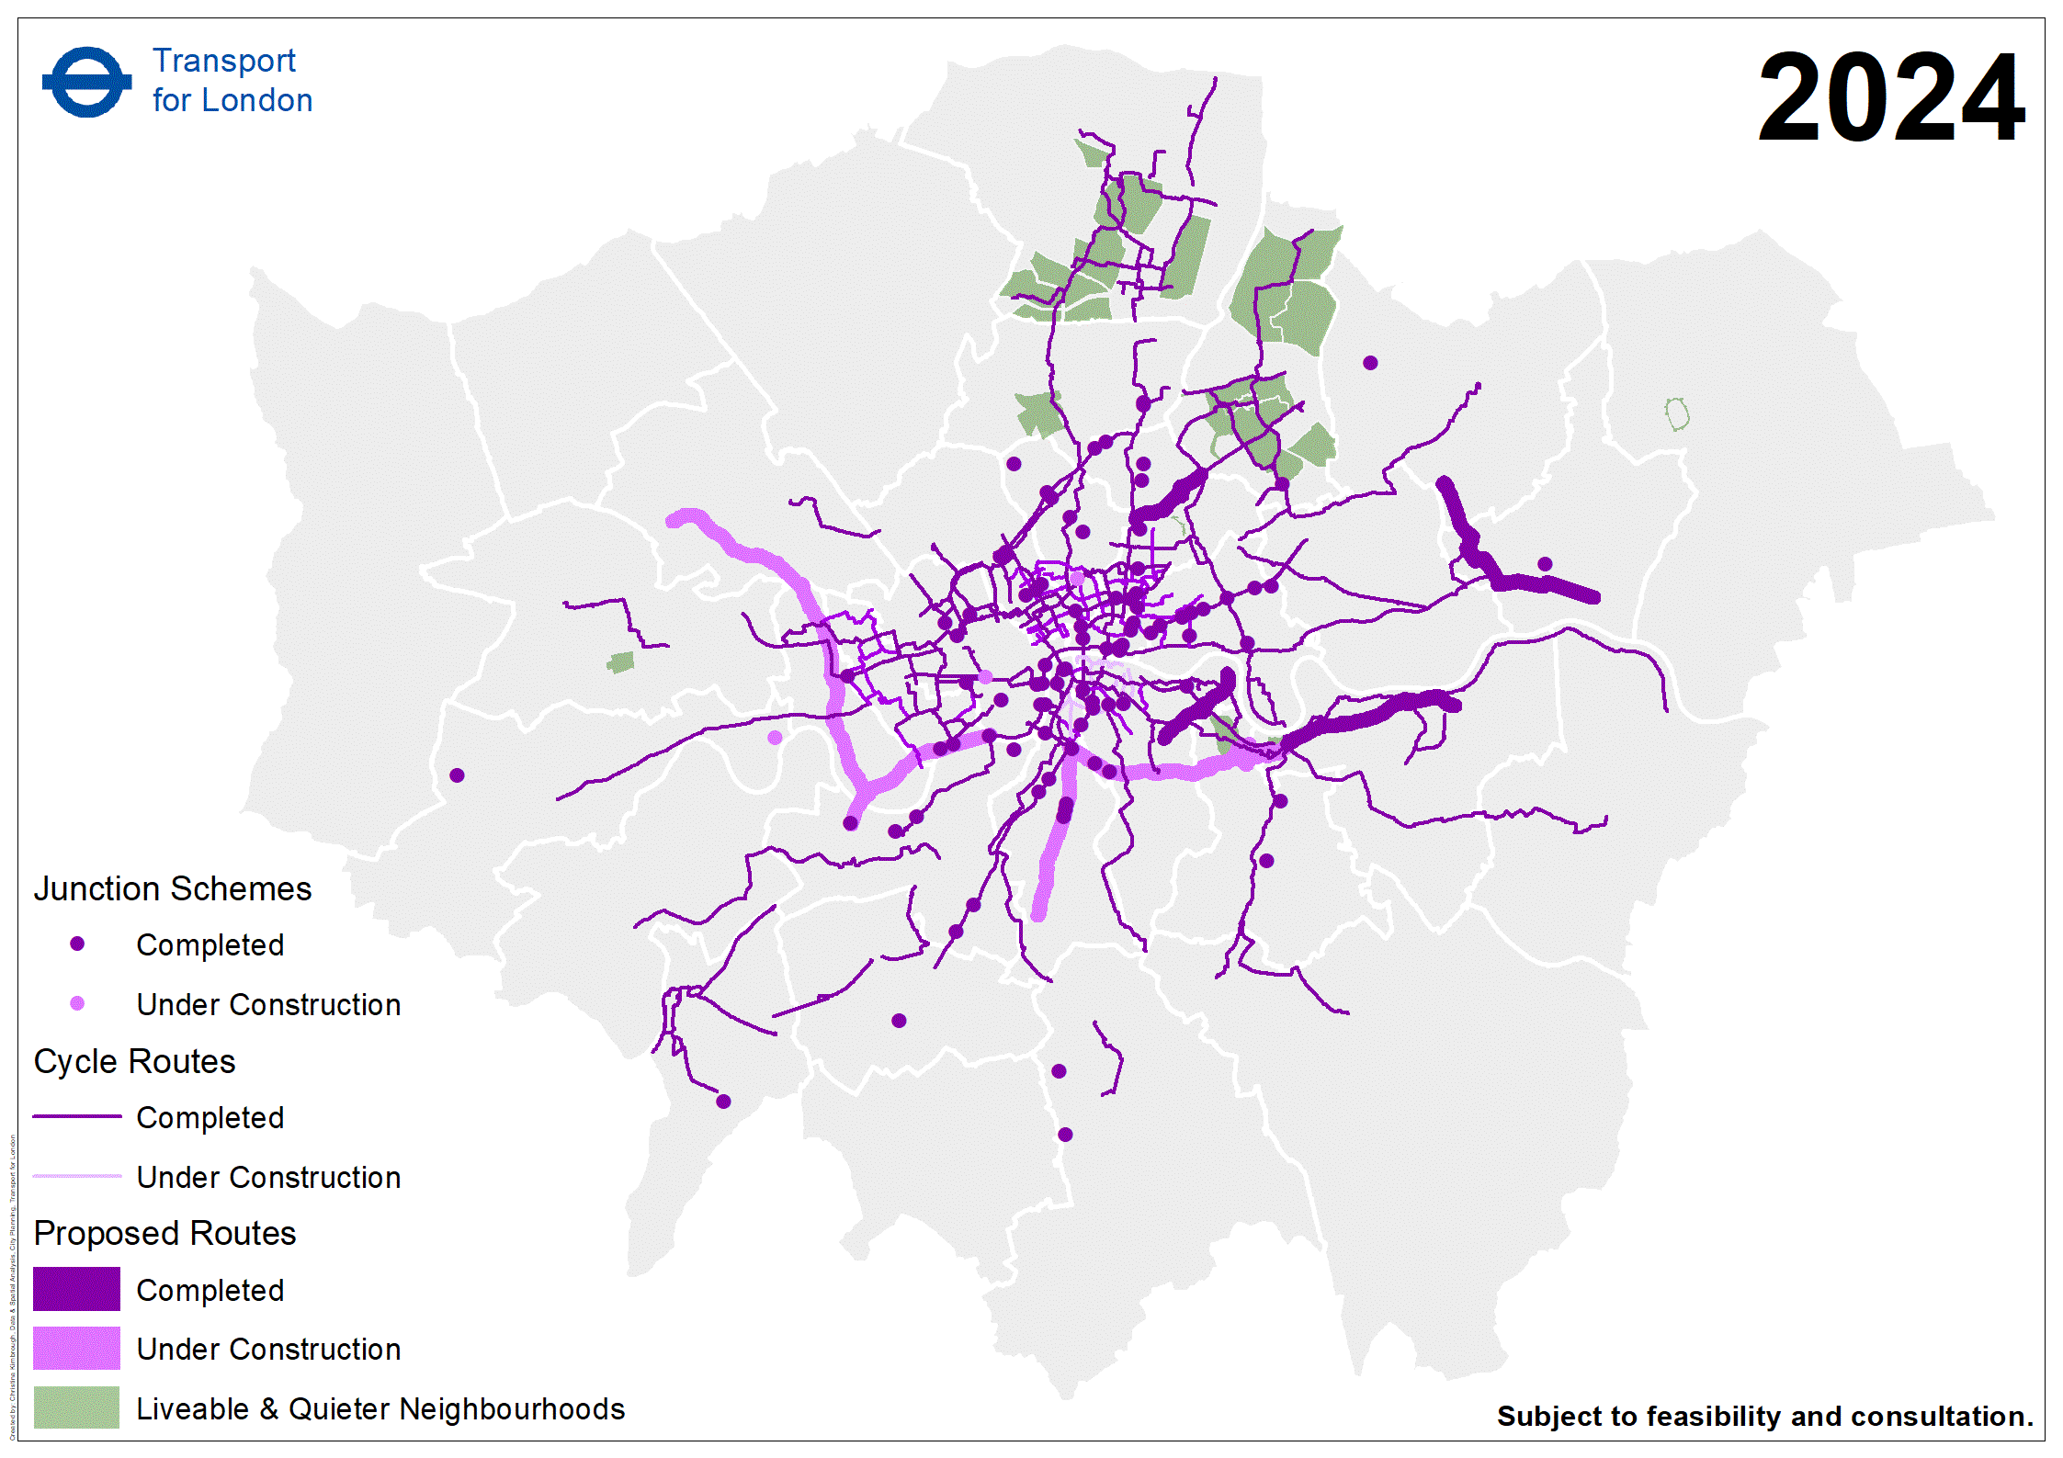

Slide 12
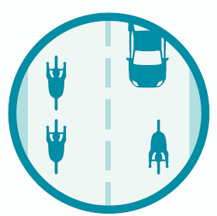

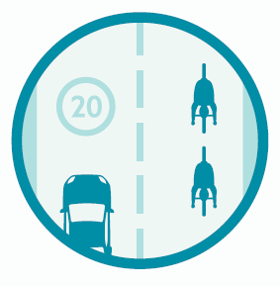


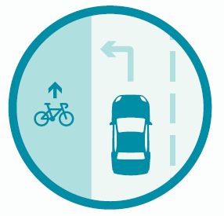
New Quality Criteria
Criteria 4: Kerbside activity has a minimal impact on people cycling
Criteria 1: Total volume
of motor traffic
Criteria 2: Speed of
motor traffic
Criteria 5: Interaction between HGVs and people cycling minimised
Criteria 6: Collision risk
between people
cycling and turning
vehicles minimised
Criteria 3: Appropriate
width for cycling

Slide 13
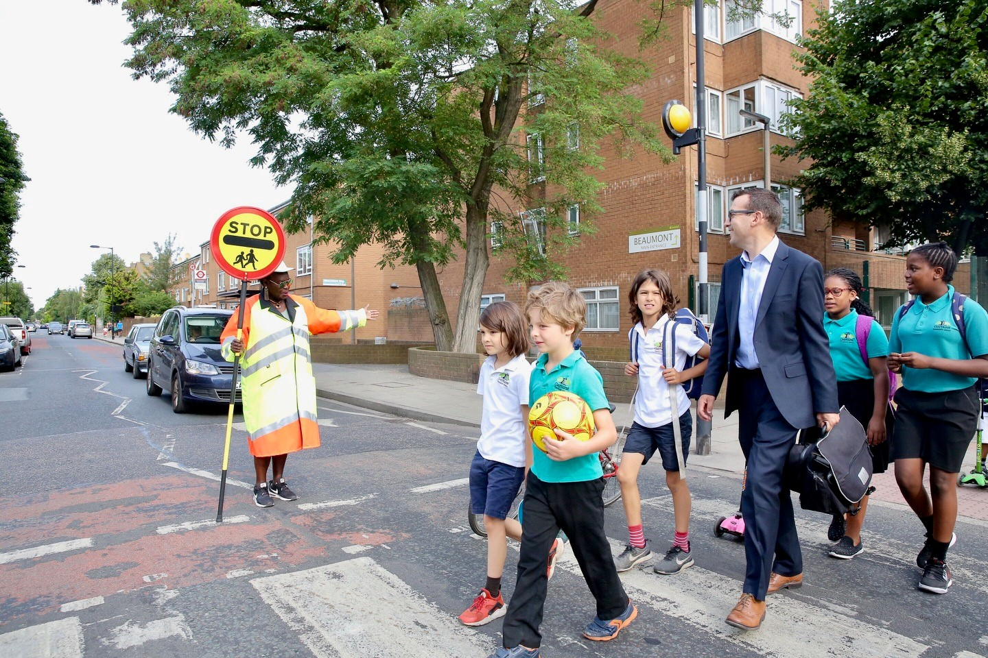
Notes:
One of the things he wants to change to is get more people walking

Slide 14
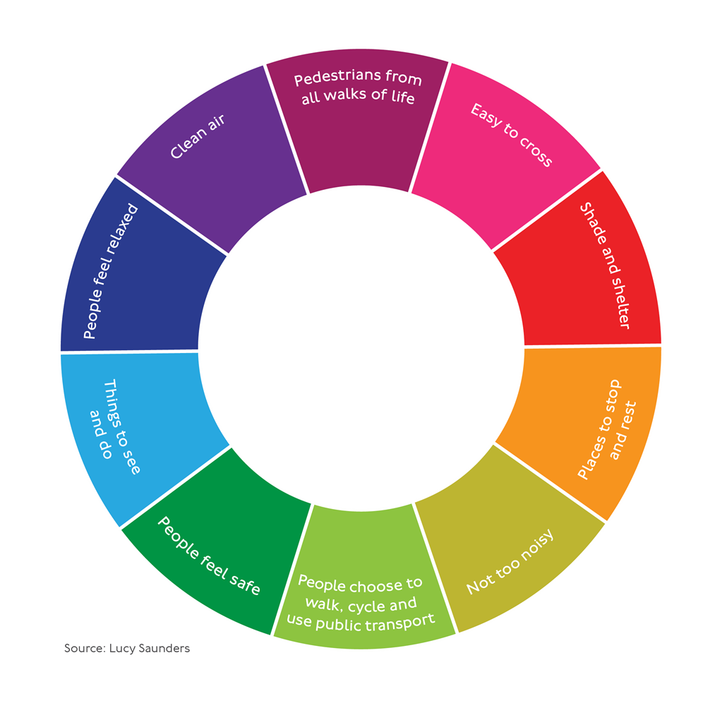
HEALTHY
STREETS
Source: Lucy Saunders
Notes:
To achieve these ambitious aims, a new approach is needed for how we look at London’s transport and streets. The new approach that we are spearheading, and that is a central theme in the Mayor’s Transport Strategy is the Healthy Streets Approach. First and foremost, it is about putting people, not vehicles at the heart of our – and critically - TfL’s decisions. This means prioritising walking, cycling and public transport over private vehicles.
The Healthy Streets Approach is a system of policies and strategies to help Londoners use cars less and walk, cycle and use public transport more
The 10 Healthy Streets Indicators shown here are the essential ingredients for a healthy street environment
They are 10 evidence-based indicators of what makes streets attractive and appealing places. Working towards these will help to create a healthier city, in which all people are included and can live well, and where inequalities are reduced.

Slide 15
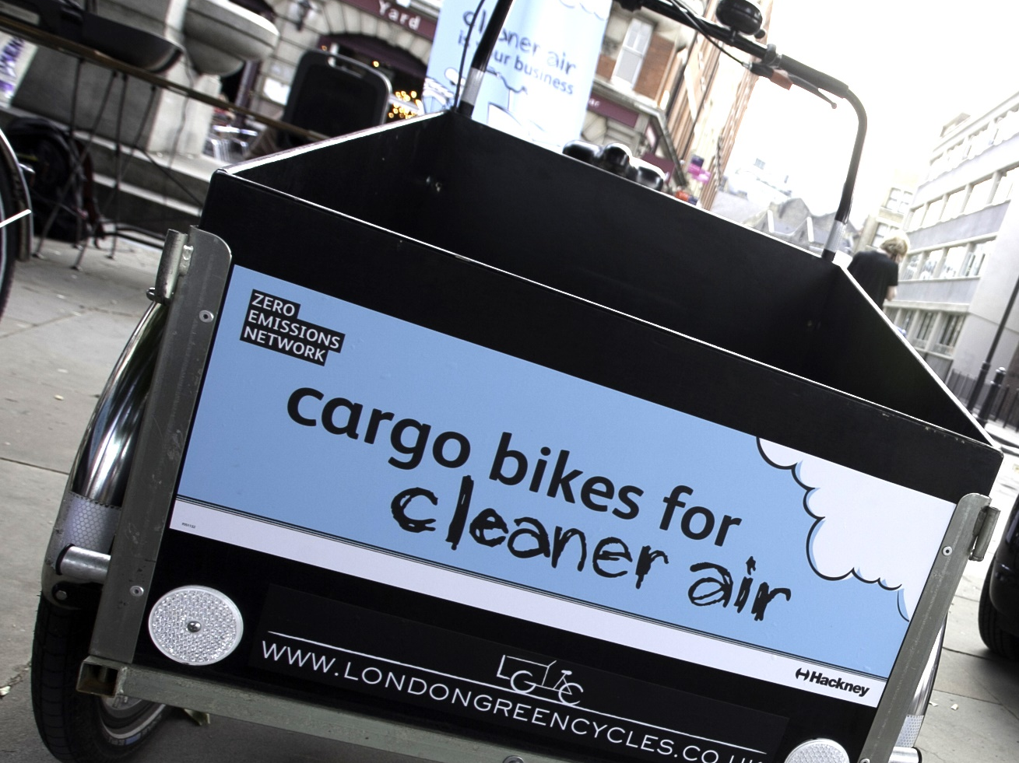
15
Notes:
We want fewer vehicles to be on our streets, including less vans delivering during busy times
Keep existing road user charging schemes including Congestion Charge scheme under review to ensure they remain effective.
Work with boroughs to develop traffic reduction strategies, including workplace parking levies or satellite congestion charging schemes.
Give consideration to the development of new ways of charging for road use in the long term reflecting distance, time, emissions, safety and other factors

Slide 16
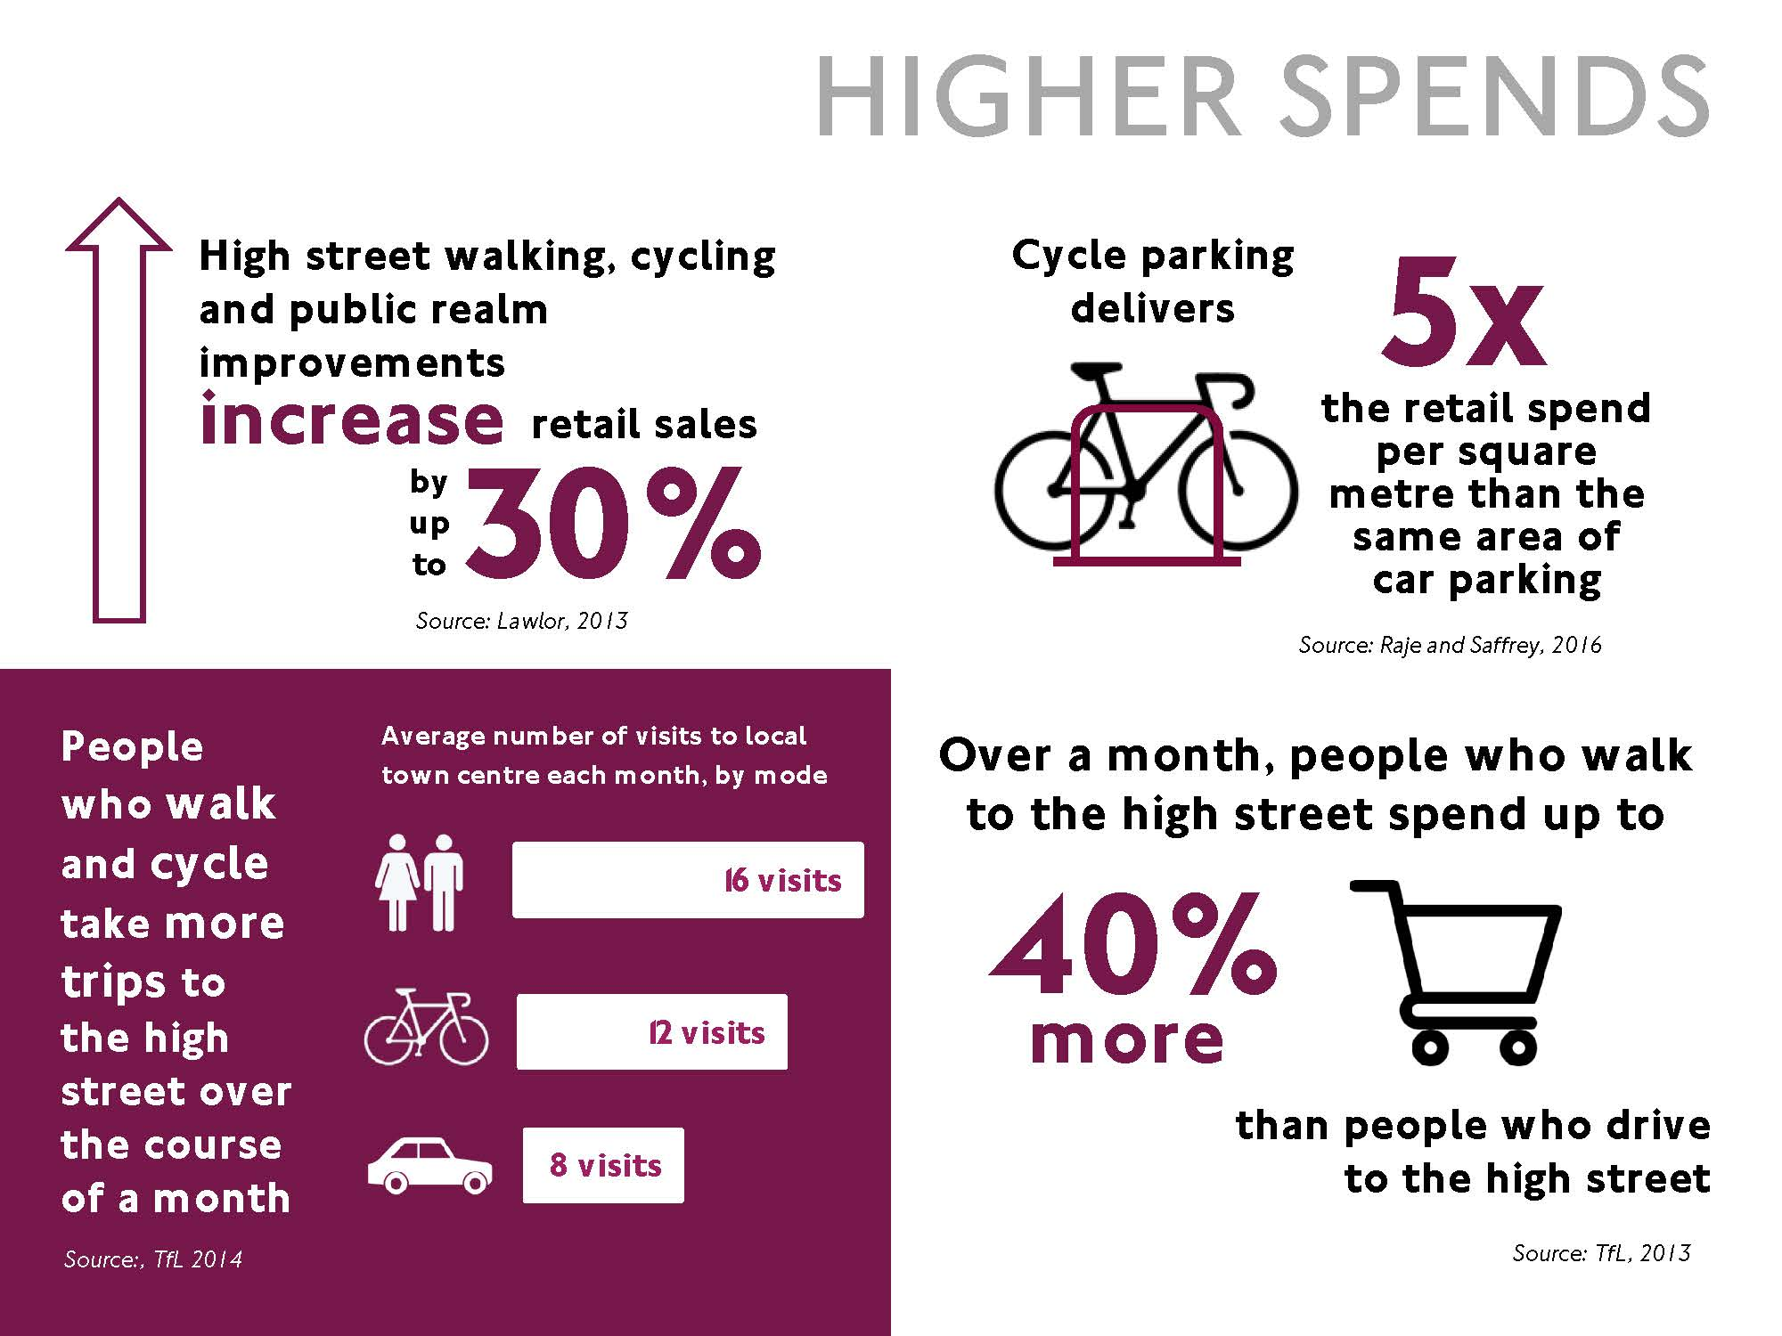

Slide 17

Notes:
Dr William Edwards Deming, an American engineer, statistician, has a great quote “In God we trust, all others bring data” For those of you at the Living Streets Walking Conference last month, you’ll know it was a favourite expression of Mike Bloomburg NY mayor.
Effective use of data to help inform decision making is at the heart of the safer junctions programme.
Going forward data, will be key to helping informing decision making processes on where we invest to promote cycling.

Slide 18
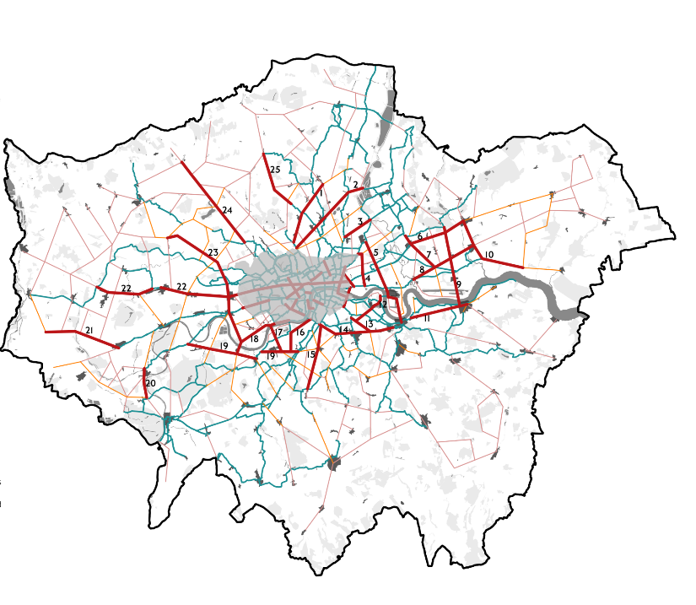
Notes:
Strategic Cycling Analysis
So what is next? Our analysis shows that Londoners make 8.17 million daily trips by motorised modes (car, motorcycle, taxi or public transport) that could be cycled.
More than half of the potential trips are made by car, with the rest largely made by bus.
Almost half of all potentially cyclable trips are made for shopping and leisure purposes, 6.5 million of these would take less than 20 minutes for most people to cycle.
We know that the main reason people don’t cycle is because they don’t feel safe. We therefore need to build a comprehensive cycling network and our recent analysis, shown in this slide, shows the top 25 connections that we need to prioritsie for creating high quality cycle routes.
The ambition contained in the Transport Strategy is for 70 per cent of Londoners to live within 400 metres of a high quality, safe cycle route and the SCA shows us how we can meet this ambition.
The Superhighways programme remains central to how we reach this target:
Work will start to extend the North-South Superhighway to Kings Cross later this year
Work will start on Cycle Superhighway 11 at Swiss Cottage also later this year.
At the end of the summer, we will launch consultations for two major routes, Cycle Superhighway 4 from Tower Bridge to Greenwich and Cycle Superhighway 9 from Kensington Olympia to Brentford. These will be substantially segregated, high quality, high capacity routes.
We are also committed to extending the east-west Cycle Superhighway from Lancaster Gate to Acton, but are working on an alternative alignment to the Westway.
We are now looking at the feasibility of the 25 identified connections, working with boroughs, and will be making a decision this year on which to prioritise and take forward to the design stage.

Slide 19
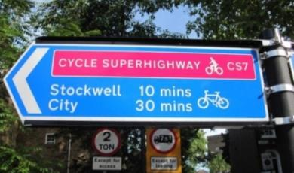
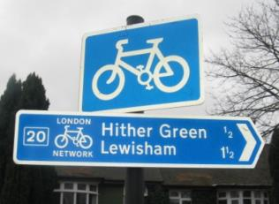
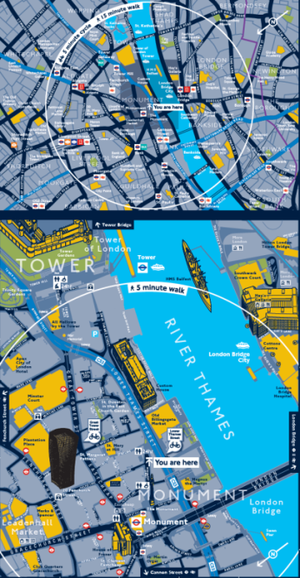
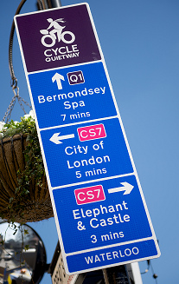
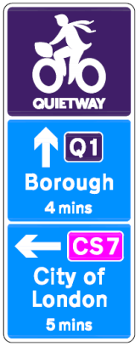
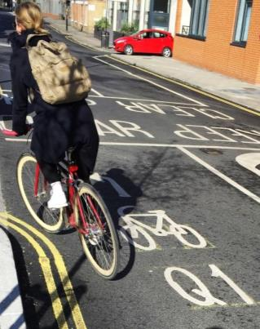
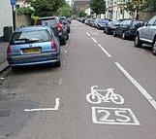
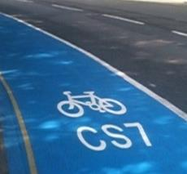
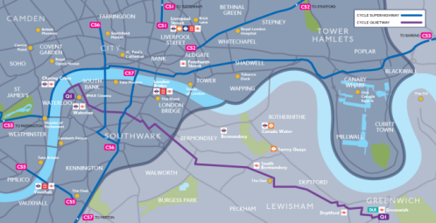
Notes:
Build this network – need to find away around

Slide 20
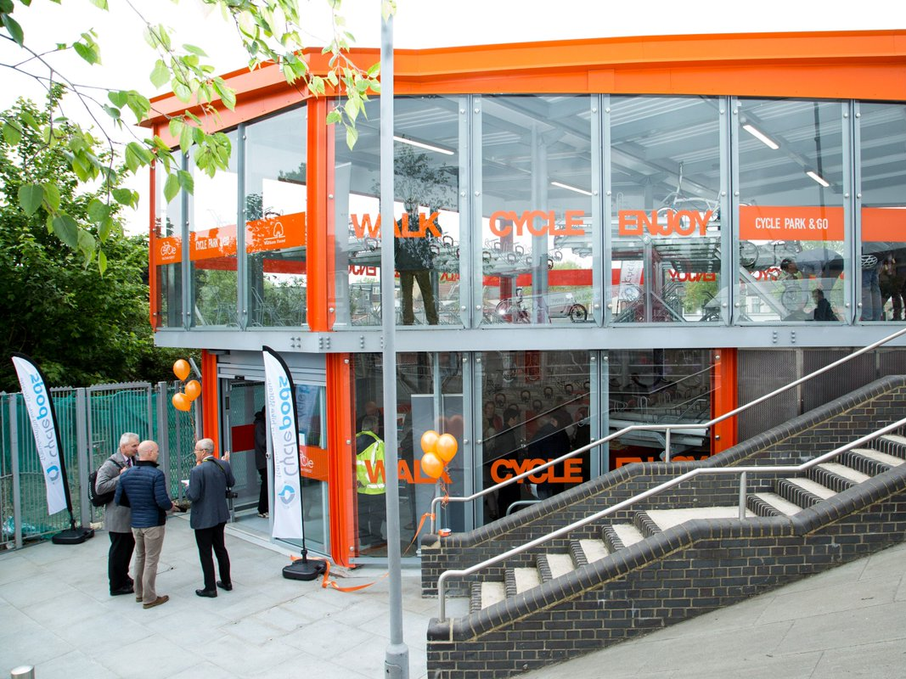
Network level – integrate into transport network – picture of bike hub near station? Leyton ?
Notes:
At a network level, we must design and manage our streets and rail systems so that more active travel becomes part of every journey. We are not trying to get people to cycle from Dagenham to Heathrow. But we can enable them to walk or cycle for part of a journey, for example by providing good quality cycle parking at train stations.
This recently opened cycle hub at Leyton station, for example, provides safe and secure parking for 156 bikes and enabling people to cycle as part of a longer journey or commute.

Slide 21
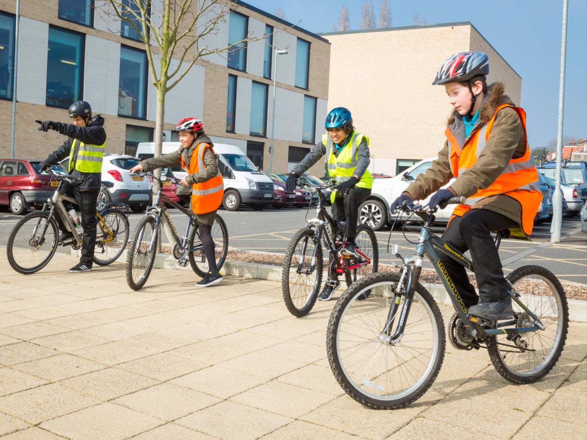

Slide 22
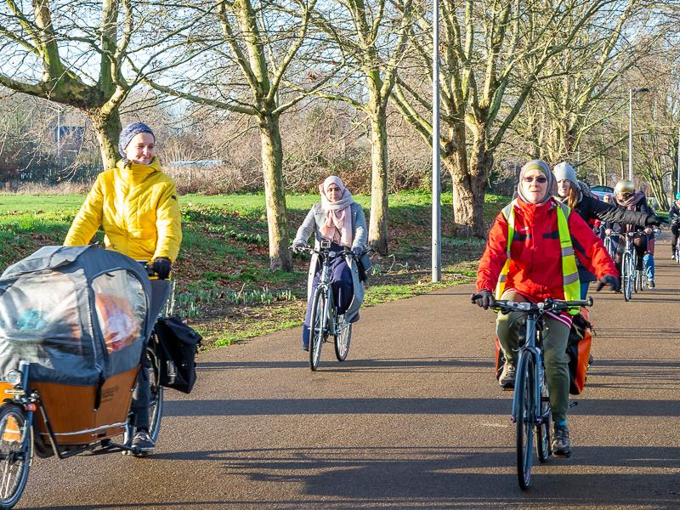

Slide 23
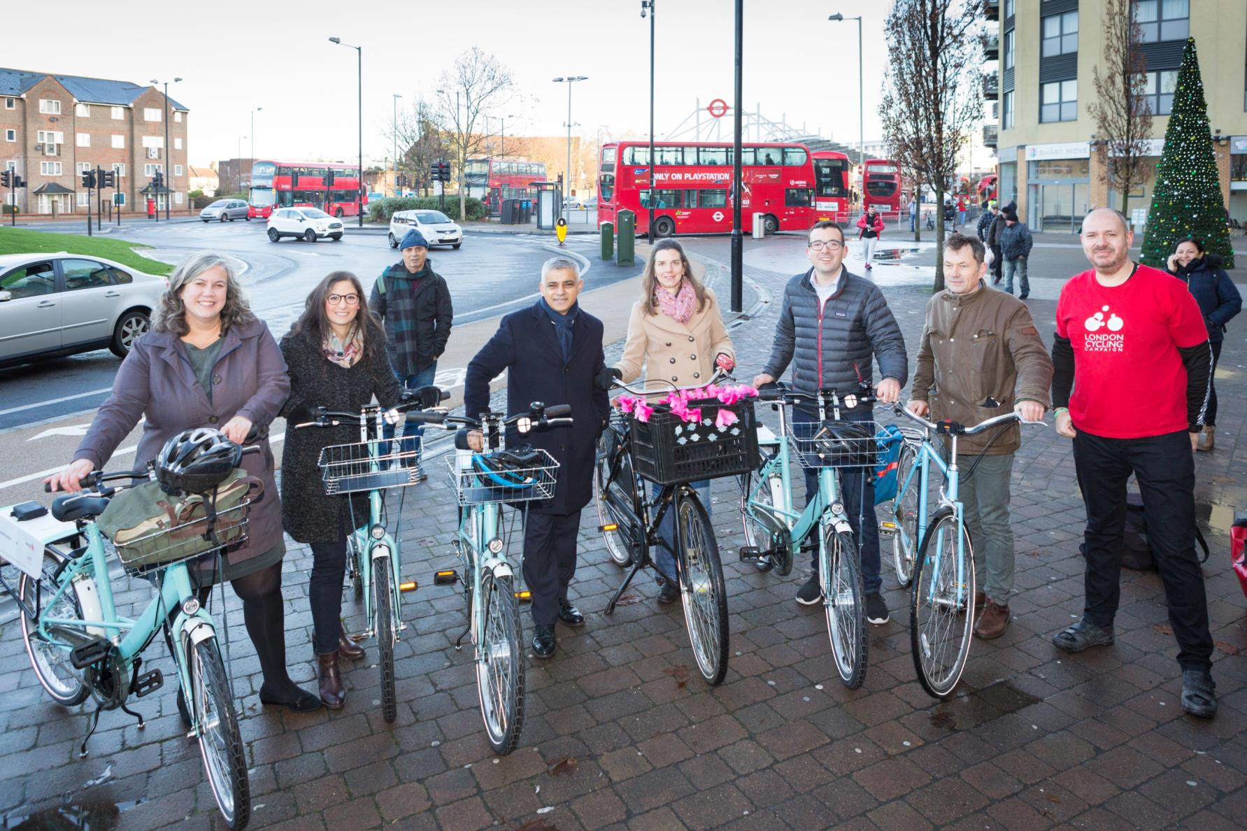

Slide 24
