Slide 1
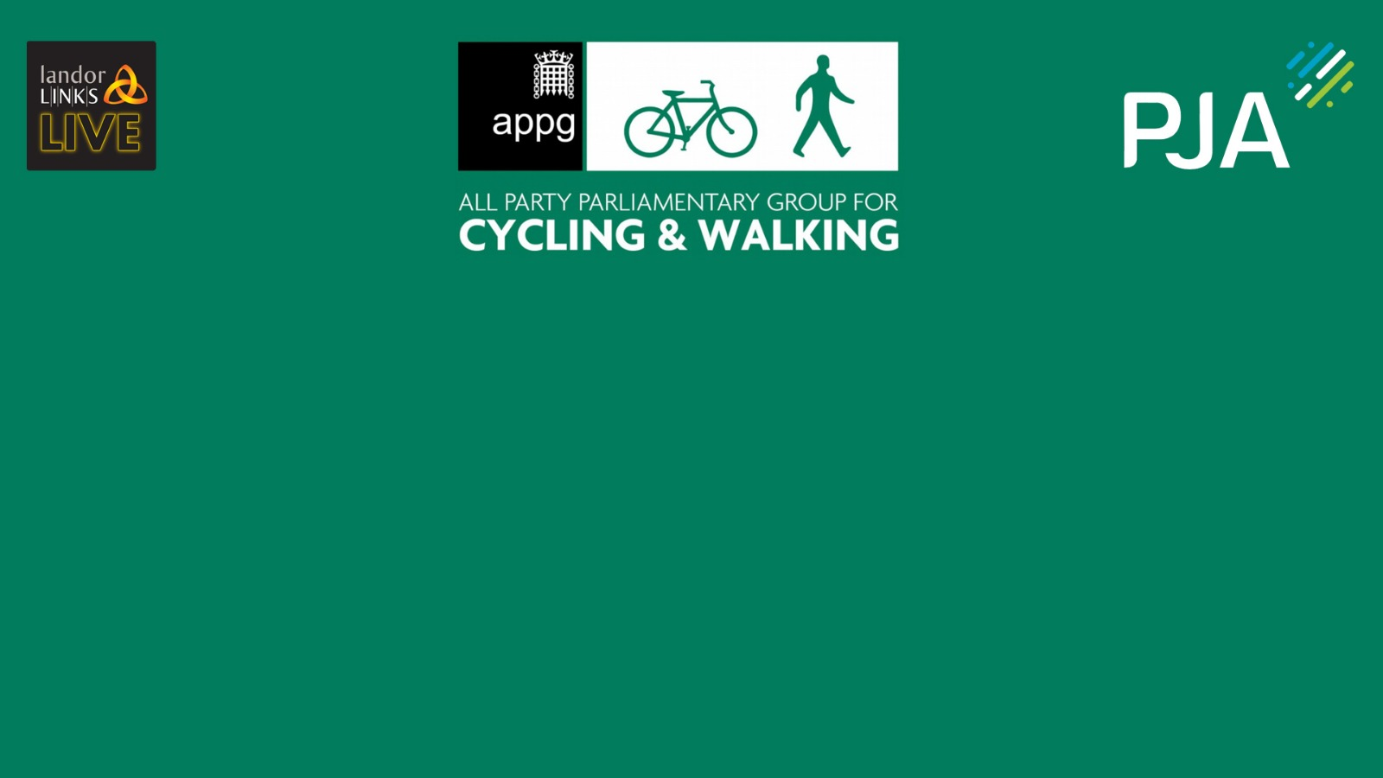
The webinar will begin at 10:30am
#APPGCW

Slide 2
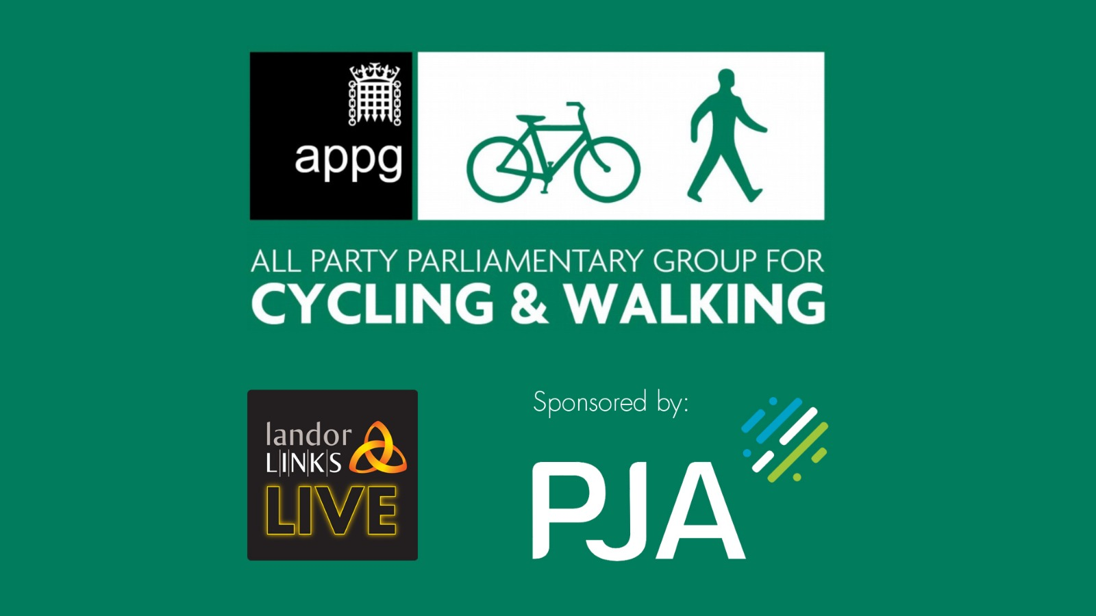
#APPGCW

Slide 3
Ruth Cadbury MP & Selaine Saxby MP
Co Chairs
All Party Group for Cycling and Walking
#APPGCW

Slide 4
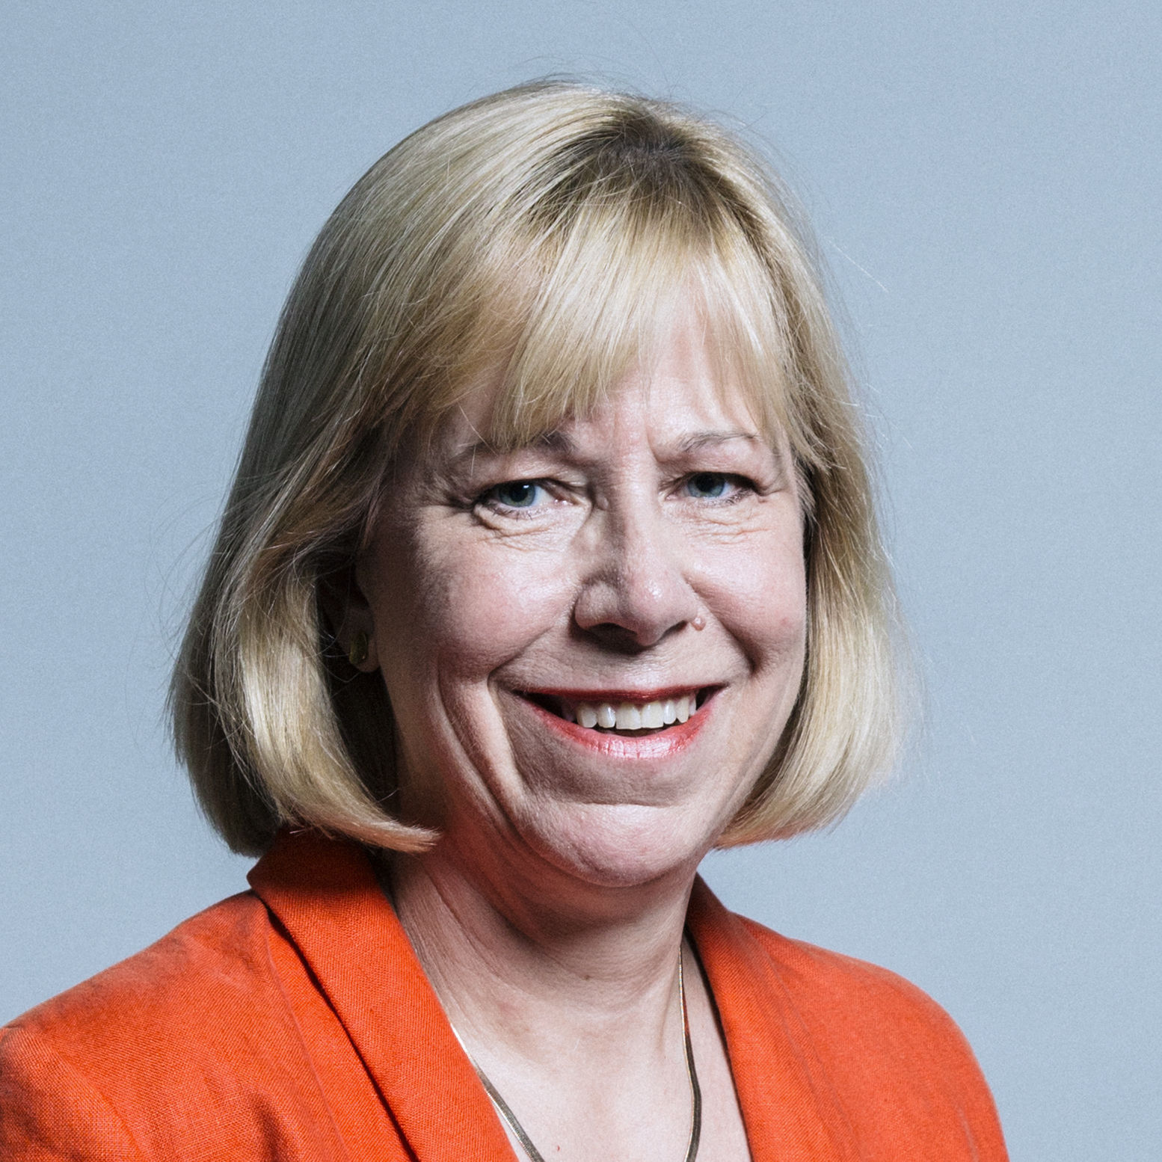
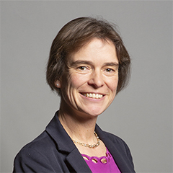
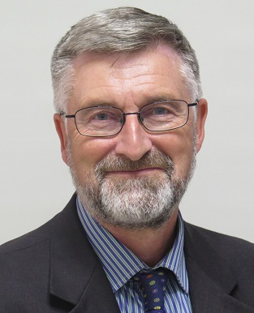
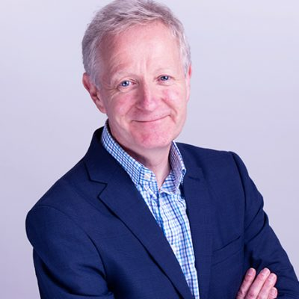
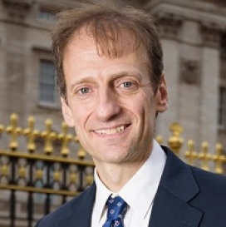
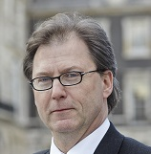
#APPGCW
Ruth Cadbury MP
Co-Chair
All Party Group for Cycling & Walking
Selaine Saxby MP
Co-Chair
All Party Group for Cycling & Walking
Joe Irvin OBE
Former CEO
Living Streets
Phil Jones
Chairman
PJA
Roger Geffen MBE
Policy Director
Cycling UK
Steve Gooding
Director
RAC Foundation

Slide 5
Joe Irvin OBE
Former CEO
Living Streets
Phil Jones
Chairman
PJA
Roger Geffen MBE
Policy Director
Cycling UK
#APPGCW

Slide 6
APPGcw: Highway Code review 2020
WACA Team:
Joe Irvin, Phil Jones, Roger Geffen

Slide 7
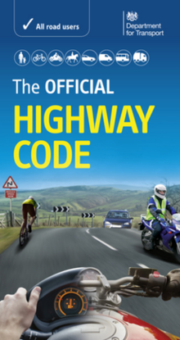
HC Review: Why and how
Why? To improve safety and promote active travel.
c 27,000 people killed or seriously injured on GB roads last year = 520 KSI per week. c 1,700 killed (cf 147 in all industries)
Progress stalled since 2010.
Vulnerable road users suffer disproportionately.
More UK motor vehicles 1990: 20m 2020: 38m
Timeline:
CW safety review – DfT call for evidence: March-June 2018
Walking and Cycling Alliance calls for Highway Code review: June 2018
DfT CWIS safety review, 50 proposals inc HC review: November 2018
DfT ‘focus group’: July 2019 - Feb 2020
Highway Code proposals, consultation: 28 July – 27 October 2020

Slide 8
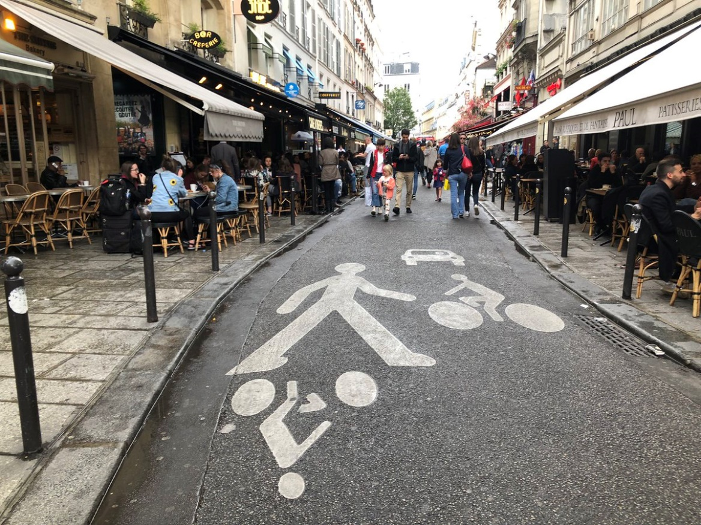
Rule H1: Hierarchy of Road Users
Those who can cause the greatest harm in a collision bear the greatest responsibility to take care.
‘This principle applies most strongly to drivers of large goods and passenger vehicles, followed by vans/minibuses, cars/taxis and motorcycles.’
Road users most at risk: ‘The top of the hierarchy would therefore be pedestrians, in particular children, older adults and disabled people, cyclists, horse riders, and motor cyclists before other motorised vehicles.’
Does not detract from the responsibility of ALL road users… to have regard for their own and other road users’ safety.
NOT presumed liability.

Slide 9
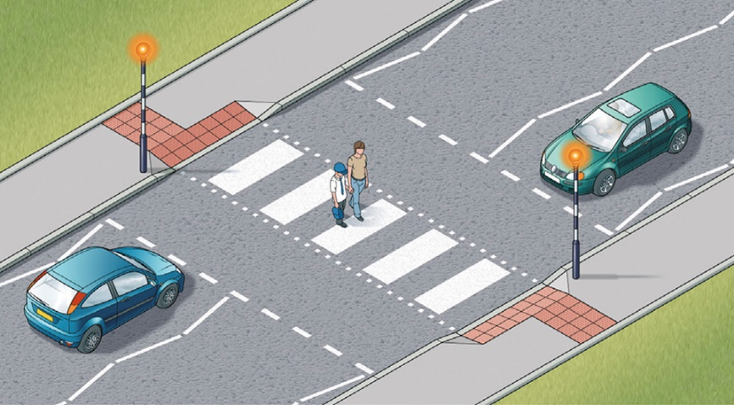
H2: Pedestrians at zebra crossings
Current rules
Proposals
R195: Drivers ‘MUST give way when a pedestrian has moved onto the crossing’
BUT pedestrians told in R19 : ‘Wait until traffic has stopped… Remember that traffic does not have to stop until someone has moved into the crossing.’
Drivers and riders ‘MUST give way to pedestrians on a zebra crossing.’‘You should give way to pedestrians waiting to cross at a zebra crossing.’
R192: ‘ In slow-moving and queuing traffic you should keep crossings completely clear, as blocking these makes it difficult and dangerous for pedestrians to cross.’

Slide 10
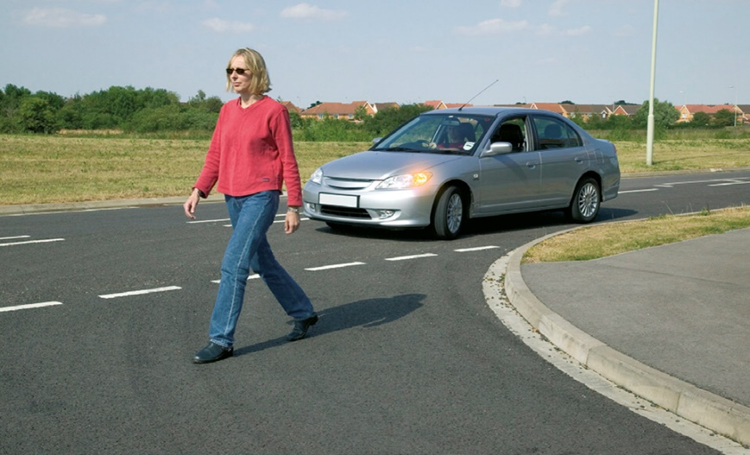
H2: Pedestrians at junctions
Current rules
Proposals
R170: Drivers: ‘Watch out for pedestrians crossing a road into which you are turning. If they have started to cross they have priority, so give way’
BUT pedestrians told in R7D (Green Cross Code): ‘If traffic is coming, let it pass.’
H2 Drivers and riders: ‘At a junction, you should give way to pedestrians crossing or waiting to cross a road into which or from which you are turning.’

Slide 11
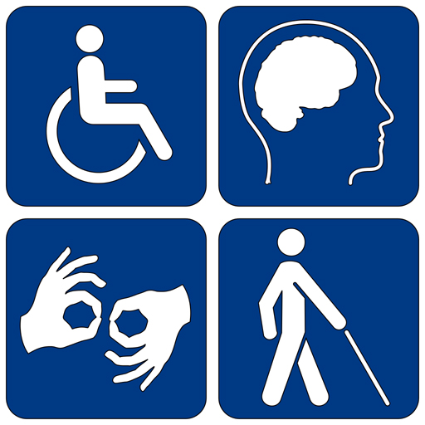
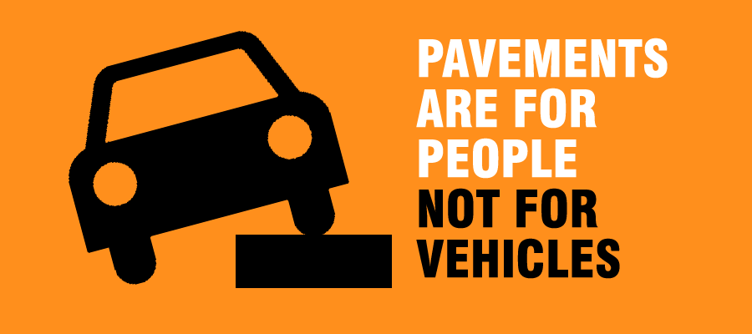
H2 Pavements and disabled people
H2: ‘Only pedestrians may use the pavement. This includes people using wheelchairs and mobility scooters.’
Drivers and riders ‘Always remembers that the people you encounter may have impaired sight, hearing or mobility, and may not be able see or hear you.’
Pavement parking: Q. is this consistent with statute law on mounting the pavement and causing an obstruction? And new law in Scotland?
Current R244. ‘You MUST NOT park partially or wholly on the pavement in London, and should not do so elsewhere unless signs permit it.’
Current R145. ‘You MUST NOT drive on or over a pavement, footpath or bridleway except to gain lawful access to property, or in the case of an emergency.

Slide 12
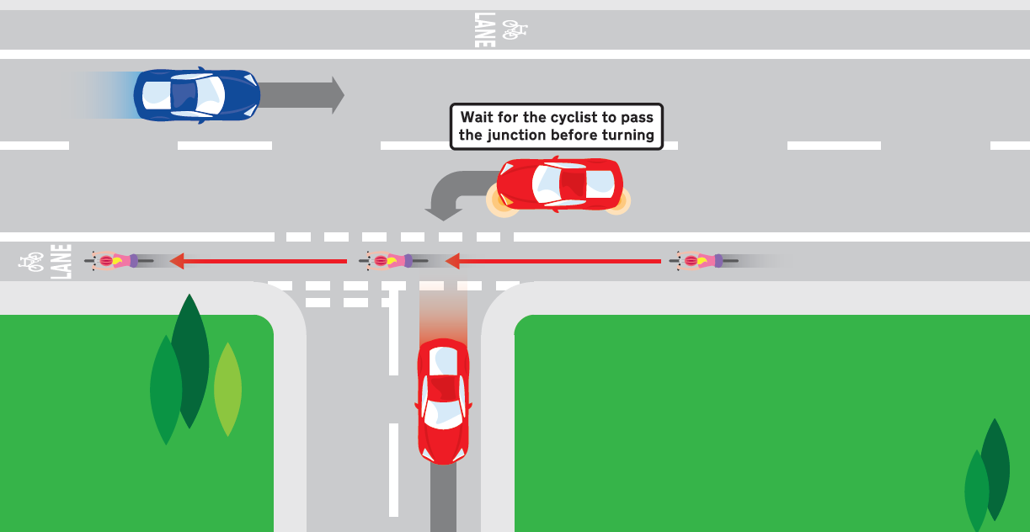
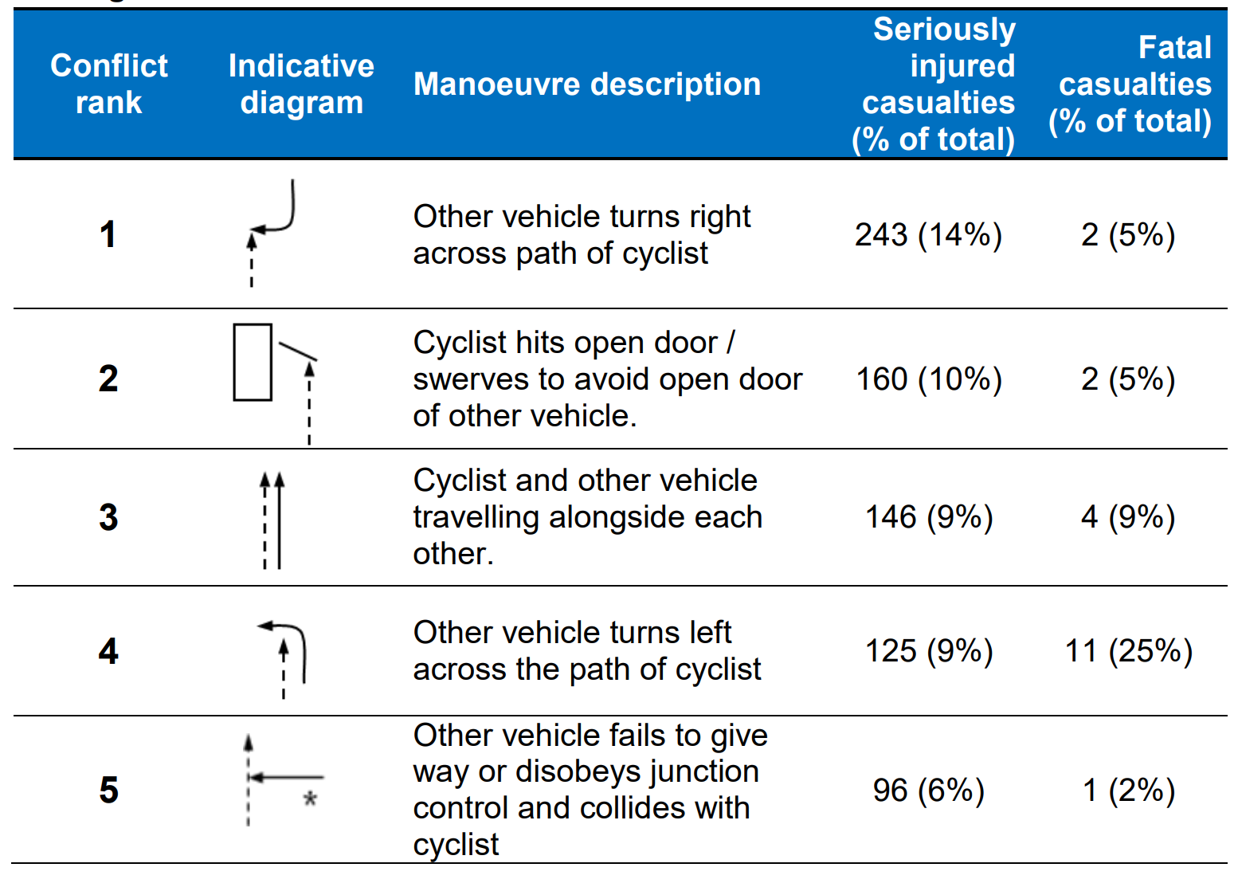
H3 Priority for Cyclists Going Ahead
Some existing Highway Code rules for junctions are unclear
Eg existing Rule 170 – ‘watch out for cyclists…’ – and then what?
New Rule H3 – do not cut across cyclists going ahead.
Wait for a gap if necessary.

Slide 13
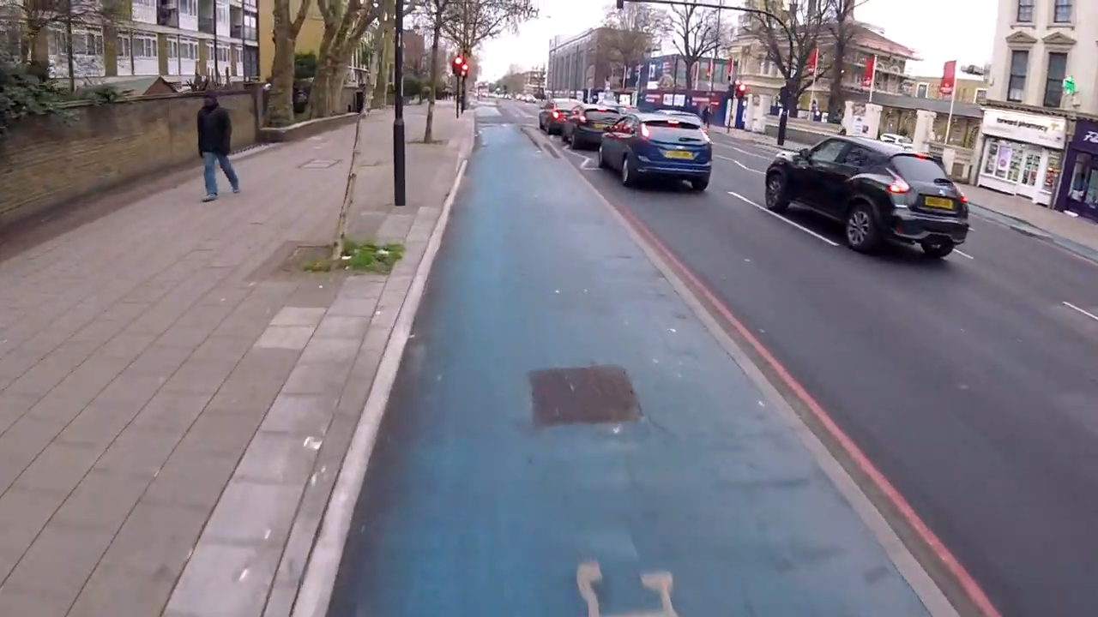

Slide 14
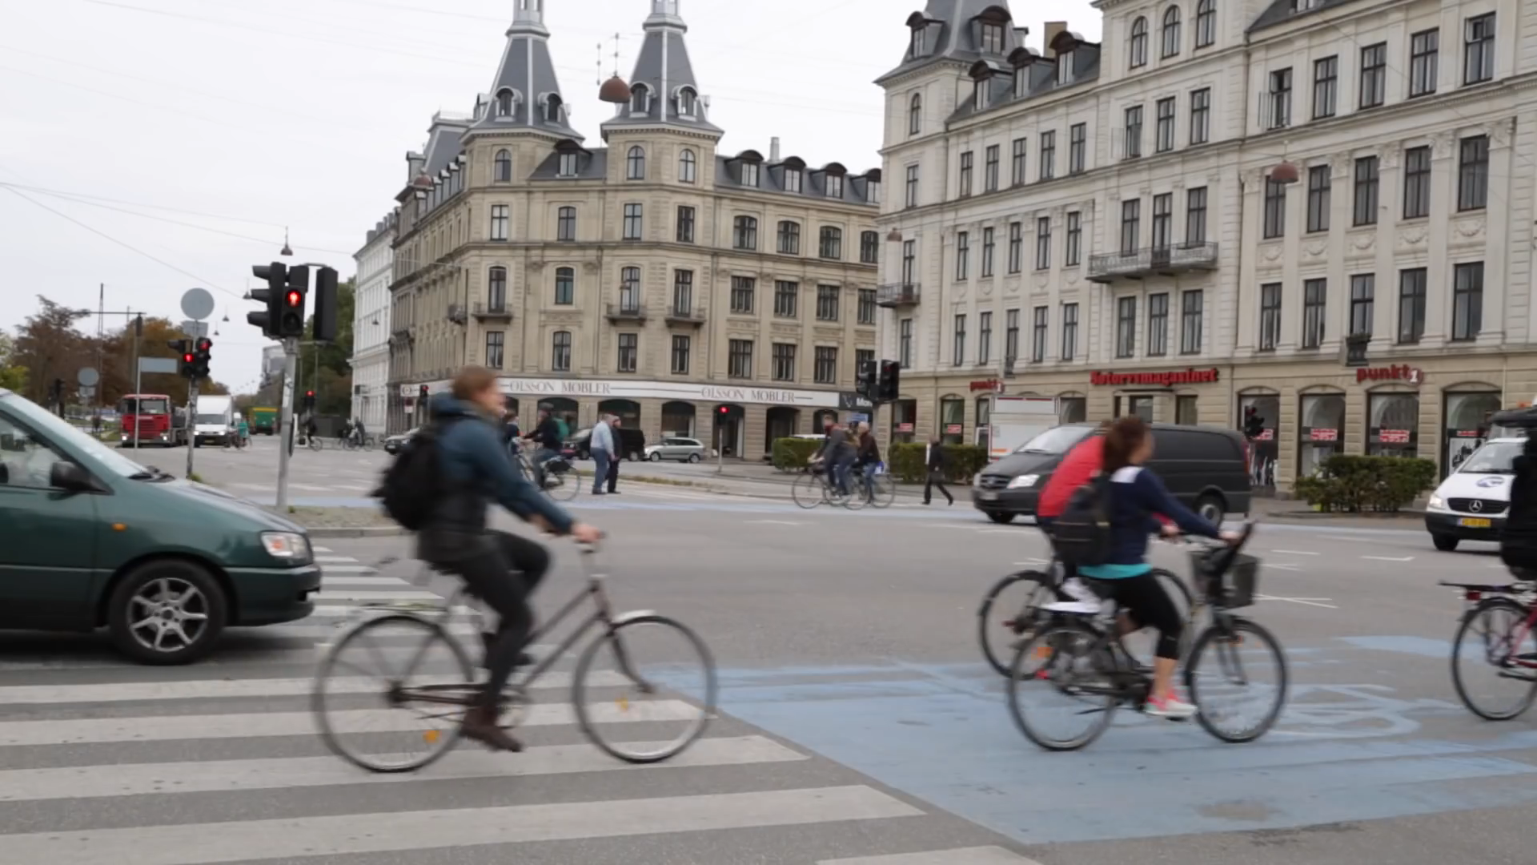

Slide 15
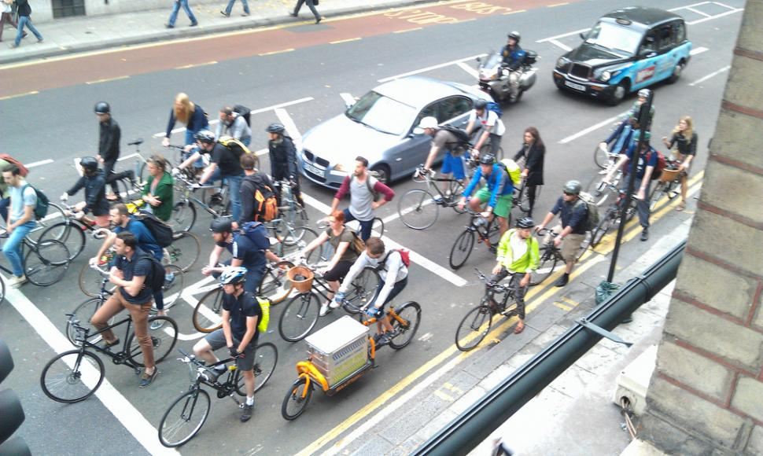

Slide 16
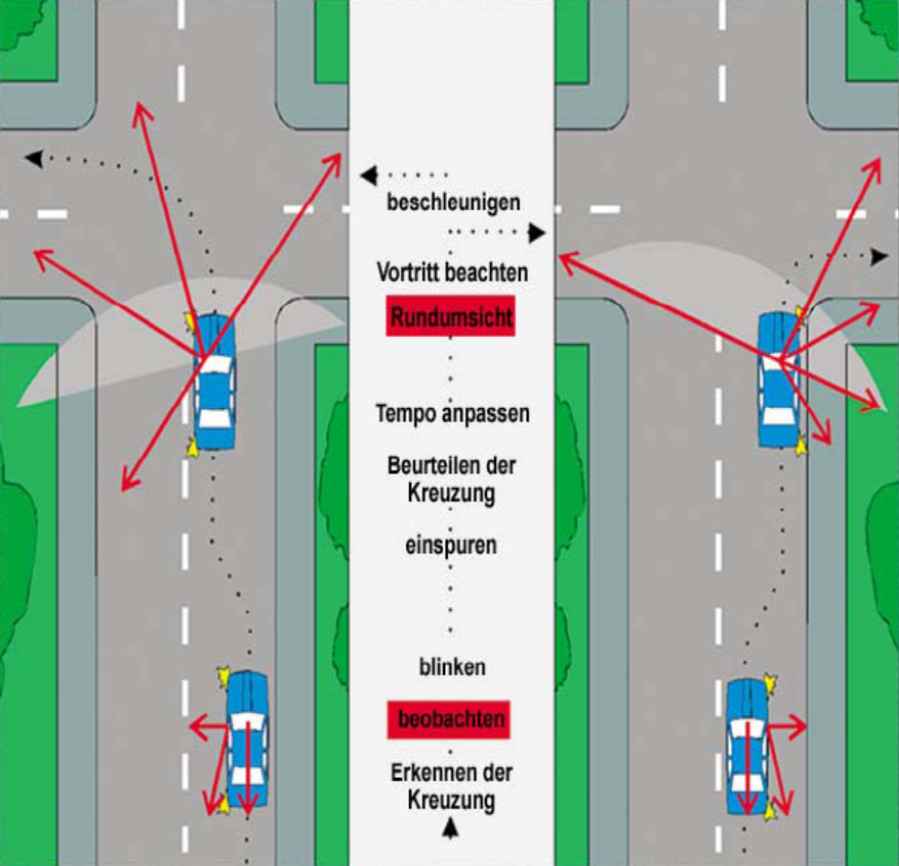
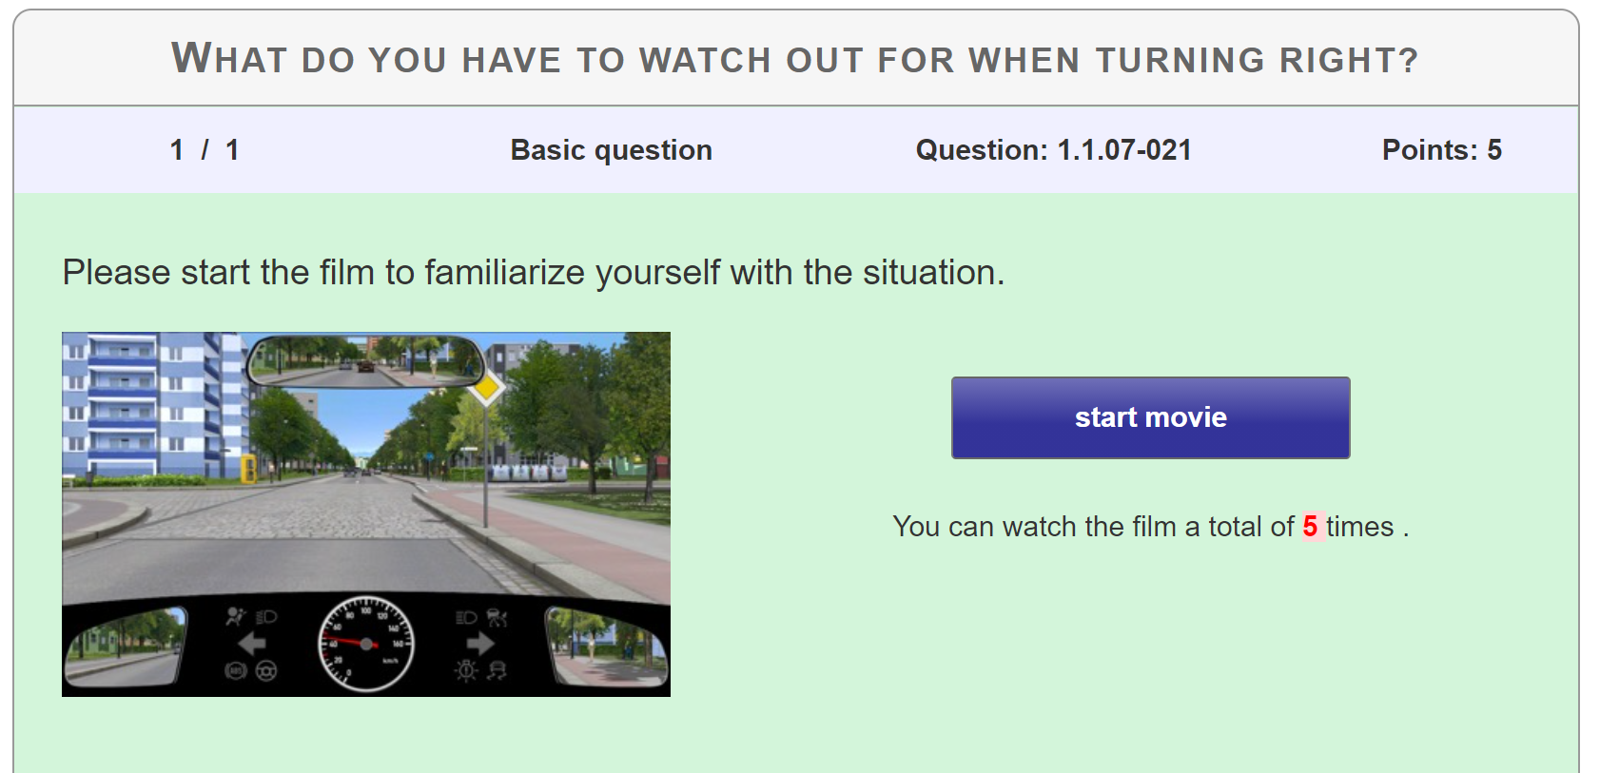
Driver Training in Germany
Before Turning
Check the mirrors
Look over your right shoulder
Give way to pedestrians and cyclists crossing or approaching the junction from ahead and from behind
Fines payable and points added to license holder if not observed
http://www.fahrschule.de/Fragenkatalog/1.1.07-021
Notes:
What I kind of took for granted as a child suddenly started to make sense when I took driving lessons
I learned that pedestrians and cyclists travelling straight ahead along a road and across a junction will always have priority over any vehicle turning right or left into the mouth of a side road
Therefore as a driver before turning right I need to …
Driving School video shows this quite clearly

Slide 17
Cycle-specific changes
Opening car doors safely: the Dutch Reach
Cyclists’ road positioning
Safe overtaking distances
Group riding / cycling 2-abreast
Consistent advice to drivers and cyclists

Slide 18
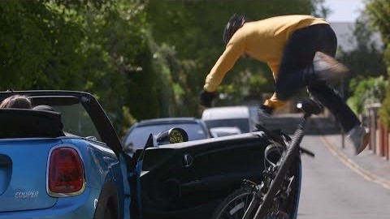
Opening doors safely: the ‘Dutch Reach’
Draft rule 239 advises drivers and passengers to open vehicle doors with the opposite hand to the door they’re opening
Makes you turn your head, reduces how widely the door will open

Slide 19
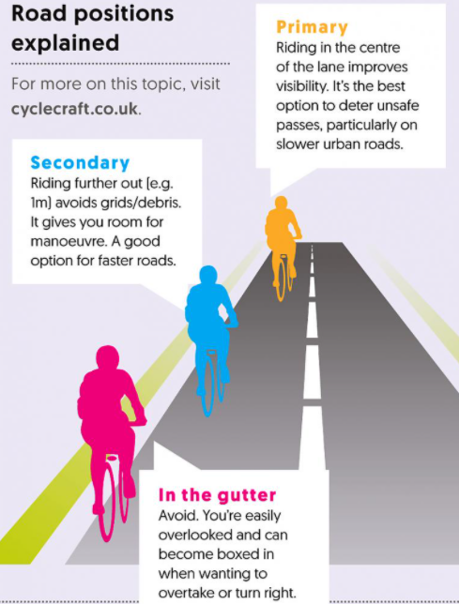
Cyclists’ positioning
Primary position: centre of the lane. When traffic is very light, or slow-moving, or when you want to avoid being overtaken dangerously
Secondary position: to the left of the traffic stream and at least 1m from the gutter or car doors
See rule 72 for cyclists, rule 213 for drivers

Slide 20
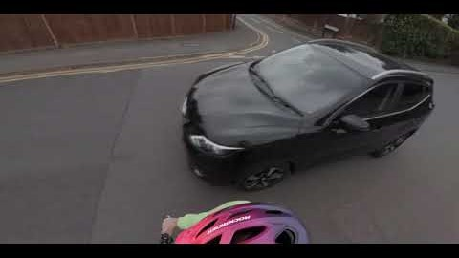
Safe overtaking
Current rules (163, 211, 212): drivers should leave cyclists, pedestrians, motorcyclists and equestrians at least as much room as when overtaking a car. How much is that?
New rule 163: at least 1.5m at speeds up to 30mph, at least 2.0m at higher speeds (and at all speeds when passing peds on road)
More for HGVs & other large vehicles, and/or in adverse weather
Cyclists may overtake slow or stationary traffic on left, but should do so with caution

Slide 21
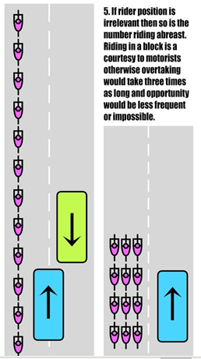
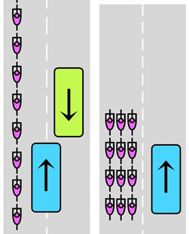
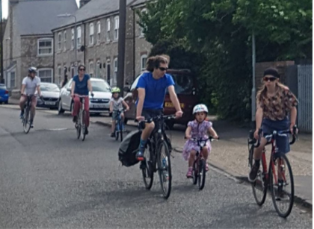
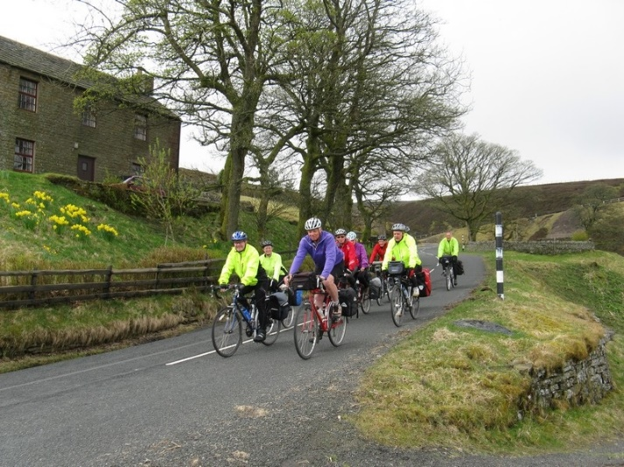
Riding 2-abreast
Some drivers think 2-abreast cycling is illegal - it’s not!
For groups on narrow lanes, it’s actually safer
We seek to rewrite rule 66, allowing it where safe (i.e. where ‘primary position’ would be advisable)
“When cycling in groups, you may cycle 2 abreast where this is safe, such as on roads with light traffic, or with plenty of space for overtaking, or where you can keep up with the speed of other traffic around you. You may also do so where being overtaken by drivers could be dangerous, such as on roads with poor sightlines. Allow them to do so when you feel this is safe, by switching to single file.”

Slide 22
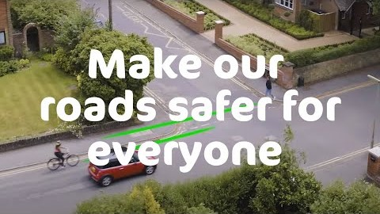
Communications campaign!
Following the rule changes, a comms campaign will be crucial to raise public awareness (n.b. DfT accepts this)
Remember “Green Cross Code” and “Clunk Click”
Here’s one we made to explain the junction priority change

Slide 23
Steve Gooding
Director
RAC Foundation
#APPGCW

Slide 24
#APPGCW
Ruth Cadbury MP
Co-Chair
All Party Group for Cycling & Walking
Selaine Saxby MP
Co-Chair
All Party Group for Cycling & Walking
Joe Irvin OBE
Former CEO
Living Streets
Phil Jones
Chairman
PJA
Roger Geffen OBE
Policy Director
Cycling UK
Steve Gooding
Director
RAC Foundation

