Slide 1
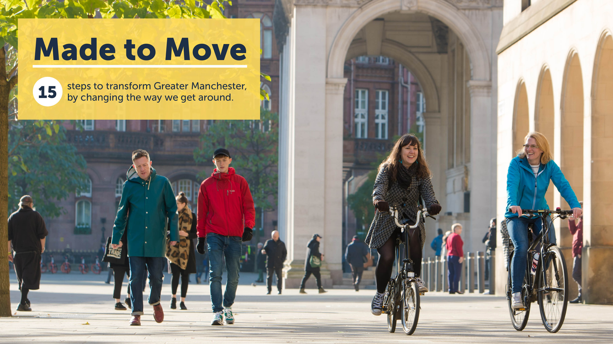
Made to Move, published December 2017
Notes:
Presented the Made to Move report to the APCG in January last year.
I’m to report some great progress on how that report is being turned into action to enable people who work and live in Greater Manchester to leave the car at home.
As you’ll know, we published Made to Move in December 2017 and the 15 steps in that report guide everything we do.
Fundamentally, what we needed to do had to do was for people in cars, not cyclists, and it had to look easy attractive and safe…or why get out of the car?
The tests or guiding principals to deliver that are two fold:
Must be usable and would want to be used by a competent 12yr old and their parent would let them
Must be usable by and would want to be used by a parent pushing a double buggy.
30% of all journeys under 1km are made in a car
88% are less than 5 miles
Potential massive with small, local changes

Slide 2
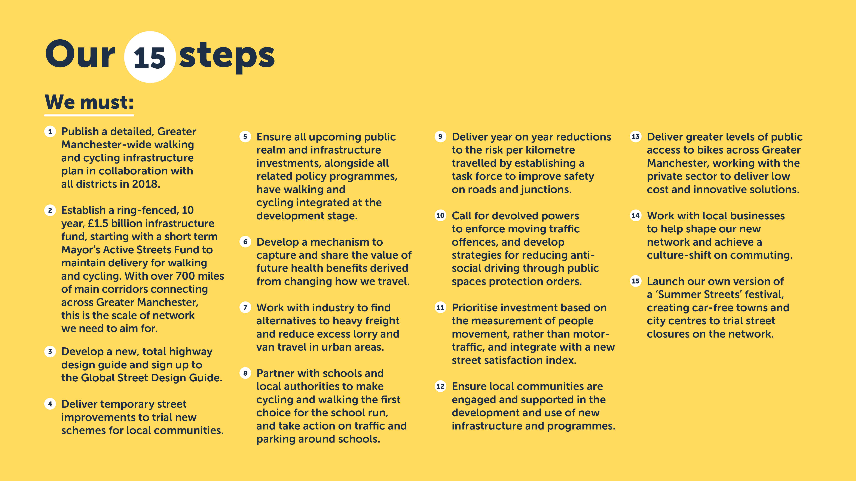
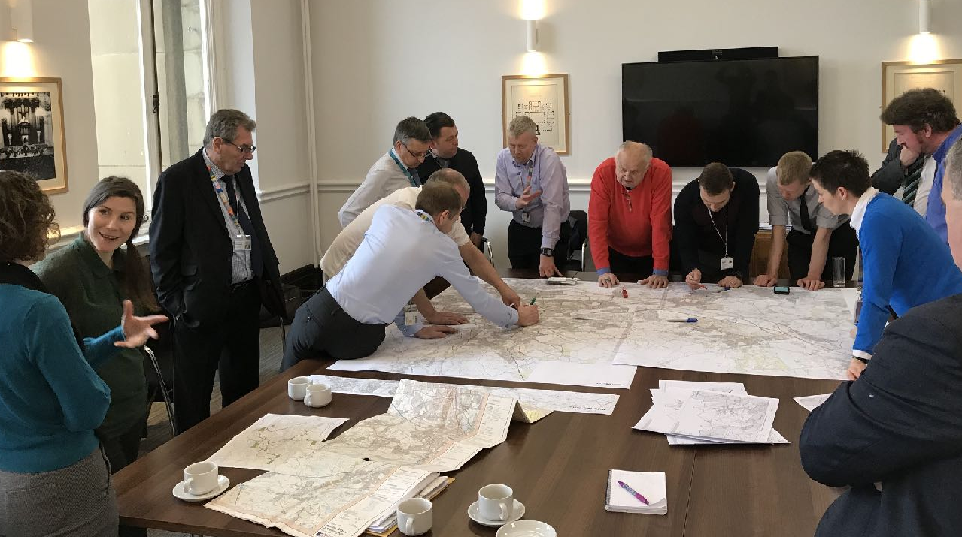

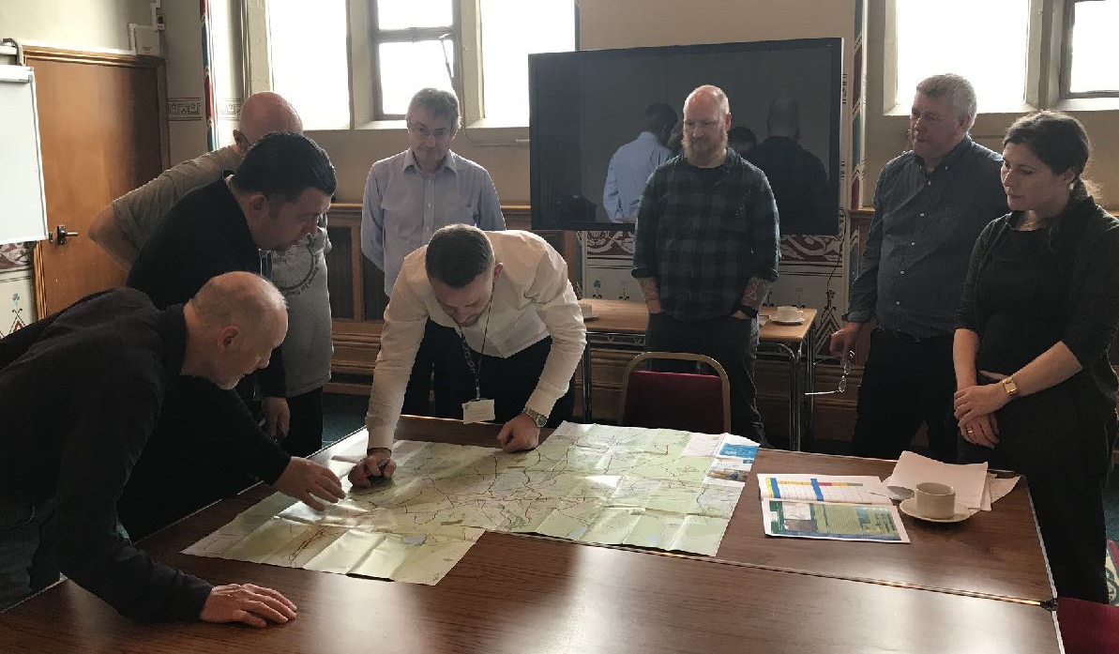
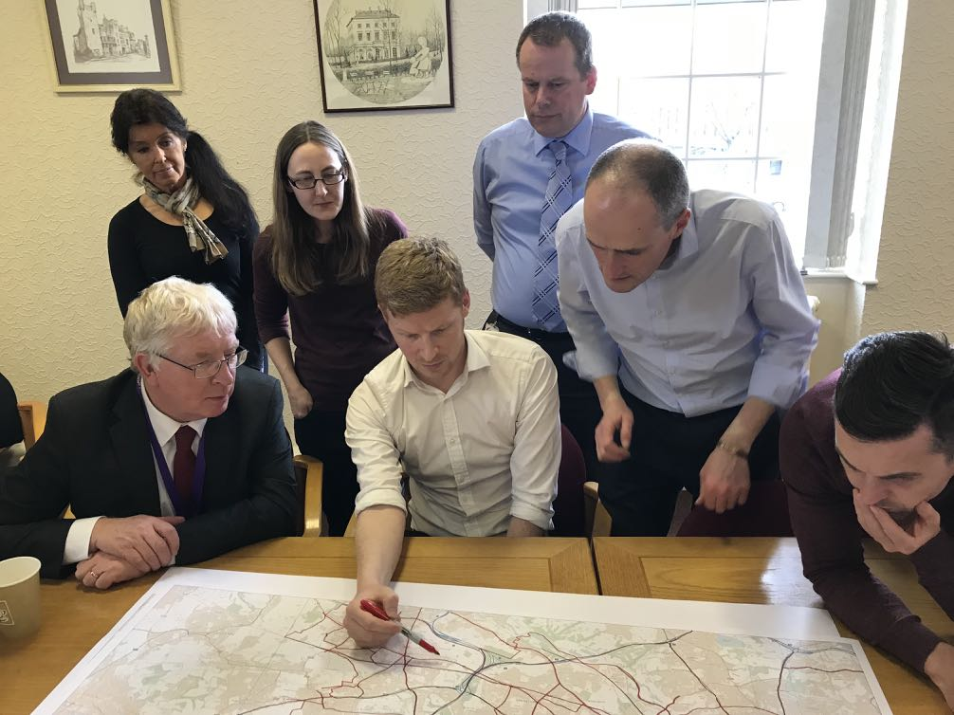
Notes:
Step one, you’ll see, was to publish a detailed, GM-wide cycling and walking infrastructure plan.
June 2018
1] Put in the hands of the districts
2] Their choice, even to do nothing. (not evenly funded, ambition led funding, creating a healthy competition)
3] We didn’t touch pen

Slide 3
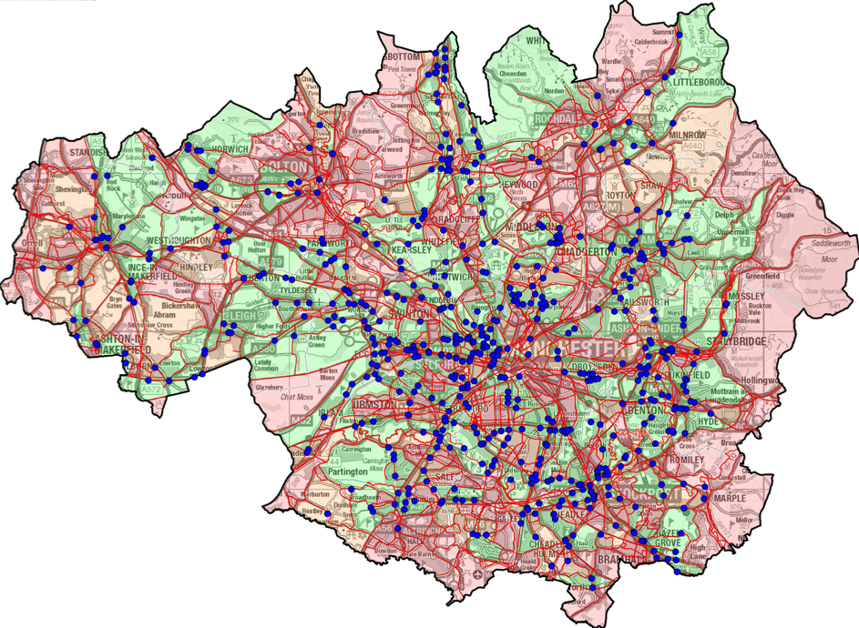
Greater Manchester: before (areas in red denote areas that are not easy to access on foot or by bike)
Notes:
I said from the beginning that the districts must own this. The network planning was district led, they held the pen at all stages
We took a layered approach,
focusing on obstacles in people’s way, not big statement projects [necessary but slow]

Slide 4
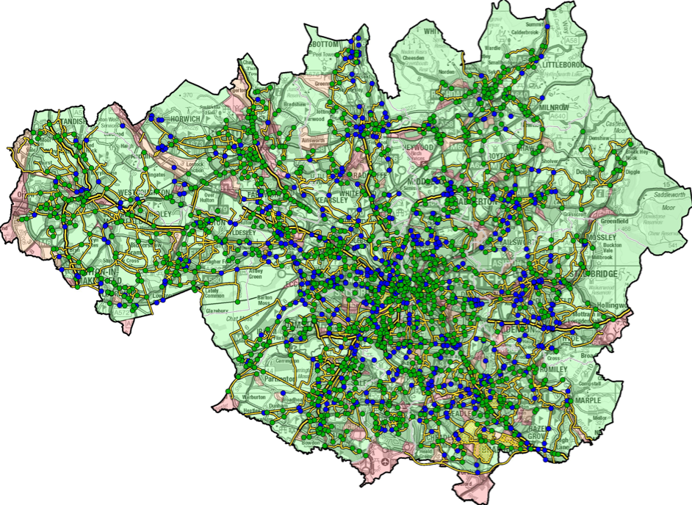
Greater Manchester: after (the vast majority of GM would be accessible)
Notes:
As you can see with this ‘after’ map, we’ve opened up most of GM. The positive peer pressure that resulted from the districts seeing what each other is planning has led to widespread ambition.

Slide 5
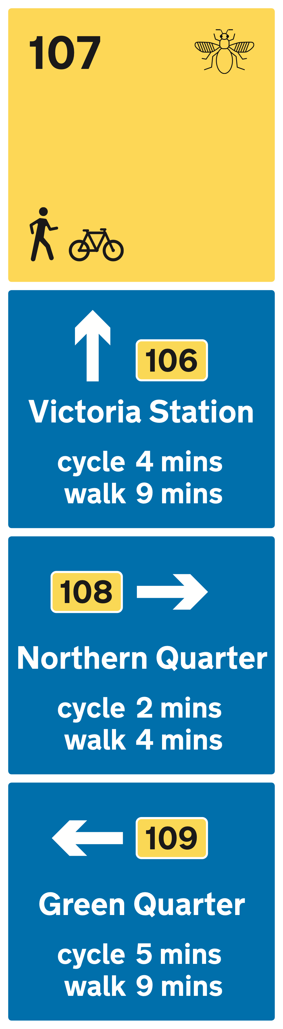
Crossing Point
Start
8
Decision Point
4
5
6
7
8
Finish
Proposed wayfinding system and signage: a signifier of quality
Notes:
We’ve also got a way-finding system that must be a signifier of quality. Our standards are absolute and non-negotiable - they must be fit for a double buggy and a competent 12 year old. That means in practice the network can be used by people of all ages, abilities and disabilities.

Slide 6

Beelines (now ‘Bee Network’) published in June 2018
Notes:
One thing we’ve learnt throughout this process is being careful with what we call things. So in order to move quickly, and in keeping with empowering rather than convincing, we presented this infrastructure plan as a proposal ‘proposal’ and Made to Move was a ‘report’ - it’s not too scary and if well received, it virtually becomes policy.

Slide 7
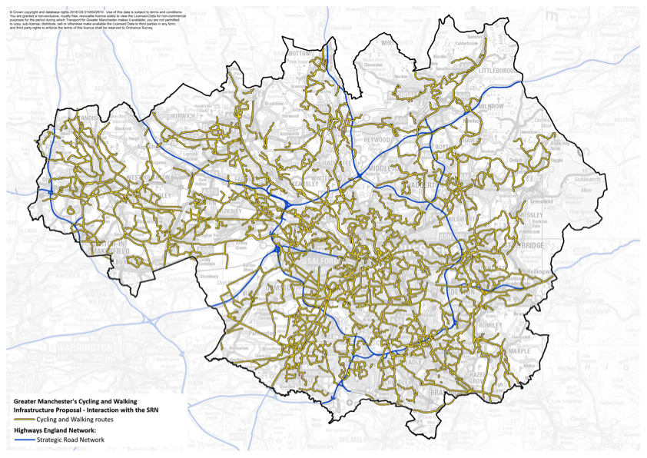
MappingGM
Bee Network
& Motorways
MappingGM platform has allowed us to make first draft of network public for comment
Notes:
Also allowed us to take bold steps, such as consult the public immediately on this proposal
mappingGM. [describe]
We’ve had 4,000 comments on the proposed network and each one is being used to refine the next draft.
Give ownership to communities,
Given politicians and councillors the courage to support
With mappingGM you can also overlay [clickable layers] other transport infrastructure and modes so we can see where parking is required and which severance points are a priority. Ensuring we have good integration.

Slide 8
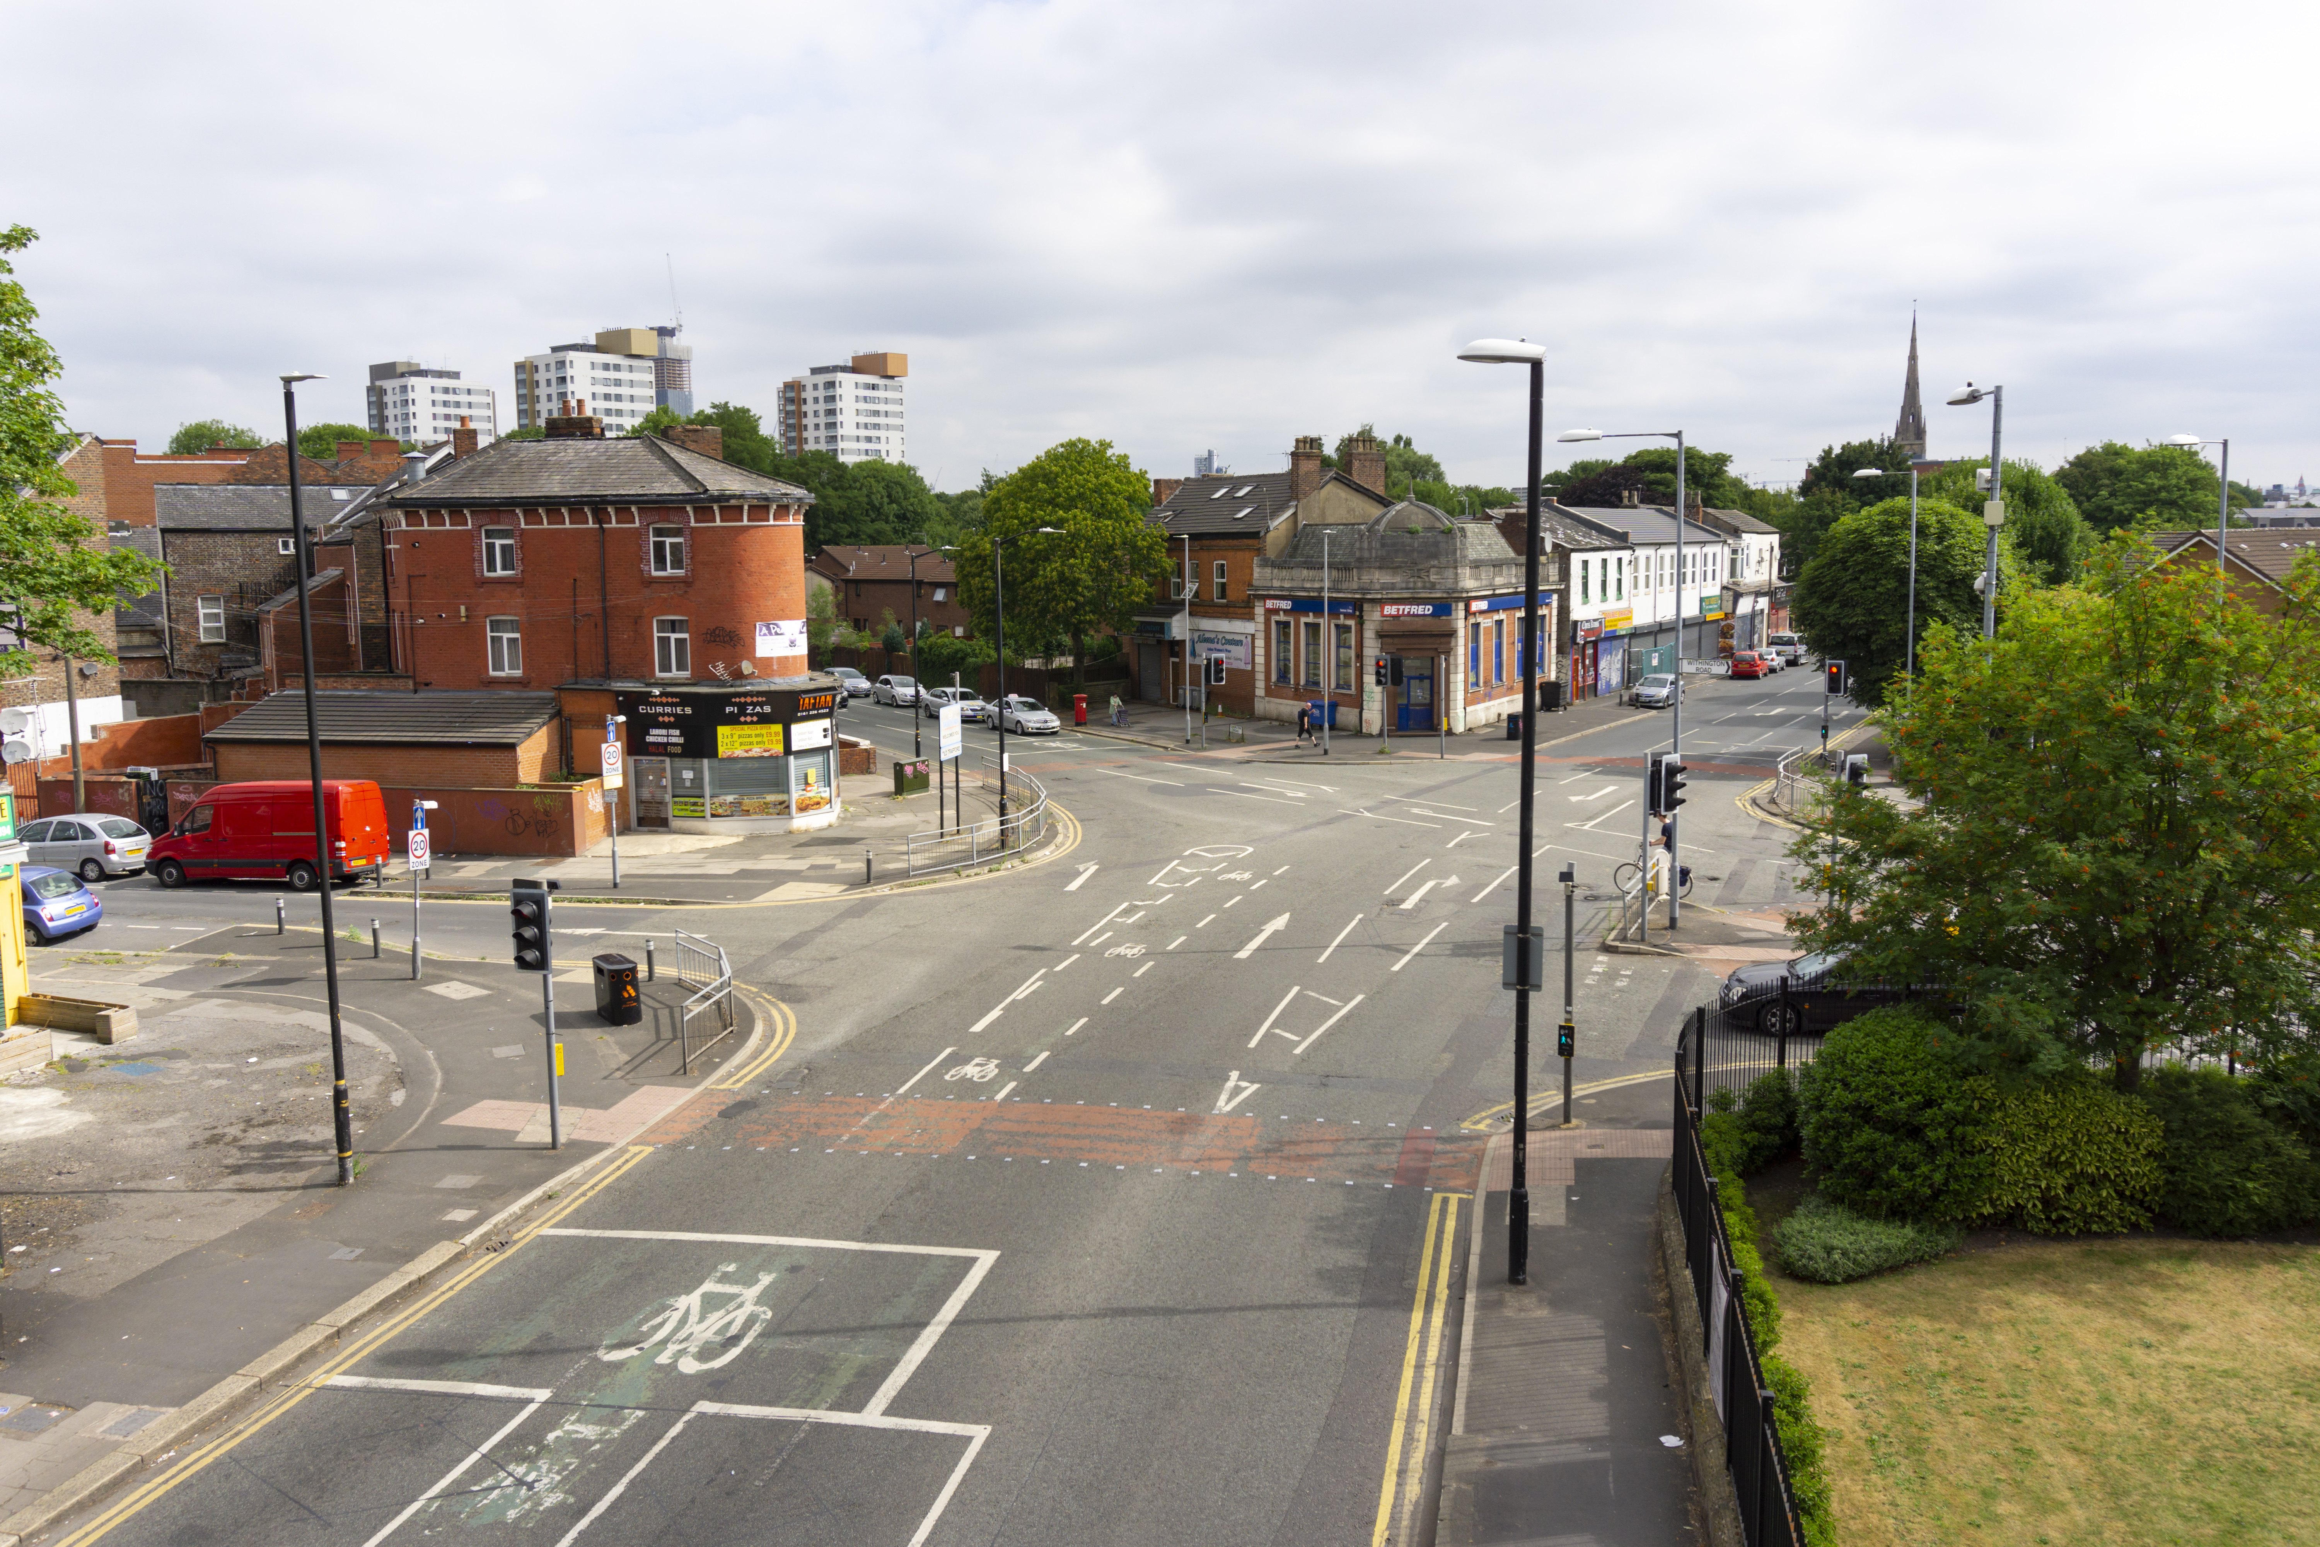
Junction in Whalley Range, near Chorlton: before
Notes:
Another important part of selling the vision is high quality visualisations.
This is a junction in Whalley Range, part of Chorlton’s cycling and walking route.

Slide 9
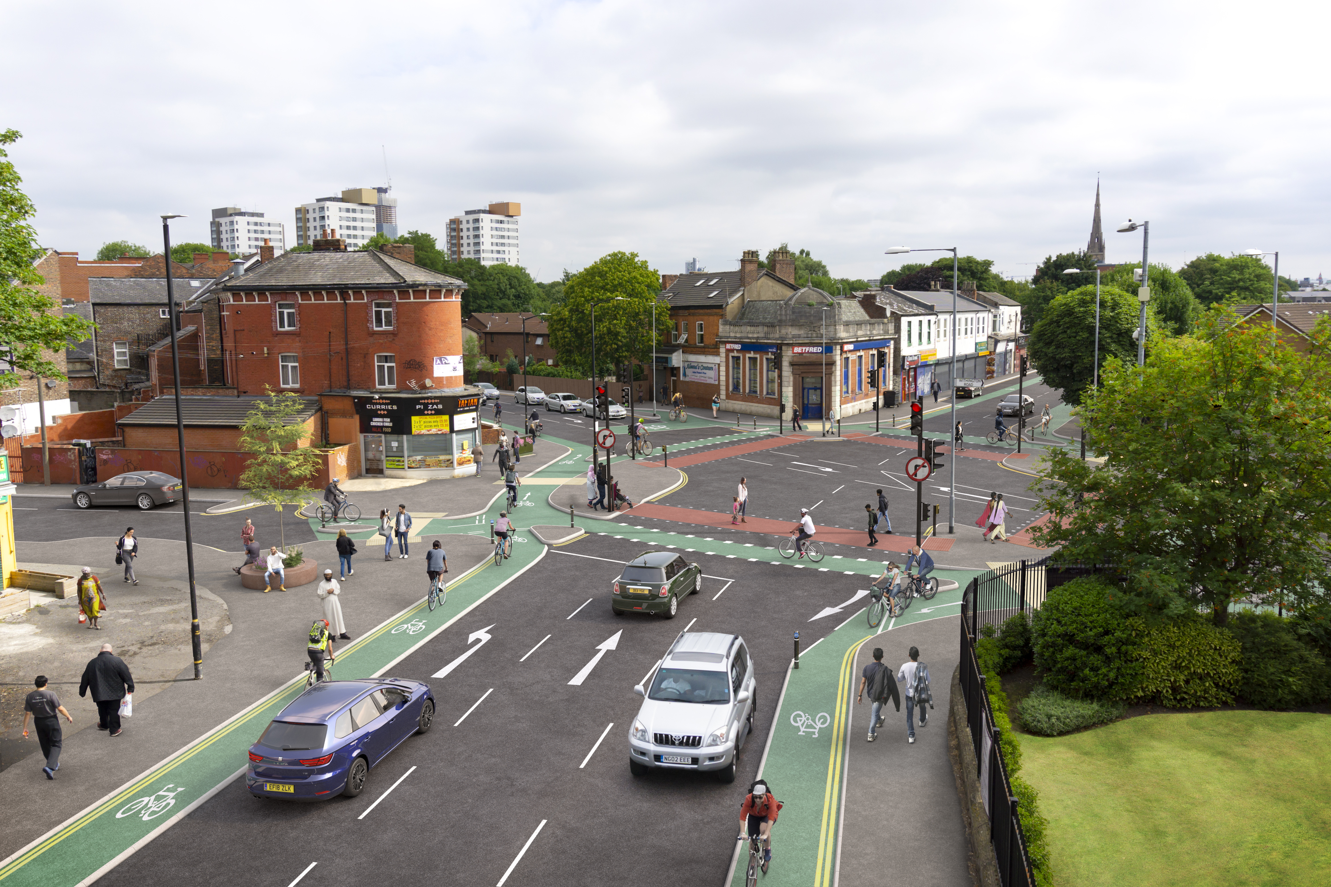
Junction in Whalley Range, near Chorlton: after
Notes:
Where would you prefer to live?

Slide 10
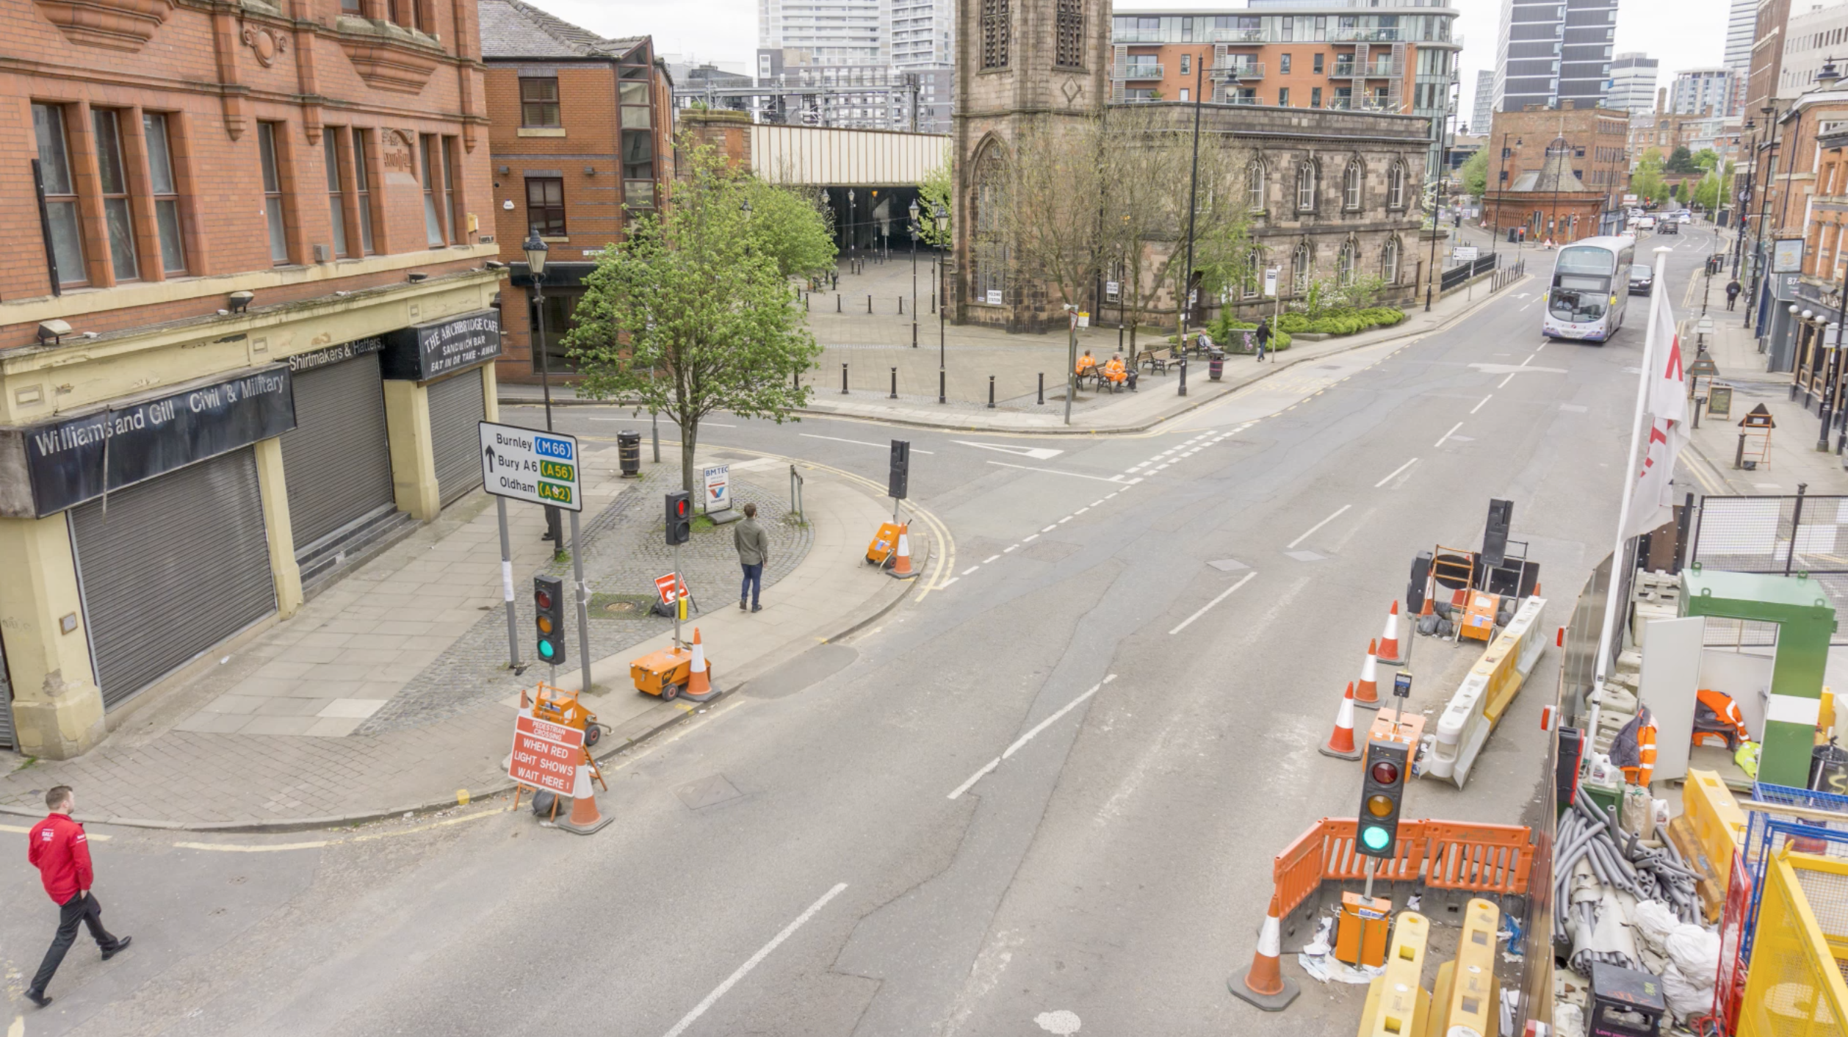
Chapel Street East, Salford: before
Notes:
And again, here’s Chapel Street East in Salford.

Slide 11
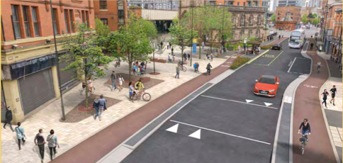
Chapel Street East, Salford: after
Notes:
We expect this consultation to begin in the next month or so.

Slide 12
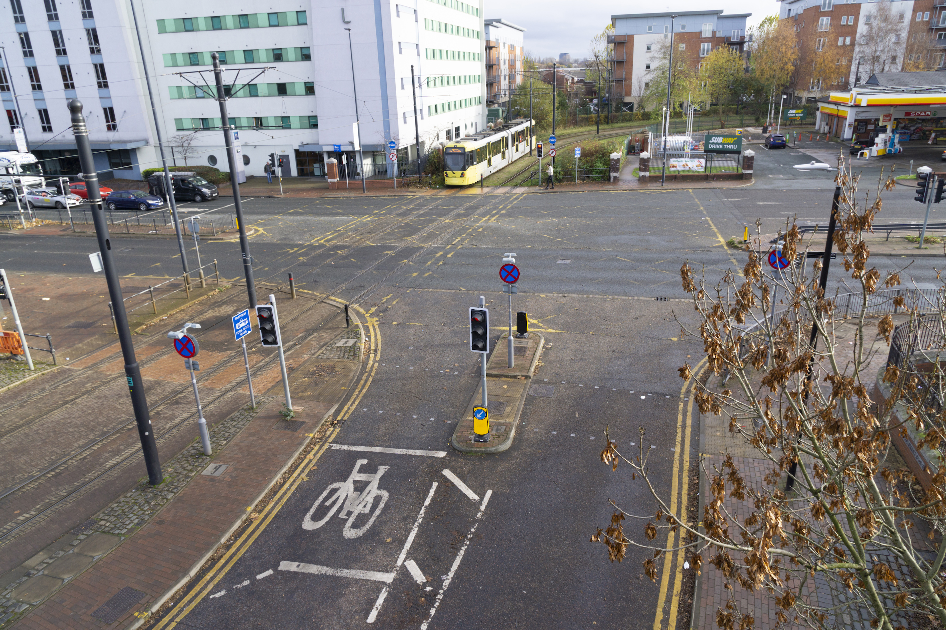
Merchants Quay, Salford: before
Notes:
And lastly here’s Merchants Quay, again in Salford.

Slide 13
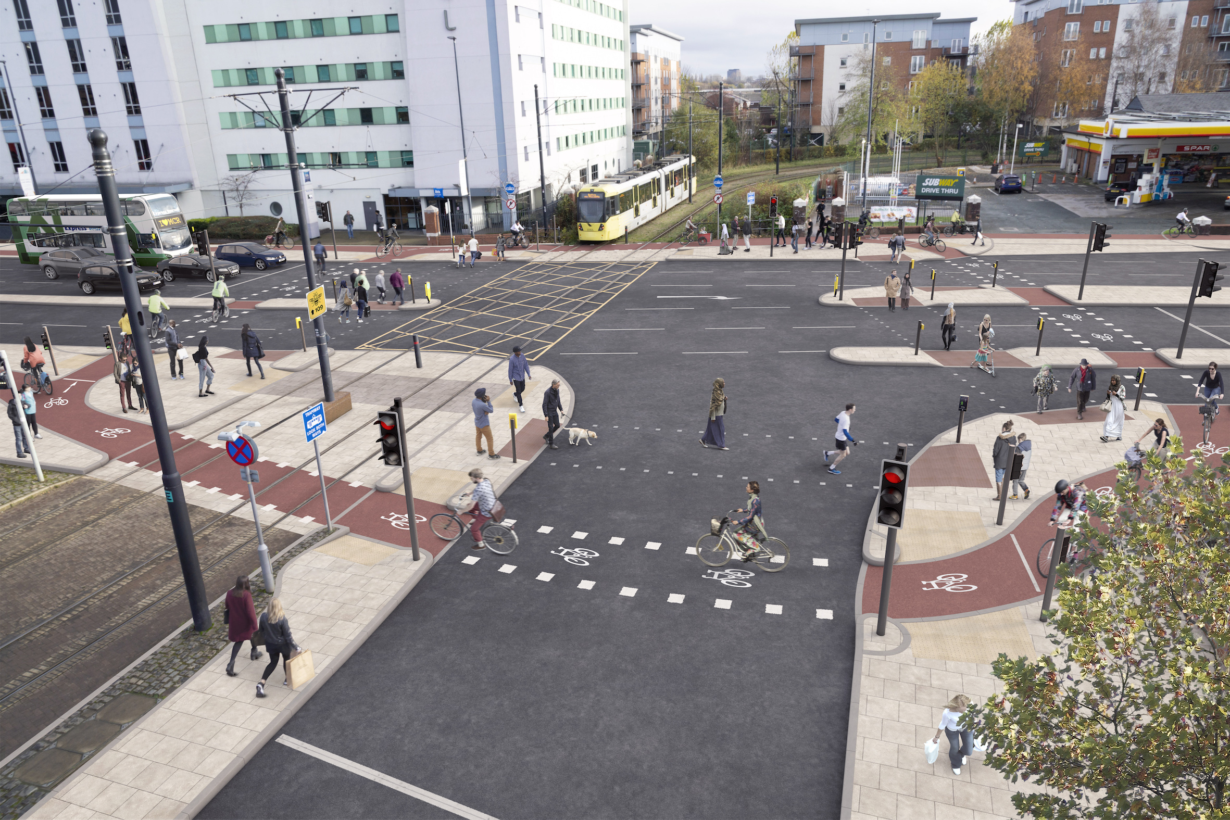
Merchants Quay, Salford: after

Slide 14
-24 schemes
-Total planned spend 67m
-39m MCF / 28m other contributions
-144 new or upgraded crossings
-26 miles of new routes
-9 miles of Dutch style segregated cycle lanes
Notes:
Taken submissions -each has a set of stringent requirements to ensure it meets our tests in quarterly tranches.
This is a summary at tranche 3.
We’ll be publishing tranche 4 at the end of March.
We are seeing a rapid acceleration on quality and ambition already for reasons I will explain in a moment.

Slide 15
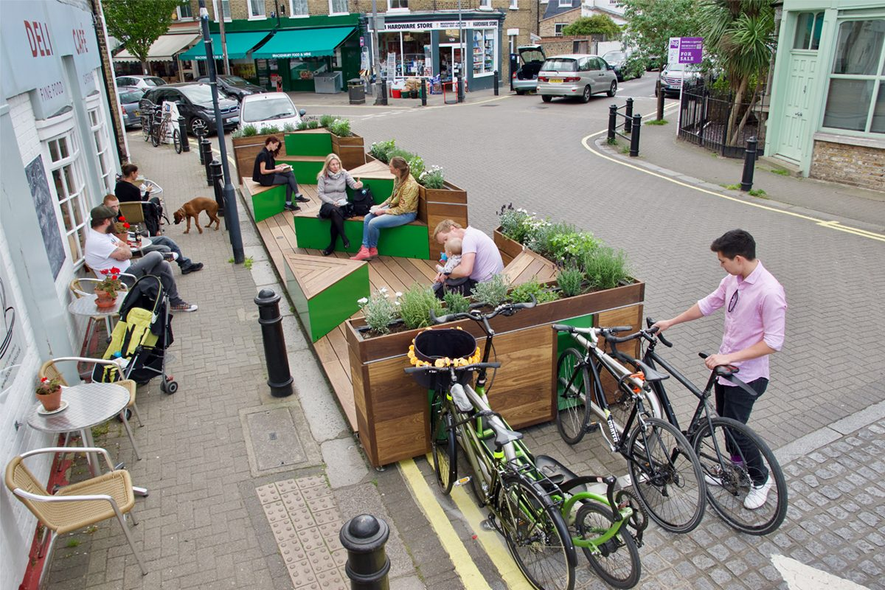
Parklets, like this one in London, are a concept we’d like to test in GM
Notes:
Parklets are another concept we’re keen on rolling out.
This is one in Hackney but watch this space for one popping up in GM quite soon.

Slide 16
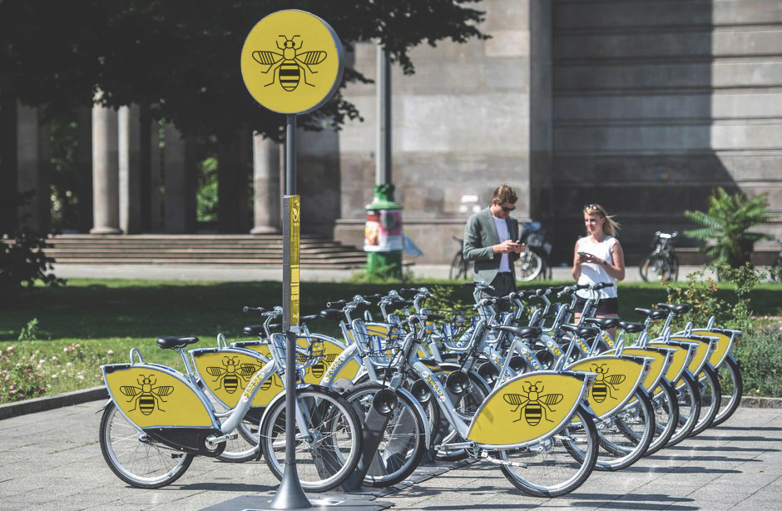
We are currently exploring options for a GM bike hire scheme
Notes:
In terms of bike hire, again, the wheels are turning with this and we hope to be able to say more in the next few months. But being as we have to address all 10 boroughs and be sure it will work well, it’s a massive project.

Slide 17
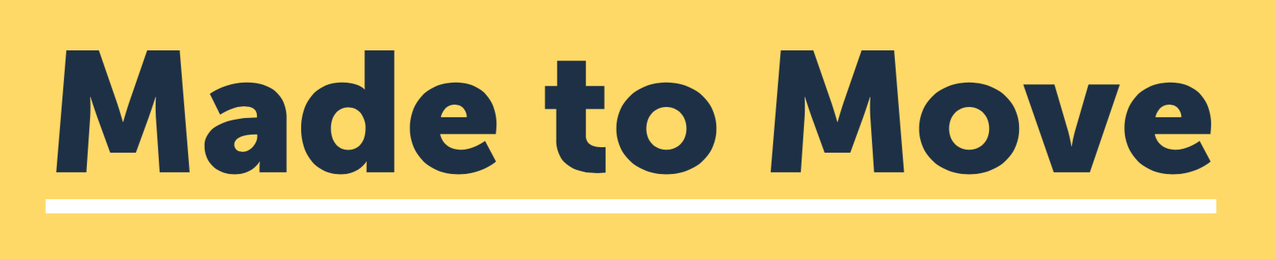
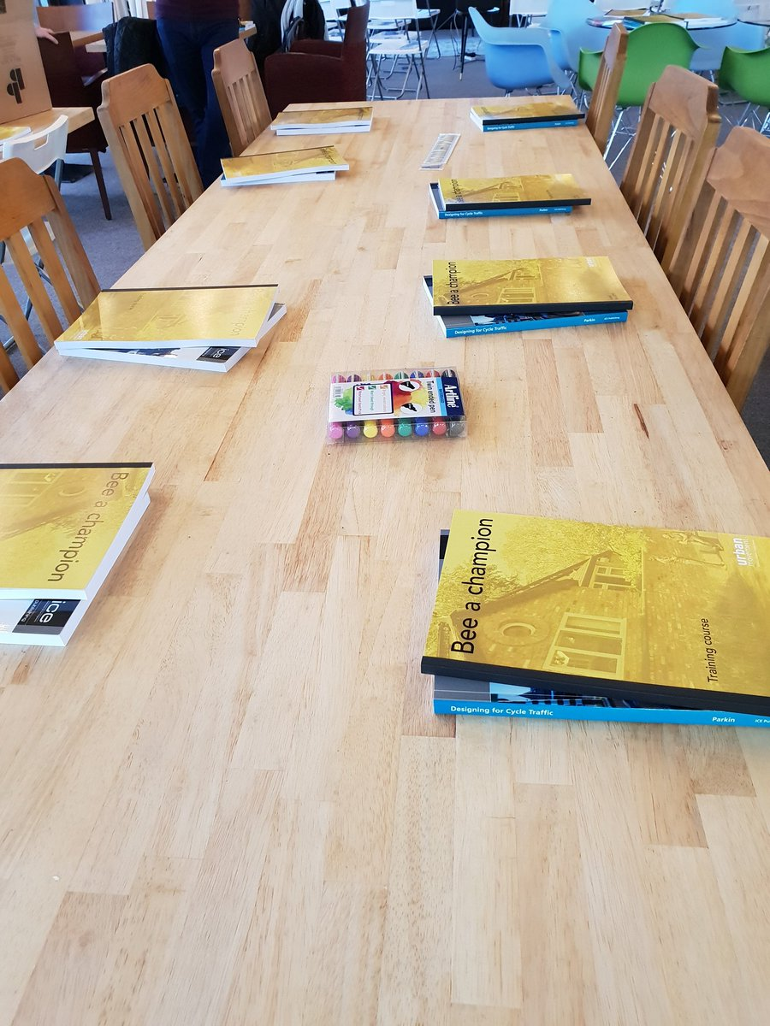
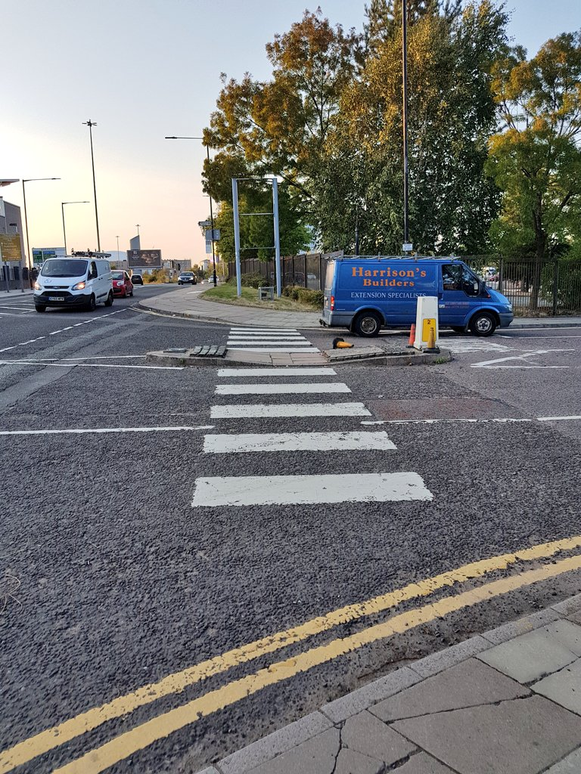
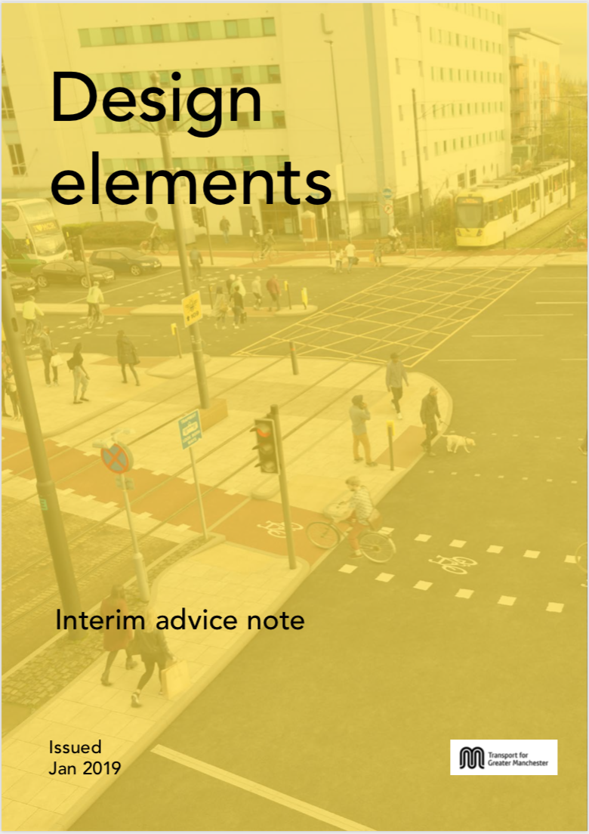
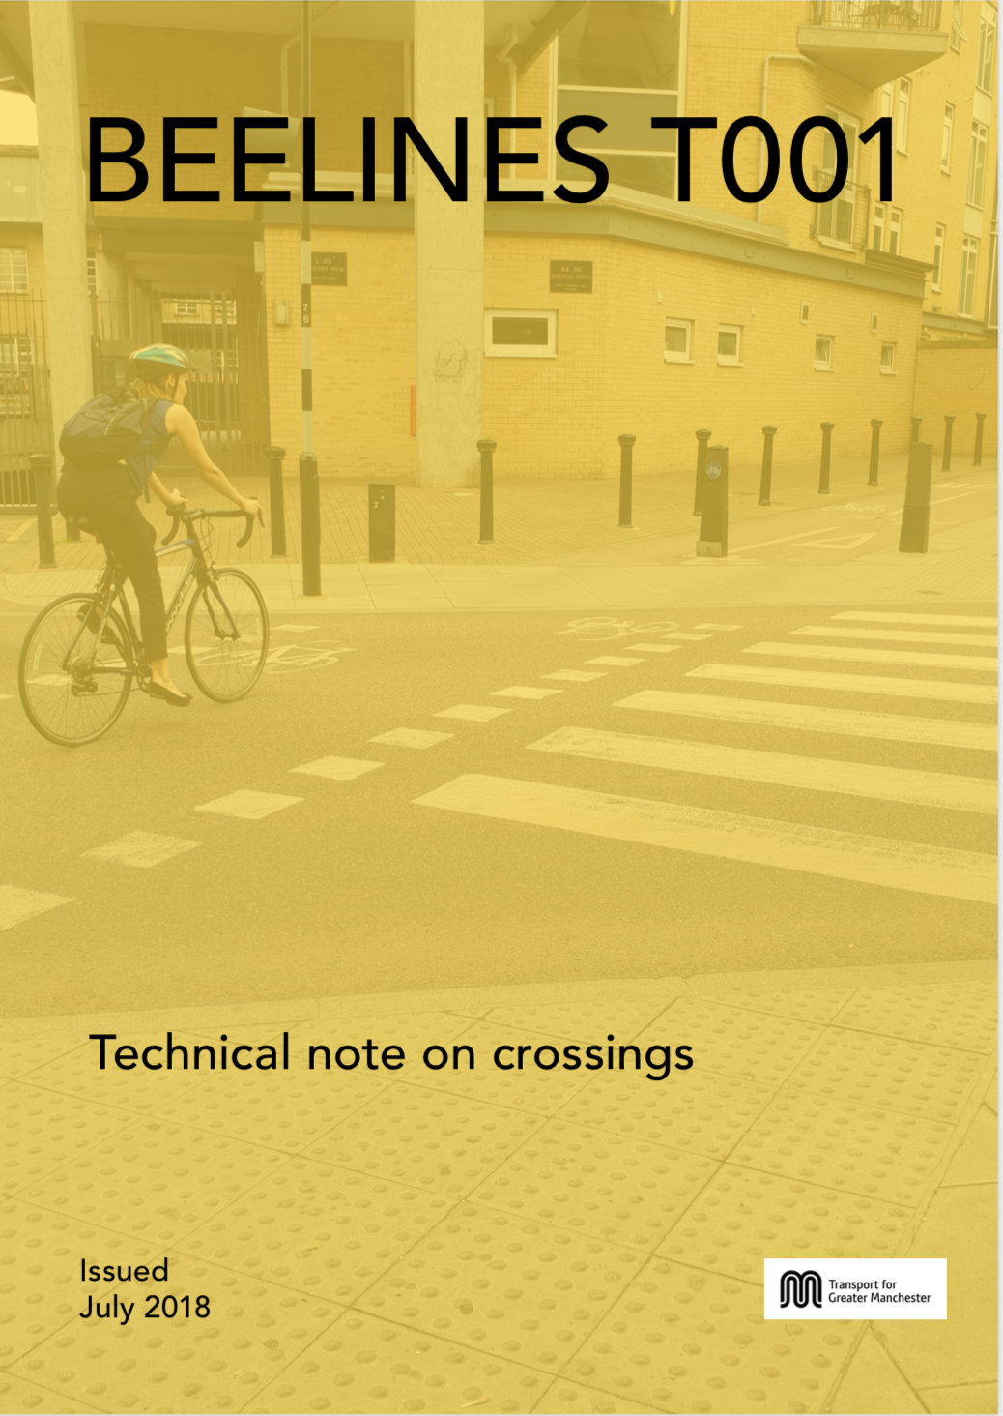
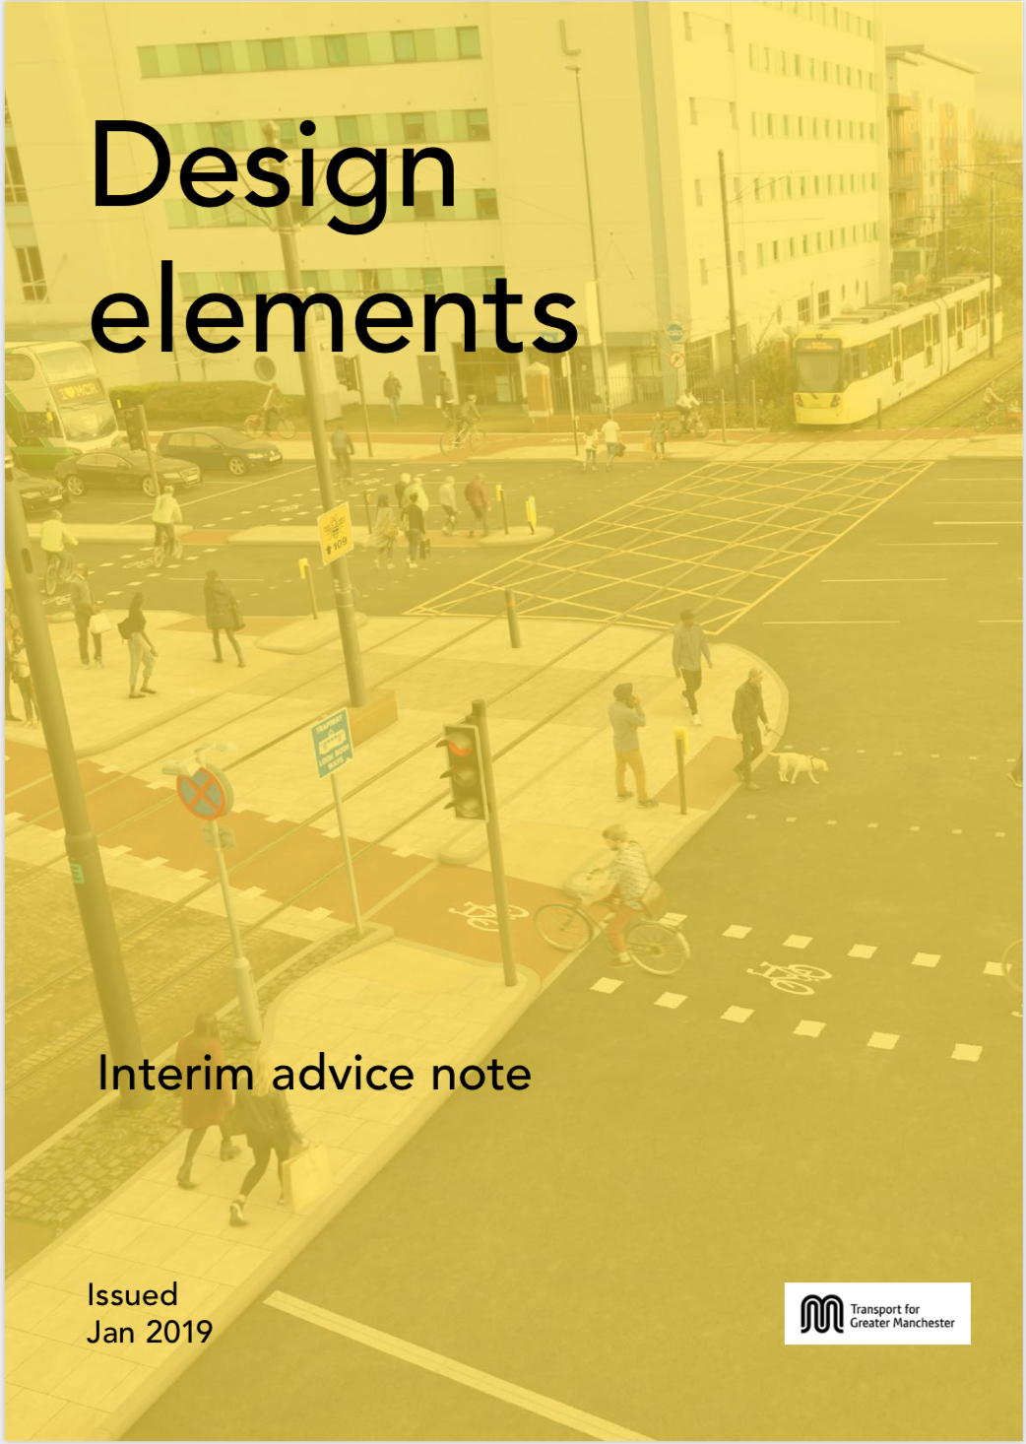
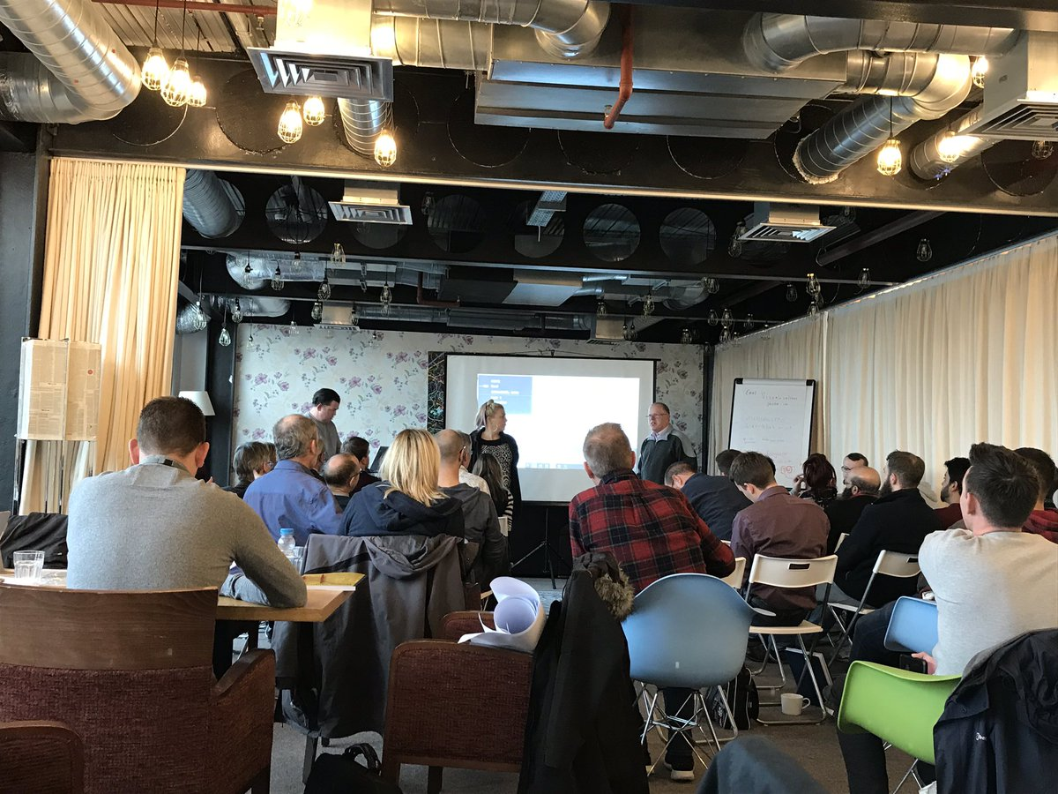

January 2019
Zebra Study
November
Infrastructure Design Course
Ongoing
Technical Notes
Notes:
Behind the scenes:
We’ve trained up 37 Champions from the districts,
we’re punishing on-going technical notes
working towards a comprehensive street design guide to cover every aspect to ensure consistency in all aspects.
We are about to begin a study looking at side road zebras this year -the sight of most collisions- with a view to submitting evidence to the DfT to help them and to guide what we do in GM, to ensure whatever we do is robustly defensible.

Slide 18
Cycling and walking | Travelling without cars
Cyclists and pedestrians | People on bikes People on foot
Encouraging people to walk or cycle | Enabling people to not have to drive / giving an alternative to the car
Delivering a cycling and walking scheme | Creating more pleasant places to live, work and socialise
Using the right language is critical to behaviour change
Notes:
I wanted to leave you with a point about how language is so important and it’s something I’ve been victim to in media interviews.
We must talk to people about things they are interested in, not what we are interested in.
So many people get switched off by the word cycling or cyclist, so instead be focus on taking about the outcome. If that outcome is not something people want, then we shouldn’t be doing it.
We have a fantastic product [film] that not even the most anti cycling person could refute, So we need to stop getting bogged down in squabbles about how hard the journey is and insrtead do a much better job of painting the picture of the detonation.

Slide 20
Thank you!

