Slide 1


Slide 2

APPGCW Investing in cycling and walking to achieve net zero

Slide 3


Slide 4
APPGCW Investing in cycling and walking to achieve net zero

Slide 5
Chair:
Selaine Saxby MP
Co-Chair, All Party Cycling and Walking Group

Slide 6
Chair:
Selaine Saxby MP
Co-Chair, All Party Cycling and Walking Group
Dr Ian Philips
Senior Research Fellow, Institute for Transport Studies, University of Leeds
Dr Llinos Brown Research Fellow, Institute for Transport Studies, University of Leeds
Susan Claris, Transport Planner, Arup
Ruth Cadbury MP Co-Chair, All Party Group for Cycling and Walking
Laurence Oakes Ash
CEO, City Science

Slide 7
Dr Ian Philips
Senior Research Fellow, Institute for Transport Studies, University of Leeds

Slide 8

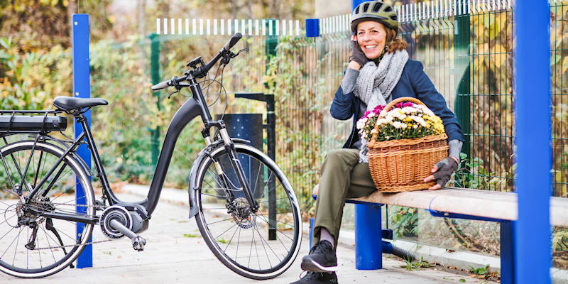
E-bikes’ capability to reduce transport CO₂
emissions.
Dr Ian Philips
Dr Ian Philips
Presentation to All Party Parliamentary Group for Cycling and Walking November 5th 2020
i.Philips@leeds.ac.uk
Notes:
Image source: https://unsplash.com/photos/tNTvX60SN4o

Slide 9
E-bike carbon reduction capability
E-bikes could reduce car CO₂ by 50%
Biggest savings in rural and suburban areas
E-bikes could help people who are most affected by rising transport costs.

Slide 10
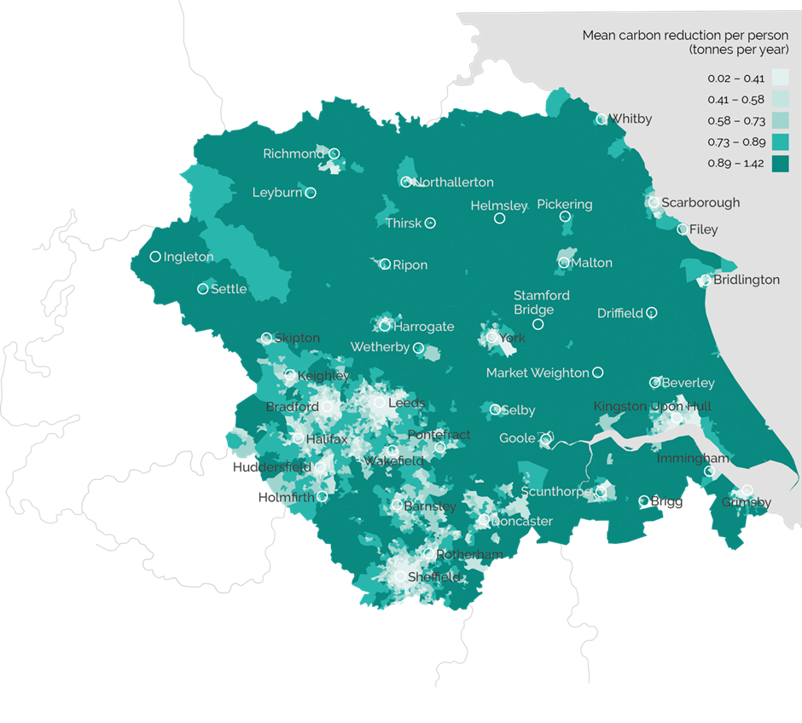
E-bikes carbon reduction capability higher outside cities.
1000kg per person per year
200kg per person per year

Slide 11
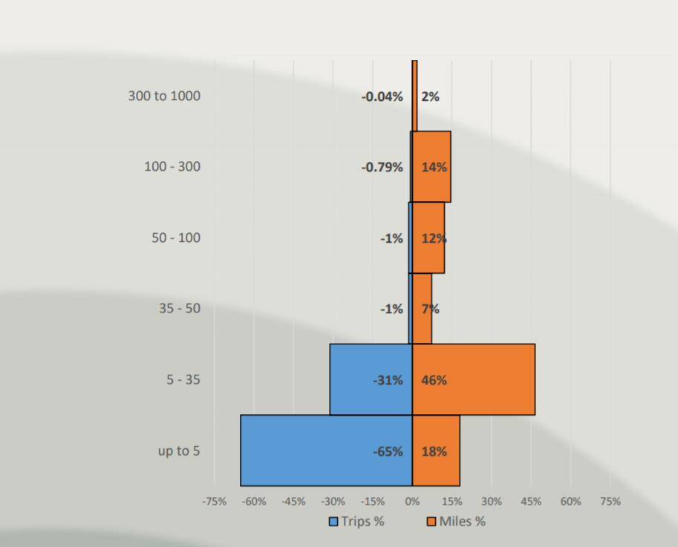
E-bikes can shift journeys over 5 miles to active travel
Source: https://www.local.gov.uk/sites/default/files/documents/Professor%20Jillian%20Anable%20and%20Professor%20Greg%20Marsden.pdf

Slide 12
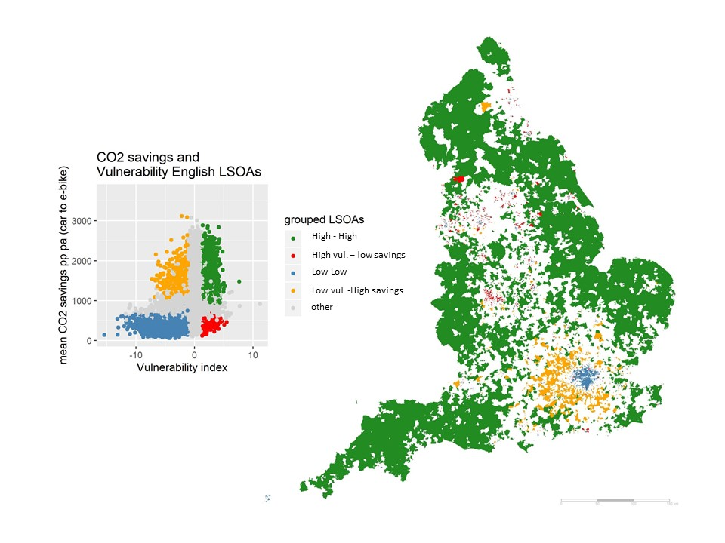
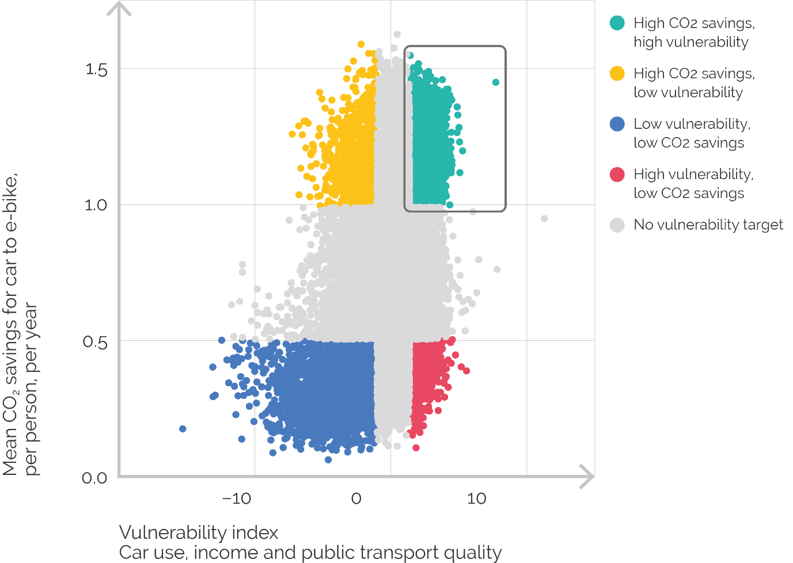
E-bikes and vulnerability to increase in motoring costs
low vulnerability
High CO₂ savings
High Vulnerability, high CO₂ Savings

Slide 13
Necessary change and hard choices
We didn’t want to do this but we did it because we had to
Source ONS: https://www.gov.uk/government/statistics/transport-use-during-the-coronavirus-covid-19-pandemic

Slide 14
Thanks
Policy briefing: https://www.creds.ac.uk/publications/e-bike-carbon-savings-how-much-and-where/
Paper pre-print: https://doi.org/10.13140/RG.2.2.27729.97120
i.Philips@leeds.ac.uk

Slide 15
Dr Llinos Brown
Research Fellow, Institute for Transport Studies, University of Leeds

Slide 16




Presentation title slide
Dr Llinos Brown
L.v.brown@leeds.ac.uk
COVID19 Transport,
travel & social adaptation study
Institute for Transport Studies – University of Leeds
Professor Greg Marsden
Professor Jillian Anable
Dr Llinos Brown
University of Stirling
Professor Iain Docherty
^{https://covid19transas.org/}

Slide 17
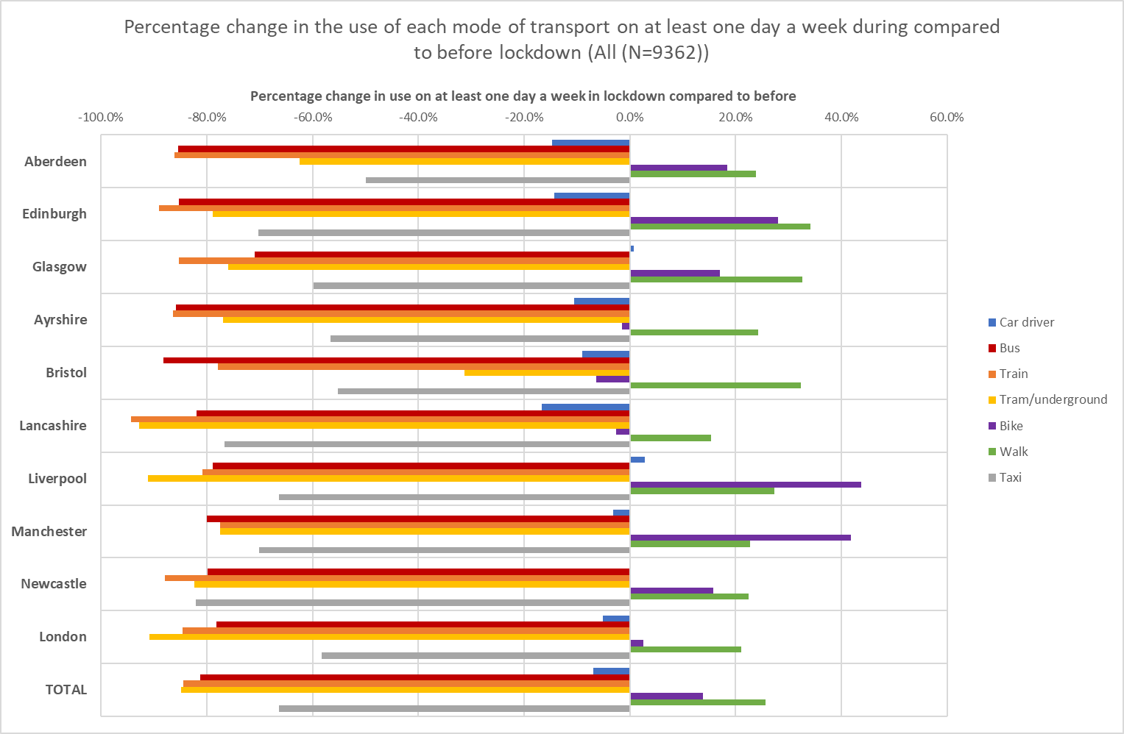
Full sized image slide
During lockdown
Public transport
Car use (driver) majority of locations
Walking
Cycling
Majority of locations
Anable, J., Brown, L., Docherty, I. and Marsden, G. (2020) COVID19 Transport, travel & social adaptation study - Wave 1 panel survey: interim findings

Slide 18
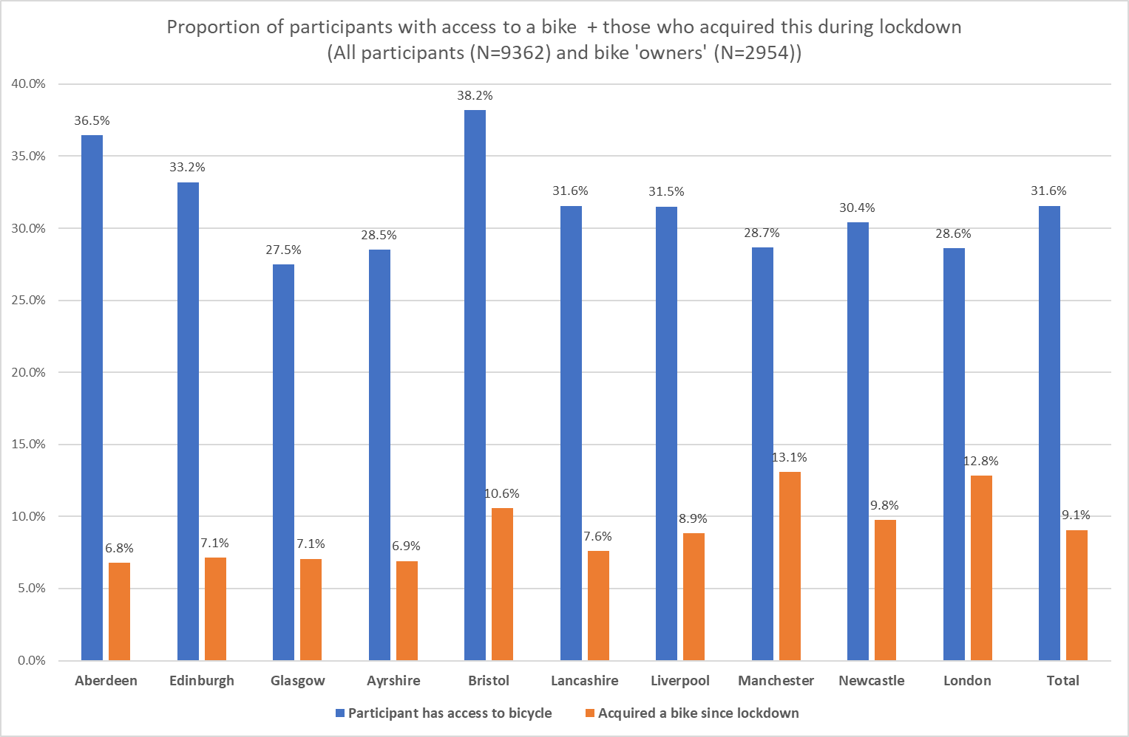
Text hierarchy and formatting information slide
Cycling has been for leisure purposes
Quieter roads
  Good opportunity to gain confidence
  Route change when traffic increased
Safety on roads is a concern and a barrier
Lots of purchasing of 2nd hand bikes
London Santander cycle hire scheme:
  Great for people with limited space and income
People are talking about e-bikes
  Especially in Glasgow
  Lack of knowledge about their range and price
Commuting by bike is a big ask for many people
  Commute is complex
  Fitness levels and fatigue at work
  Public transport and bikes

Slide 19
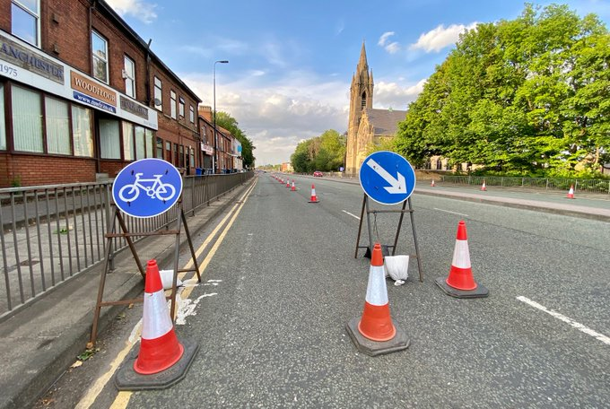
Text hierarchy and formatting information slide
Expectations on pop-up infrastructure were very (unrealistically) high
  Quantity of infrastructure to date is small
  Interviews and survey suggest awareness and use low (localised impacts)
Hard to evidence the impacts of infrastructure changes
  No before data
  Monitoring is challenging
  Noise in data is huge
Needs to be linked to localisation agenda (where bike competes)
See the investments as the end of the beginning
Image: Transport for Greater Manchester

Slide 20
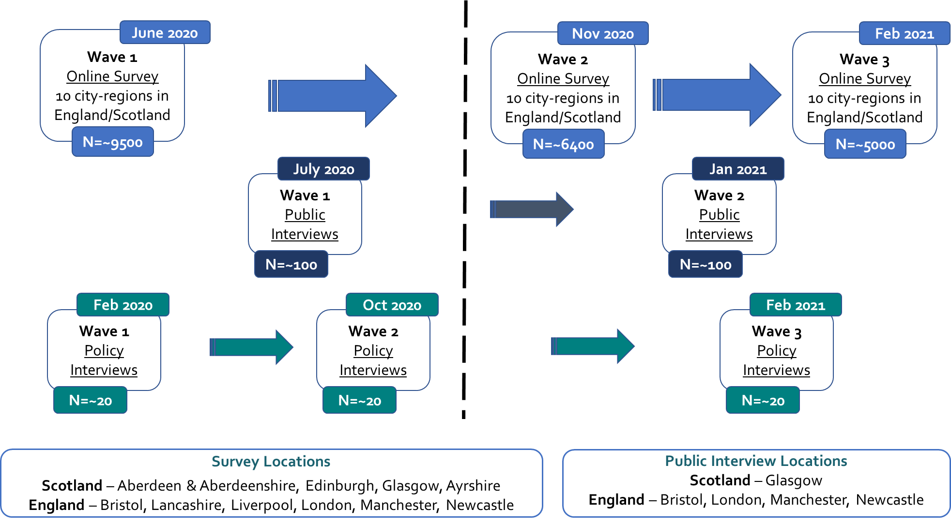
How to display schools and/or Faculties in your slides
Future rounds of research
Methodology
3 waves of online quantitative survey in 10 city-regions
2 waves of in depth interviews in 5 locations
3 waves of expert/ policy interviews

Slide 21
Text hierarchy and formatting information slide
Thank you ☺
L.V.Brown@leeds.ac.uk
For more information and additional findings:
https://covid19transas.org/outputs/findings/

Slide 22
Susan Claris
Transport Planner, Arup

Slide 23

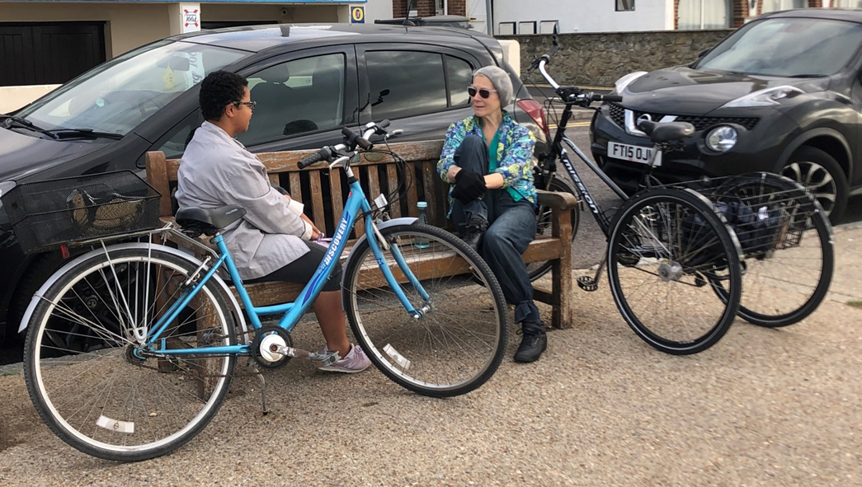
Cycling for Everyone
Investing in cycling and walking to achieve net zero
Susan Claris
Transport Planner, Arup
Vice President, Living Streets

Slide 24
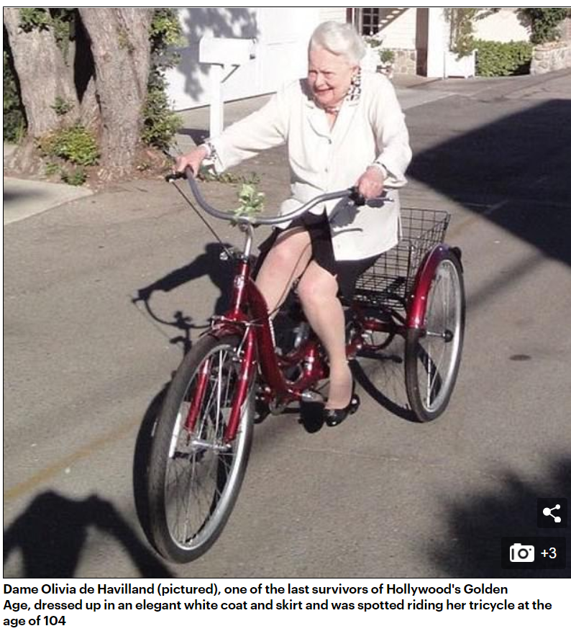
Cycling for Everyone: Overview
Barriers
Actions
  Policy
  Places
  People
Source: https://www.dailymail.co.uk/tvshowbiz/article-8488365/Go-like-wind-Hollywood-icon-Dame-Olivia-Havilland-riding-bike-age-104.html

Slide 25
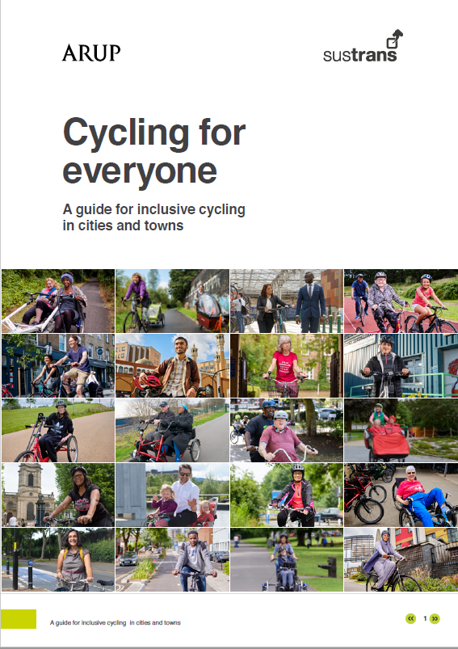
Inclusive Cycling (and walking)
Under-represented groups in cycling:
Women
Older people
People from ethnic minority groups
Disabled people
People at risk of deprivation
https://www.arup.com/perspectives/publications/research/section/cycling-for-everyone-a-guide-for-inclusive-cycling-in-cities-and-towns

Slide 26
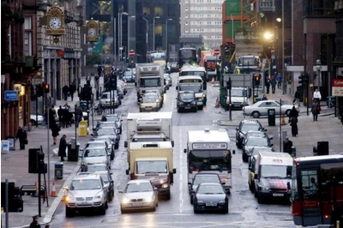
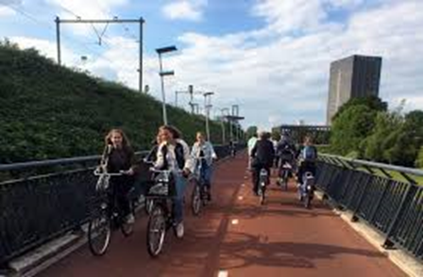
Barriers: places
  Road safety concerns
  Cycling infrastructure is not inclusive
  Cycling infrastructure does not reach all areas, or cater for all journeys
  A lack of public cycle share provision, including electric and adapted cycles
  Personal safety and security
  Integration at home, destinations and with public transport

Slide 27
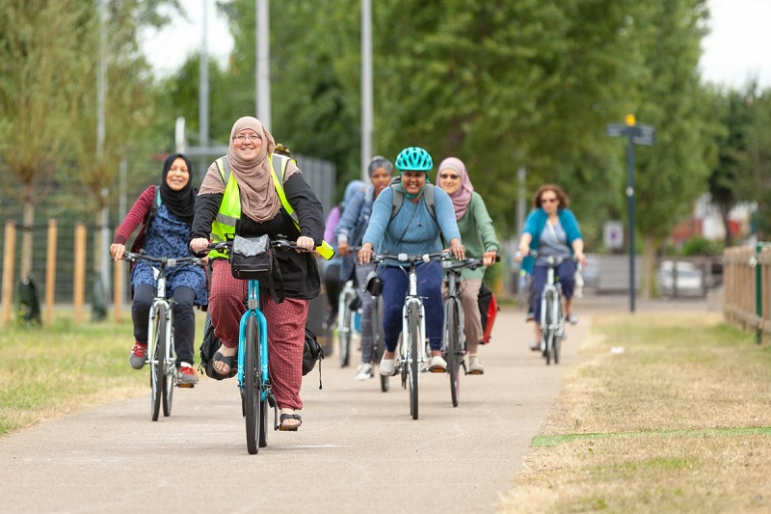
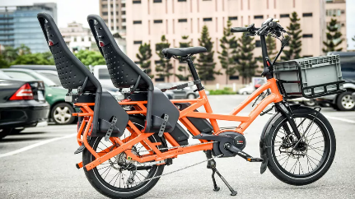
Barriers: people
  Do not associate cycling as something for people like them
  Accessibility or ownership of a cycle
  Cycling ability and/or confidence
  Fear of harassment

Slide 28
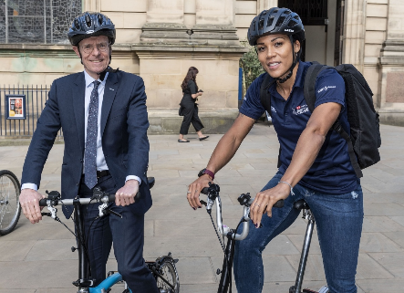
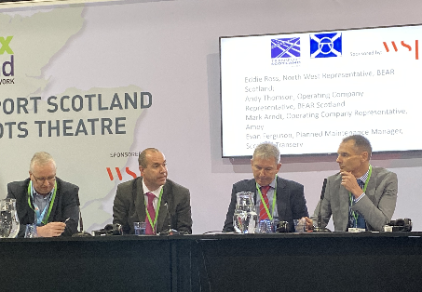
Barriers: governance
  Representation in decision making
  Engagement with the public is not representative
  Transport policy often ignores beneficiary need
  Cycling infrastructure standards
  Representation in marketing

Slide 29
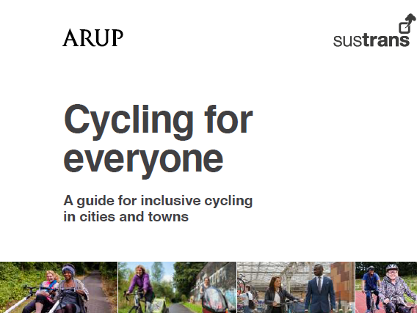

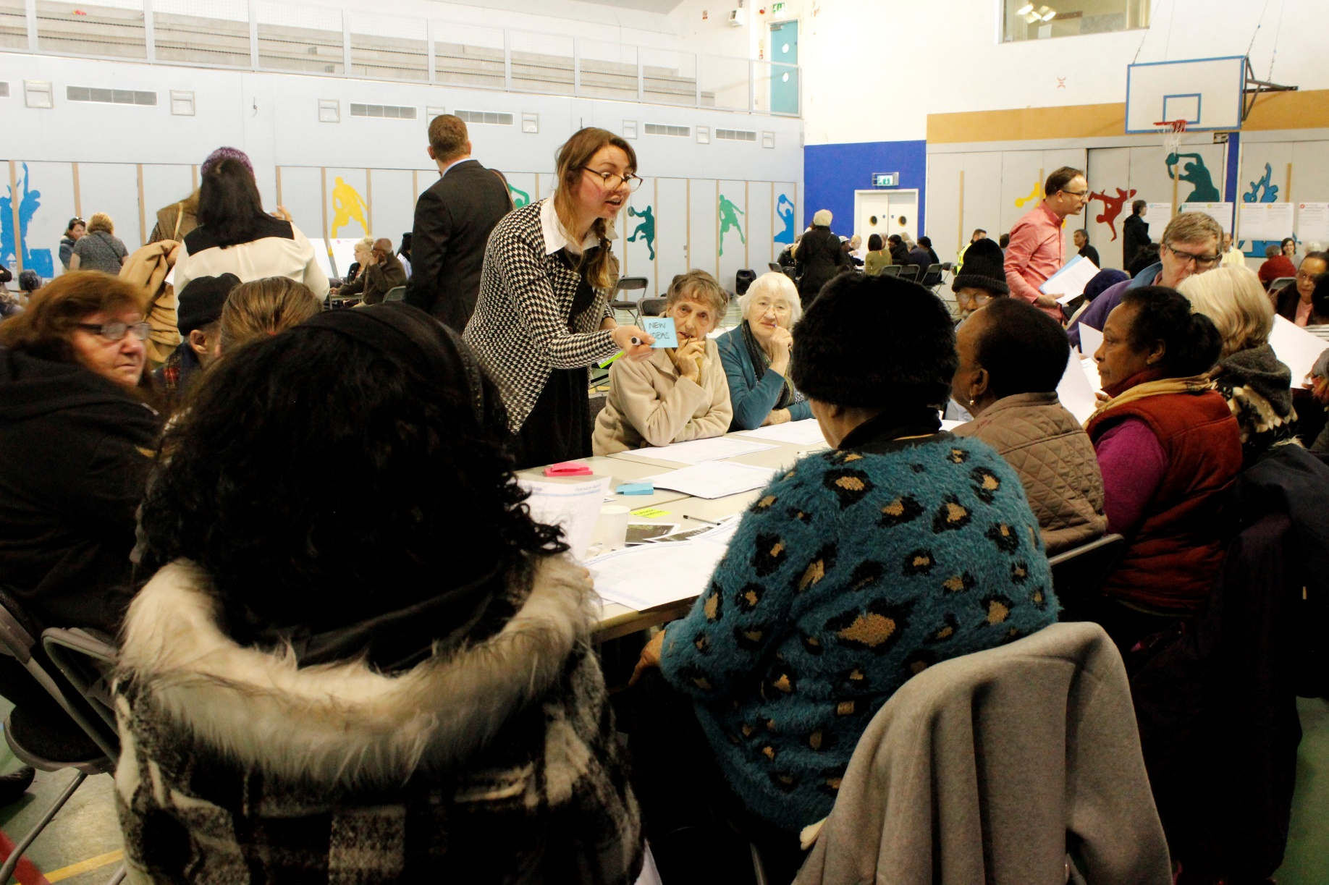
Cycling for everyone: A guide for inclusive cycling
1: Improve governance, planning and decision making
Design walking and cycling strategies and plans to address, and be evaluated against, how they reduce inequity
Increase diversity and representation in decision-making and the transport sector
Improve decision making through better evidence and public engagement

Slide 30
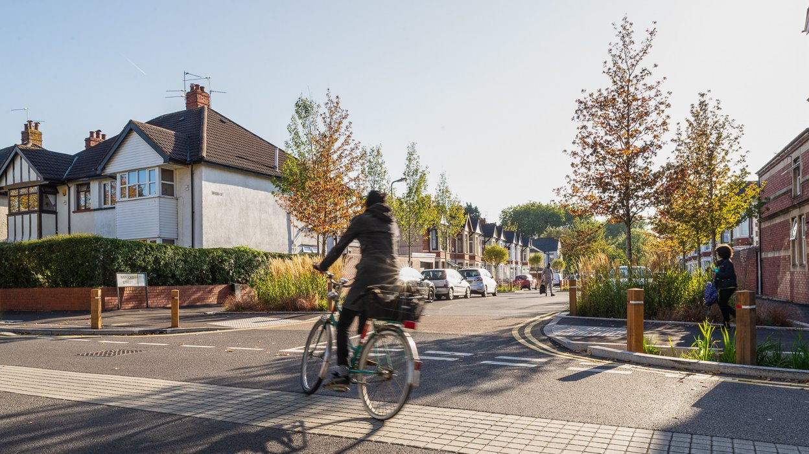
Cycling for everyone: A guide for inclusive cycling
2: Create better places for everyone to walk and cycle in
Improve road safety, primarily through protected space for walking and cycling, and low-traffic neighbourhoods
Address personal safety and harassment
Ensure walking and cycling infrastructure is fully inclusive

Slide 31
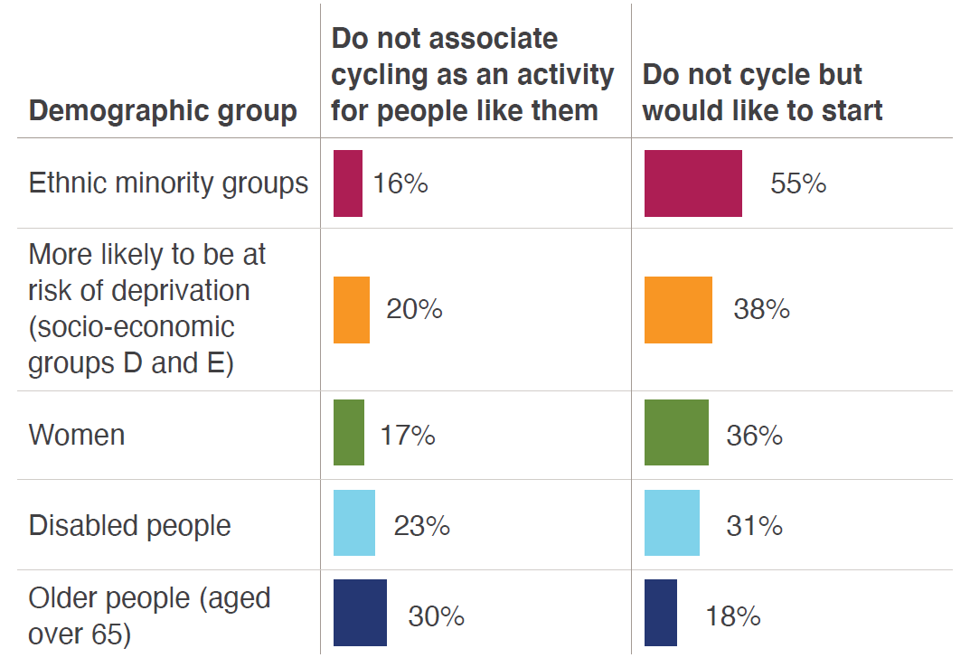
Cycling for everyone: A guide for inclusive cycling
3: Welcome and support all people to walk and cycle
Use inclusive language and imagery, and ensure walking and cycling is welcoming and celebrates diversity
Ensure cost is not a barrier to access a cycle
Offer free cycle training for all children and adults

Slide 32
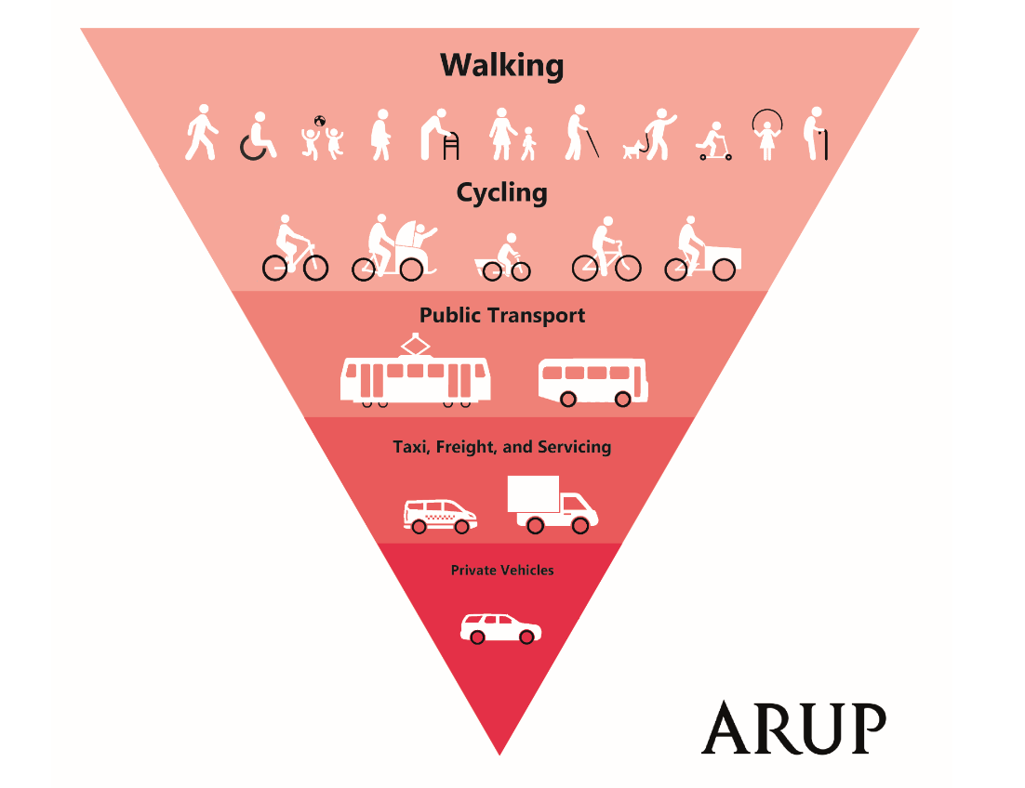



Walking for Everyone
https://www.arup.com/expertise/industry/walking-and-cycling
susan.claris@arup.com
@susanclaris

Slide 33
Laurence Oakes Ash
CEO, City Science

Slide 34
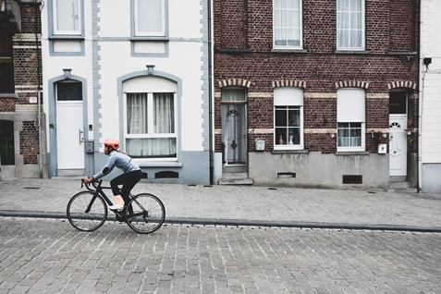

ADDRESSING THE CARBON CHALLENGE: UPDATE ON PLACE-BASED DECARBONISATION RESERCH
APPGCW Webinar | November 2020
loa@cityscience.com

Slide 35
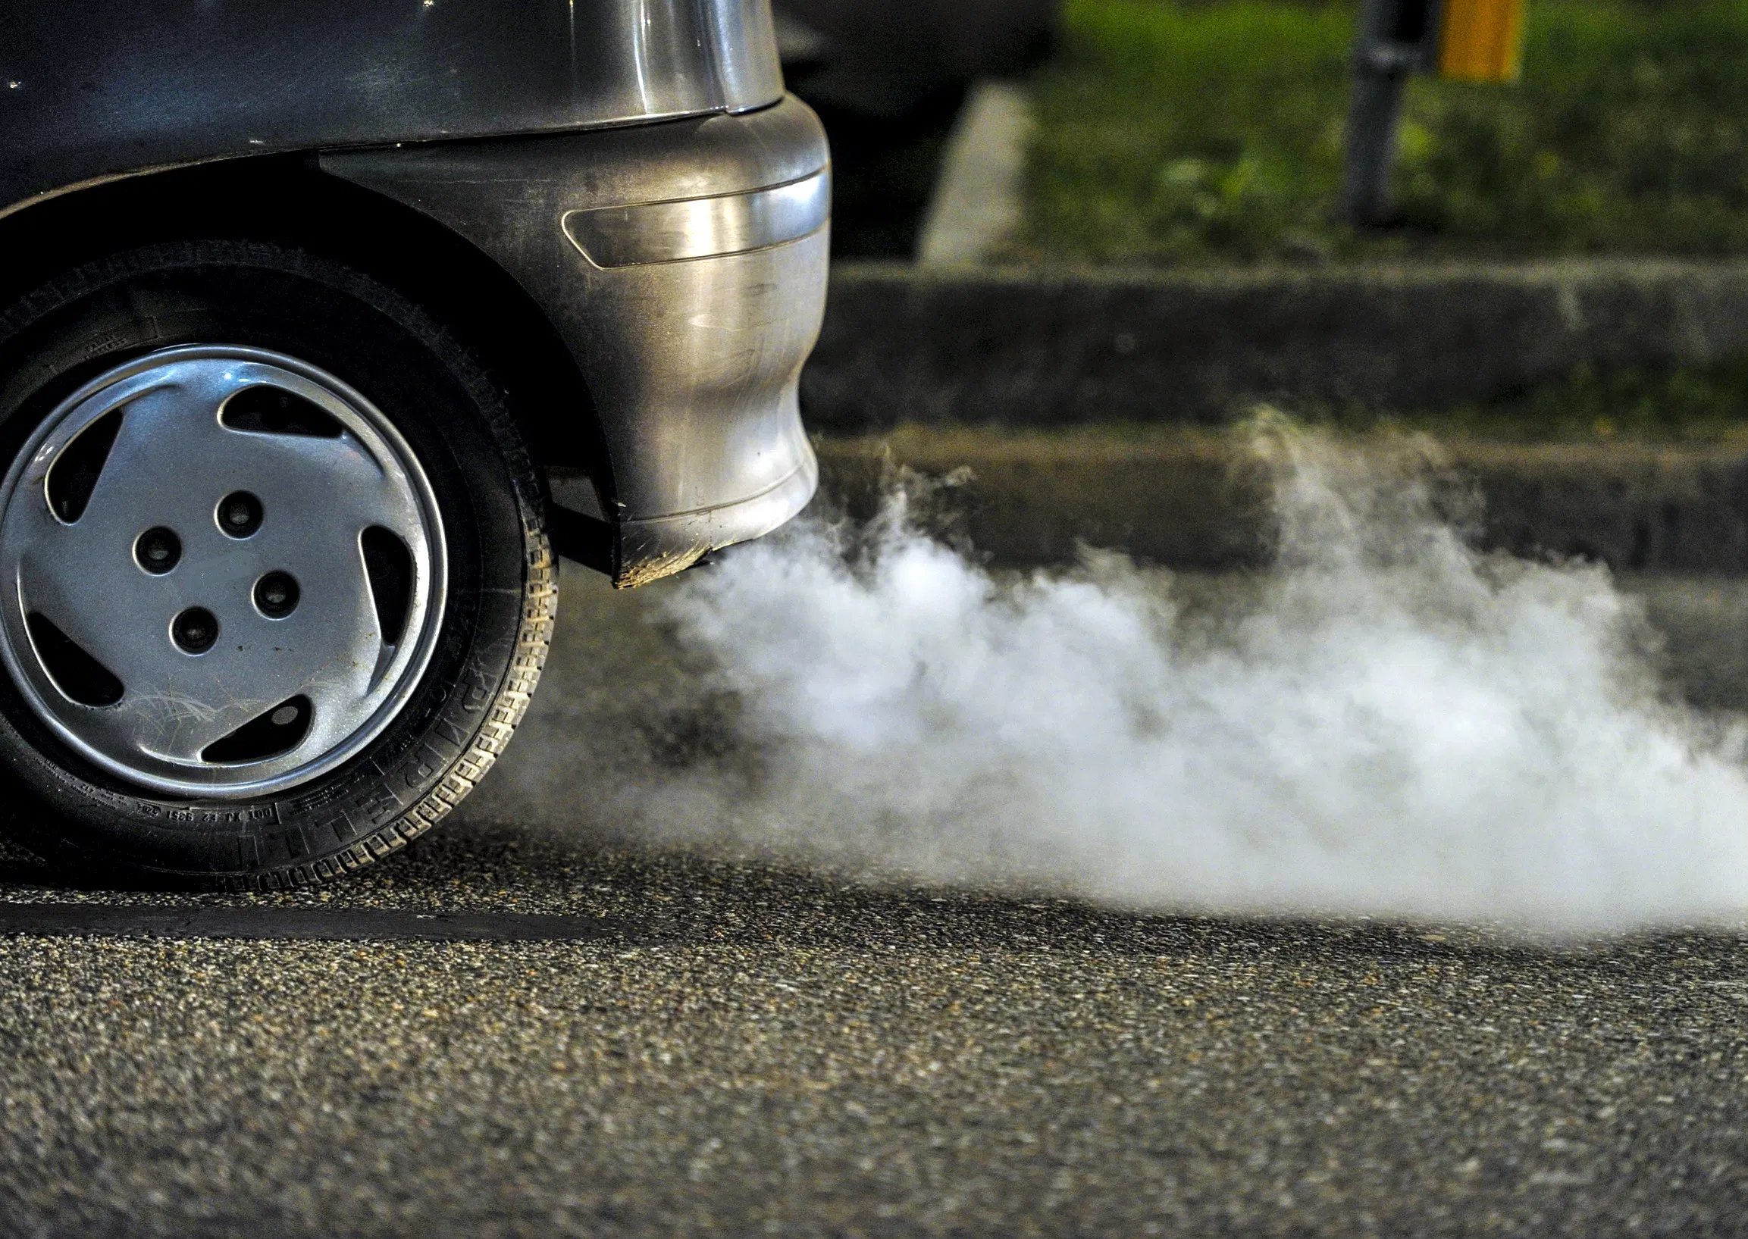



OVERVIEW
Drivers of Carbon in the UK
Learning from Best Practice
Conclusions
Can we identify what is driving carbon emissions?
What do we know about how to address emissions?
The key takeaway messages

Slide 36





THE GLOBAL CARBON BUDGET
The outcome for the planet is defined by total cumulative GHGs
To stabilise warming we must reach “Net Zero” emissions globally
To achieve a 1.5°C outcome there are just 12 years left
Global warming since pre-industrial
Remaining Carbon Budget from 2019 (GtCO₂)
We are currently emitting about 41.5 GtCO₂ each year
41.5
2.0°C
1460
GtCO₂/yr
1000
1.75°C
At current rates of production, that means we have approximately:
1.5°C
540
1.5°C Outcome
1.75°C Outcome
12
years left
23
years left
For a 50% chance to keep warming to 1.5°C, the amount of CO₂ that can be released into the atmosphere is about 500 GtCO₂. For a 50% chance of staying below 1.75°C, it is about 1000 GtCO₂.
Source: BP, Global Carbon Project, IPCC, CTI Analysis, October 2019

Slide 37
DECARBONISATION NEEDS TO HAPPEN… FAST…
Actual
Required

Slide 38
CARBON EMISSIONS IN THE UK: DRIVERS OF CARBON EMISSIONS
Study | Focus | Carbon Drivers Identified
Seto, 2014; Creutzig, 2015; Williams, 2013 | Total Energy | Density, Land use mix, Connectivity and Accessibility
Baiocchi, 2015 | Total Energy | Unique place-specific factors, Income
O'Regan, 2009 | Total Energy | Fuel mix, Distance to nearest larger settlements, Effectiveness of regional services
RTPI, 2018 | Sustainable Development | Large and compact settlement patterns tend to make more efficient use of infrastructure networks
Minx, 2013 | Carbon footprints of human settlements | Consumption based CO₂ emissions higher in Urban areas driven by Income

Slide 39
COMMUTING CARBON: BOTTOM-UP MODEL FOR TRANSPORT CARBON (COMMUTING) FOR EVERY MSOA
Distribution of transport carbon emissions by MSOA

Slide 40
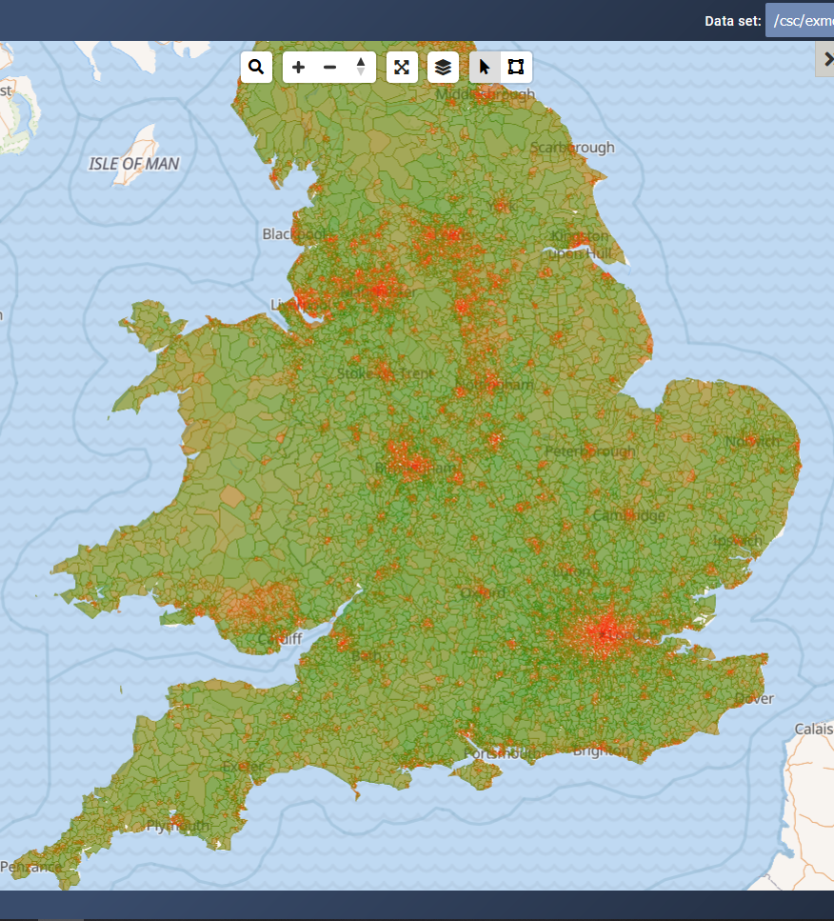
MSOA MODEL FACTORS: CLEAR GEOGRAPHIC PATTERN IN PLACE-BASED CARBON

Slide 41
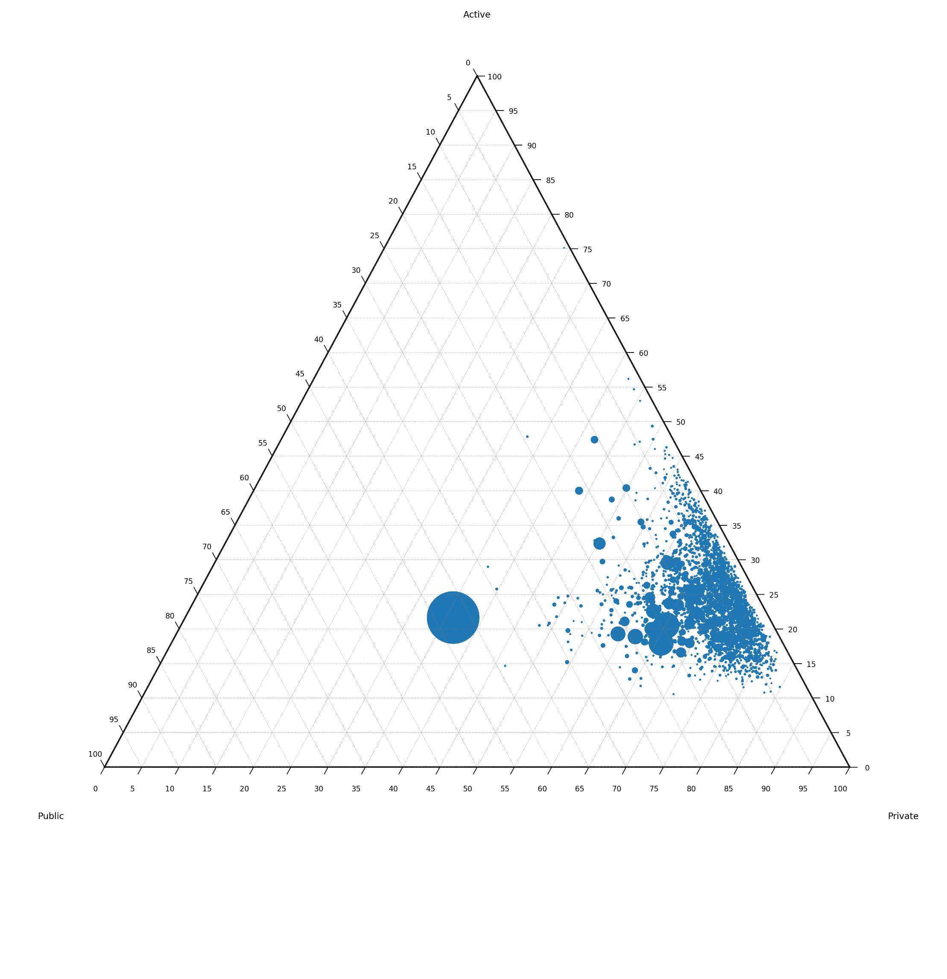
MODE SHARE OF BUIILT UP AREAS: DISTRIBUTION OF MODE SHARE IN THE UK
Private vehicle mode share at least 55%
Active travel share at least 10%
Rare for Public Transport to exceed 15% in smaller places

Slide 42
CONTRIBUTION FROM OTHER PURPOSES: RELATIONSHIP BETWEEN TRIPS, VEHICLE MILES AND CARBON

Slide 43
LEARNING FROM BEST PRACTICE: WHAT WE’VE LOOKED AT
Shift
Improve
Avoid
Land-use planning
15-minute neighbourhood
Digital / Homeworking
Digital Services
Home Deliveries
Freight Consolidation
Congestion charging
Parking restrictions
20mph zones
Low Traffic Neighbourhoods
Street space reallocation
Car free zones
Parking Levies
Fuel Tax
Walking Infrastructure
Cycling Infrastructure
Public Transport Infrastructure
Shared mobility options
Decarbonisation of private vehicles
Decarbonisation of Freight
Decarbonisation of PT

Slide 44
LEARNING FROM BEST PRACTICE: WHAT WE’VE LEARNED
Study / Evidence | Quote or conclusion
Piatkowski, 2017 | “interventions aimed at enabling active travel have modest impacts up to 5% at best”
Neves, 2015 | Individual infrastructure schemes may be unlikely to deliver impact on their own
Foletta, 2011 | Successful case studies often have extensive restrictions within the core
Pucher, 2008 | The key to achieving high levels of cycling appears to be the provision of separate cycling facilities along heavily travelled roads and at intersections but calming measures are also often needed.
Piatkowski, 2017; Petronuff, 2015 | Deterrents may be more powerful than enablers. Sticks may be more powerful than carrots.
Tight, 2018 | Similarly for walking, packages of measures have the potential to be more effective than individual measures

Slide 45
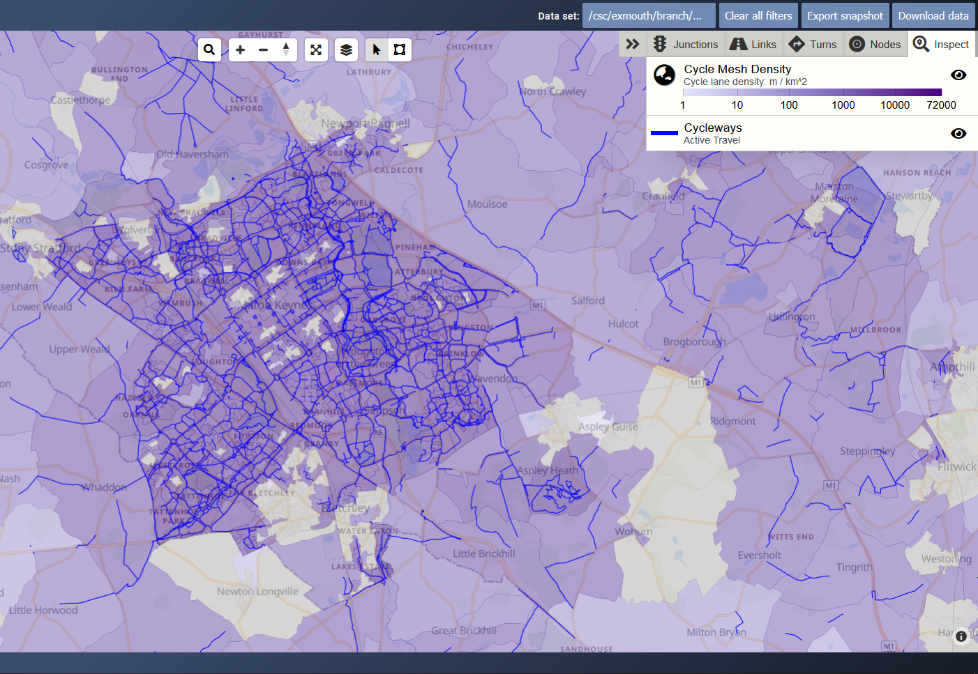
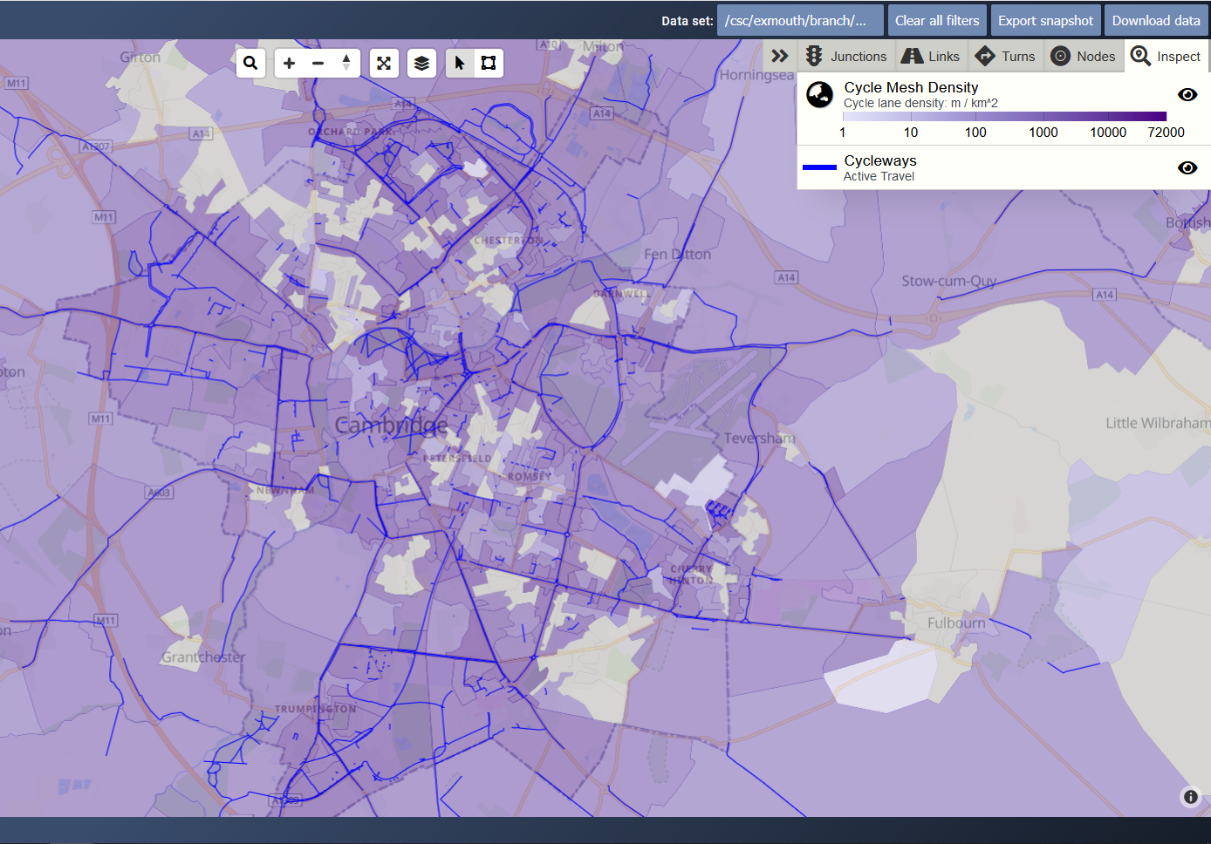
LEARNING FROM BEST PRACTICE: WHAT WE’VE LEARNED
4.2% Mode Share
29% Share
“the car clearly is, and will remain, Milton Keynes’ dominant mode”, National Infrastructure Commission
Cycling share for all work journeys by Cambridge Residents

Slide 46
CONCLUSIONS: A VICIOUS CIRCLE NEEDS TO BE ADDRESSED
Car is the primary mode of transport
Deterrents to cars are politically sensitive
Funding for alternatives is limited
Investment in alternatives is only ever marginal
Places with limited services, jobs and travel alternatives
Vicious Circle

Slide 47
CONCLUSIONS: A VICIOUS CIRCLE NEEDS TO BE ADDRESSED
Car is the primary mode of transport
Deterrents to cars are politically sensitive
Funding for alternatives is limited
Investment in alternatives is only ever marginal
Places with limited services, jobs and travel alternatives
Vicious Circle
O

Slide 48
CONCLUSIONS: A VICIOUS CIRCLE NEEDS TO BE ADDRESSED
Places become less dependent on cars
Political support to implement deterrents
Alternatives are more attractive and funding secured
‘Big Bang’ multi-year investment to deliver real change
Ridership / use of alternatives grow
Virtuous Circle

Slide 49
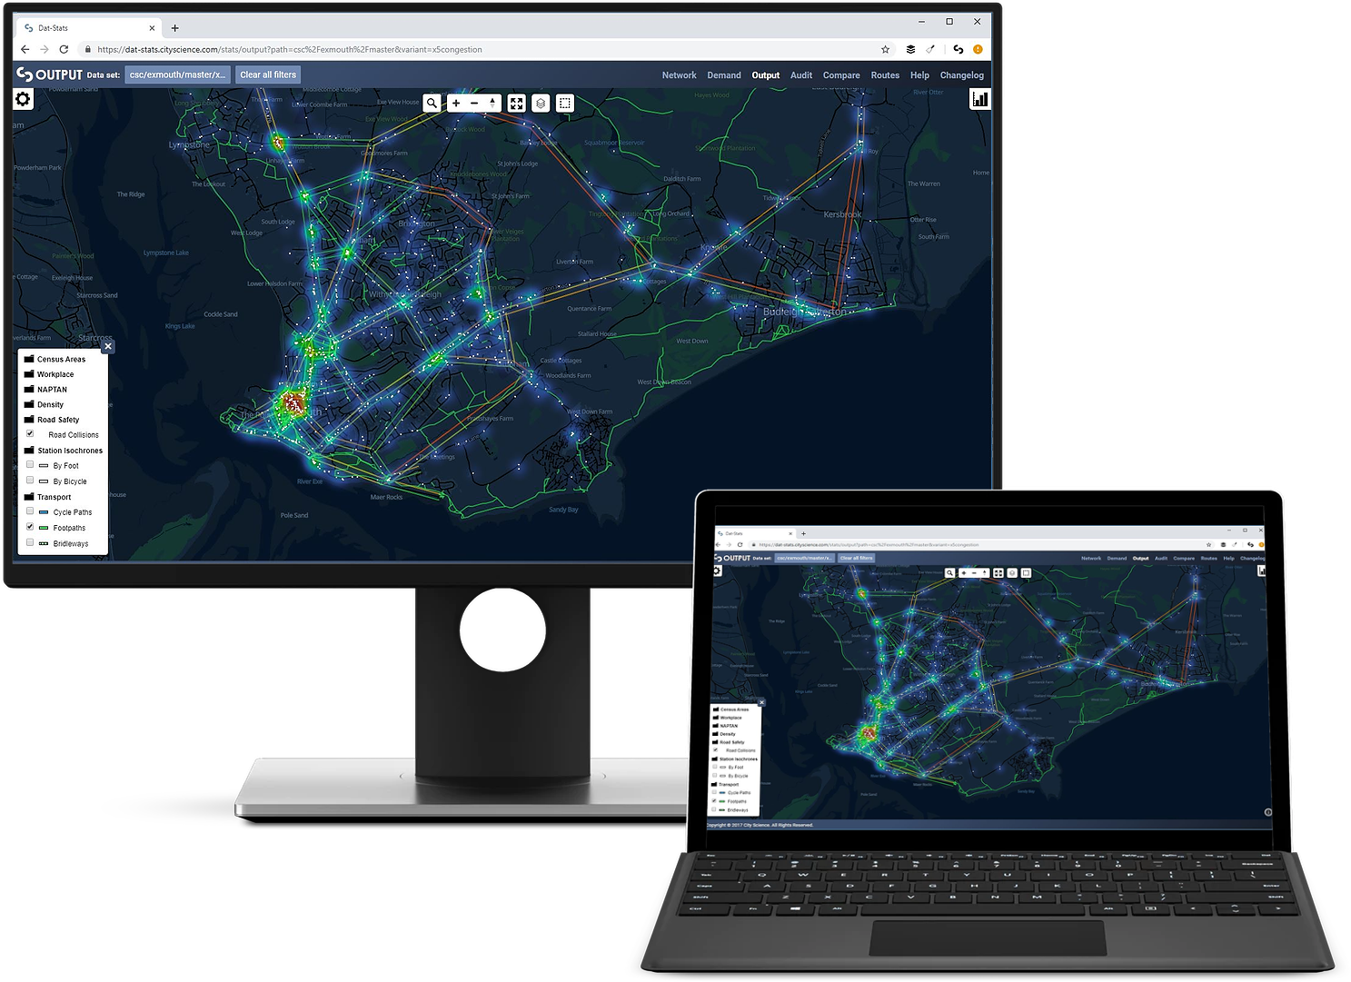
loa@cityscience.com
info@cityscience.com
@CityScienceUK
www.cityscience.com

Slide 50
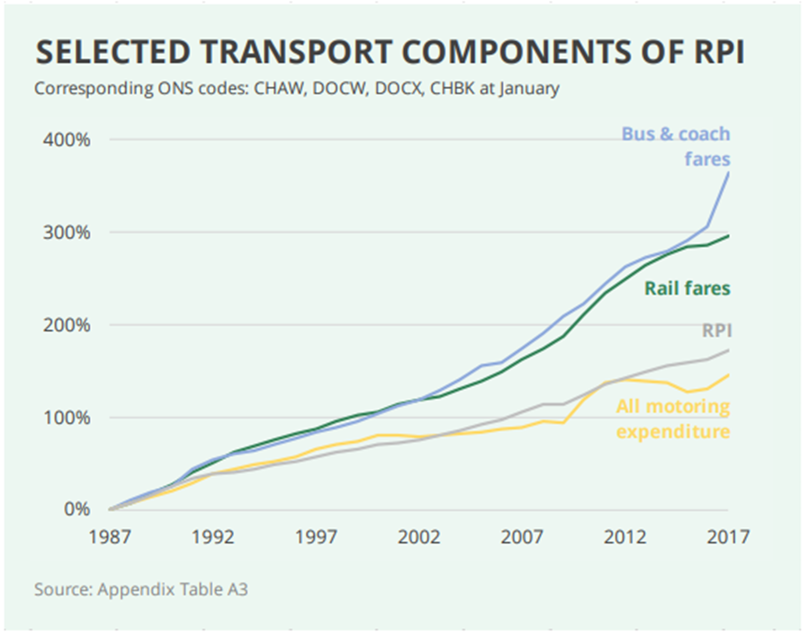
APPENDIX:
Transport Cost Evolution by Mode Compared to RPI, Source – Dempsey, 2018

Slide 51
Questions & Answers
Chair:
Selaine Saxby MP
Co-Chair, All Party Cycling and Walking Group
Dr Ian Philips
Senior Research Fellow, Institute for Transport Studies, University of Leeds
Dr Llinos Brown Research Fellow, Institute for Transport Studies, University of Leeds
Susan Claris, Transport Planner, Arup
Ruth Cadbury MP Co-Chair, All Party Group for Cycling and Walking
Laurence Oakes Ash
CEO, City Science

Slide 52
Ruth Cadbury MP
Co-Chair, All Party Cycling and Walking Group

Slide 53
APPGCW Investing in cycling and walking to achieve net zero

